Slide 1
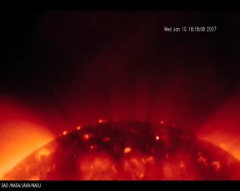
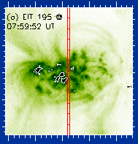
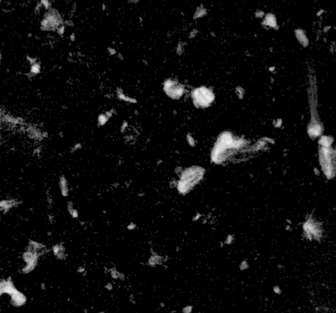
Group G – Microflares & Nanoflares
XRT Polar bright points and jets
J. Cirtain
XRT Nanoflares
P. Grigis
Evaporation in microflares
J. Brosius & R. Milligan

Slide 2
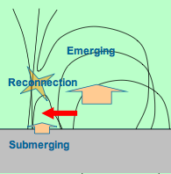
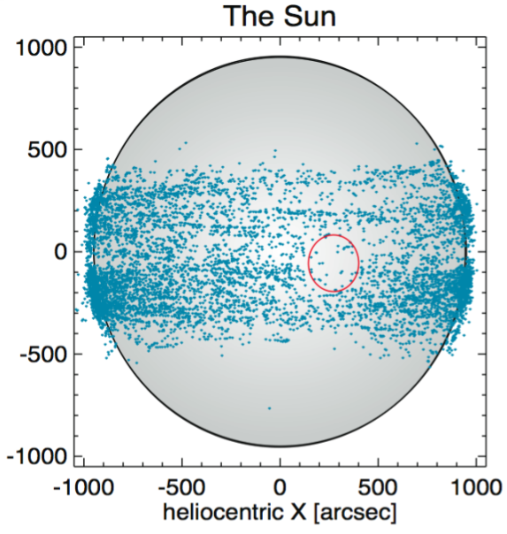
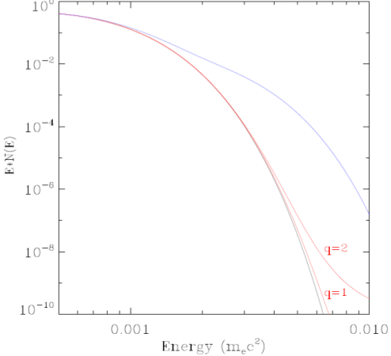
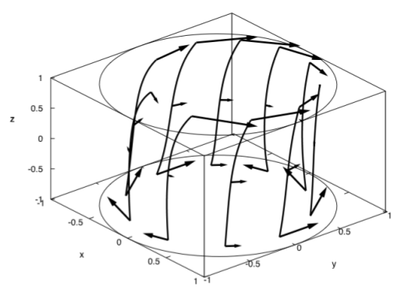
Morphology of
microflares
T. Shimizu
RHESSI Microflare Statistics
S. Christe & I. Hannah
Nonthermal particles in nanoflares.
Q. Chen
Current sheets form readily
Å. Janse

Slide 3
Impulsive energetic release (nanoflare, microflare, XBP, X class flare) are all the same. Its all a matter of scale and energy.

Slide 4
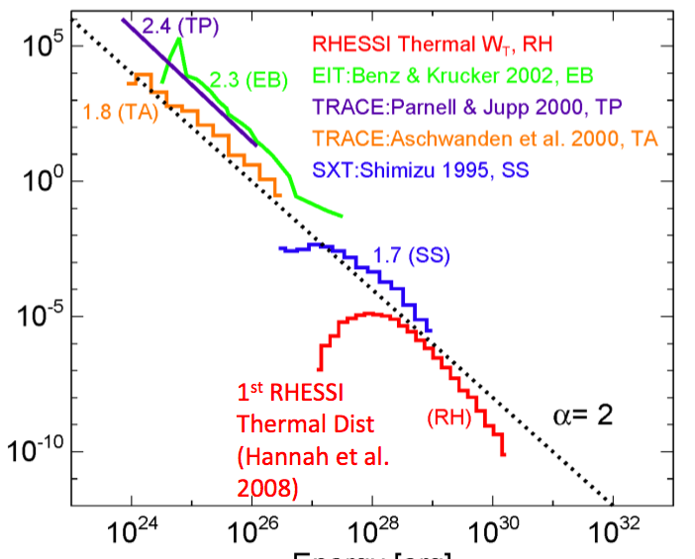
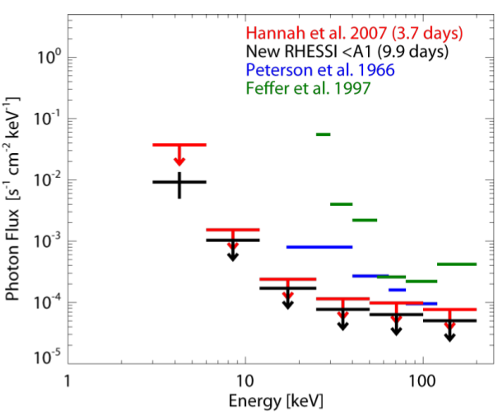
HXR microflares/nanoflares do not heat the corona.
RHESSI Microflare Statistics
I. Hannah & S. Christe
RHESSI Quiet Sun Flux
I. Hannah

