Slide 1
Flows in hot coronal loops: mass cycle and coupling from chromosphere to corona
Pia Zacharias, Sven Bingert, Hardi Peter
Solar Cycle 24
Napa, California
December 11, 2008

Slide 2
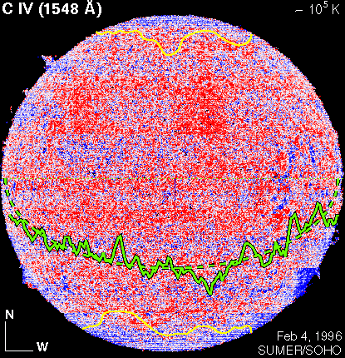
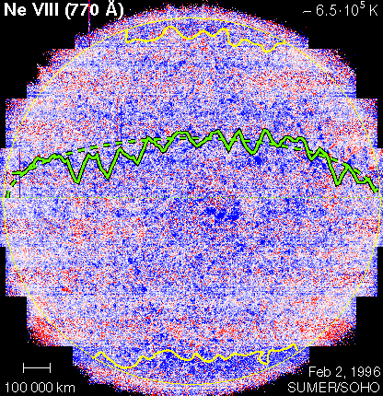
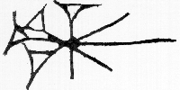
Doppler shifts in the solar transition region and in the corona
10
≈ 10⁵ K
≈ 6.5⋅10⁵ K
5
0
Peter (1999) ApJ 516, 490
Doppler shift [ km/s ]
5
10
SUMER
Notes:
Full solar disk in Doppler shift as seen in CIV in the middle TR and in NeVIII in the low corona
Overplotted are the mean variations of the Doppler shift along the equator (solid green lines). 6km/s to the red for CIV and 3km/s to the blue for NeVIII. Opposite Doppler shifts in the middle TR and lower corona. The Doppler shift varies with the cosine of the helicentric angle
the coronal hole boundaries are indicated in yellow

Slide 3
3D simulation – Doppler shifts
Simulation
Probably OK for TR (some 10⁵ K)
Not yet good for coronal lines
Observation
Notes:
Transition region emission line Doppler shift at quiet sun disk centre as a function of line formation temperature.
Peter et al. showed that the Doppler shift turns from redshift in the lower transition region into blueshift in the lower corona

Slide 4
From observation to simulation
Input magnetic field - quiet Sun-like
3D MHD model of coronal box (50x50x30Mm³=256³) (Bingert at al.)
including radiative loss, heat conduction and Ohmic heating due to flux braiding
Spectral synthesis (CHIANTI) → Resulting loop structures
Initial vertical magnetic field at bottom boundary
Evolving TR loops (snapshop)

Slide 5
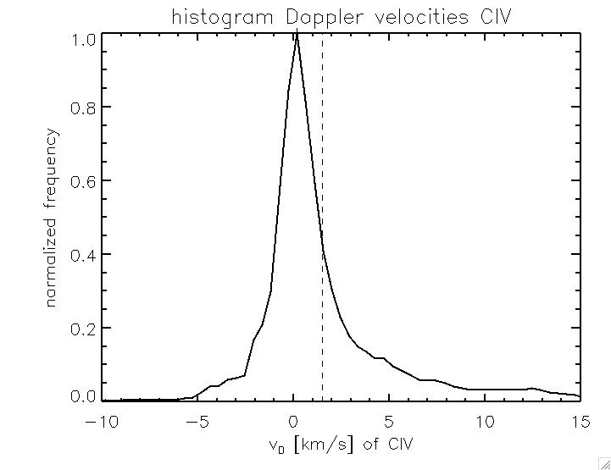
Doppler velocities in the simulation
CIV (1548 Å) Doppler map
Distribution of Doppler velocities
(smaller FWHM than observed; 3x)
<v_{D}>=1.52 km/s
➔ mean redshift
blueshift⬅ ➔redshift

Slide 6
Global mass balance: constant coronal mass
N: Number of particles
in the box with T>10^{4.1} K
<N>: mean number of particles in the box with T>10^{4.1} K
Coronal mass fluctuates ≈ 0.1%
Empty corona over simulation time (30 min) would need average flow of ≈ max 0.1 km/s
Global sinking of atmosphere due to mass loss is NOT responsible for net line shift

Slide 7
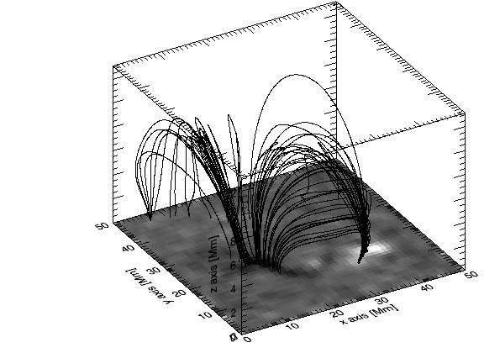
Investigation of individual loops: hot loops
1st step: restrain to L > 30 Mm and T_{max} > 10⁵ K
Assign the same fieldlines at each timestep
➔ follow fieldlines through the 30 minute time series
snapshot

Slide 8
Nature of the flows in hot and long loops
log(T[K])>10⁵ & L>30 Mm
Contradiction:
Why is the coronal mass constant while downflows dominate ?
Solution ?
Coronal mass supply
through the heating of cool loops?
27 %
62 %
10 %
Siphon flows:
Flow through the loop
Draining / downflows
Flow out of the loop
Strange flow profiles

Slide 9
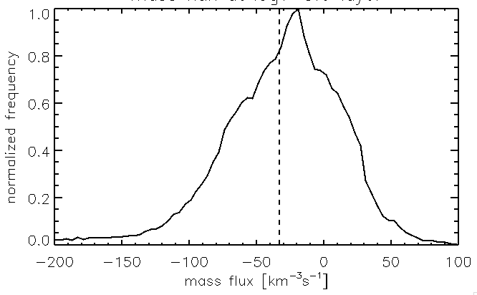
Closed mass system?
Mass flux through logT=4.0 plane
NET MASS DOWNFLOW
⬅ redshift blueshift ➔
Mass flux through logT=5.0 plane
blueshift⬅ ➔redshift

Slide 10
Downflows – Where are the upflows?
Cooling loops with downflows: one example

Slide 11
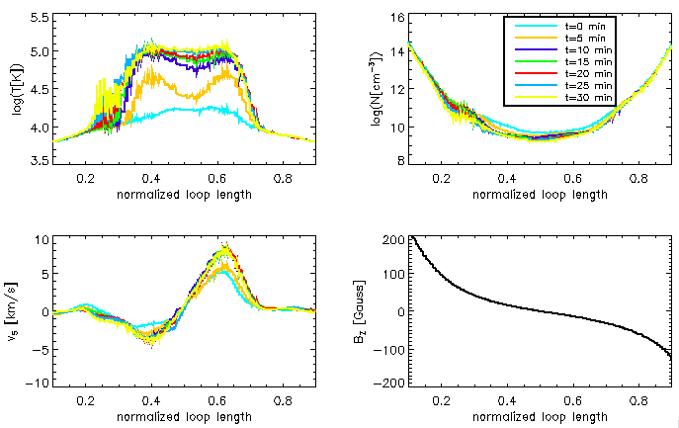
Heating loops with upflows?
➔ heating
Problem:
Even loops that are heated up
are draining...
Where are loops which fill
due to increasing heat input ?
Probably selection effect (T>10⁵K) ?
➔ downflow
→ NO hot loops with upflows found!

Slide 12
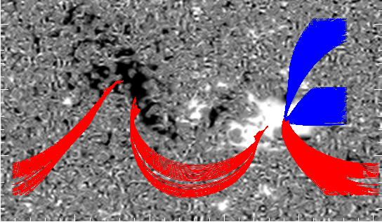
Outlook
Properly follow fieldlines in time
What about the upflows we see in the Doppler maps?
Investigate “cool“ loops (T<10⁵ K) with same lengths

