Slide 1

The SunSketcher Project
Gordon Emslie on behalf of the SunSketcher Team
NASA Heliophysics Division
November 20, 2024

Slide 2

“Events to Shake, or Gently Rattle, the World in 2024”
December 8, 2023
  April 8: Don your eclipse glasses and watch the moon and the sun align in a cosmic kiss as the Pacific Ocean, Mexico, part of the United States, Canada and the North Atlantic plunge into daytime darkness. It will be the last solar eclipse in the United States for more than 20 years. Celebrate it at the Total Eclipse of the Heart Festival in Arkansas or the Portal Eclipse Festival in Mexico. Wherever you are, download SunSketcher 2024, an app developed by NASA to allow observers in the path of totality to capture images at varying angles and contribute to NASA’s heliophysics research.

Slide 3



“Events to Shake, or Gently Rattle, the World in 2024”
December 8, 2023
  April 8: Don your eclipse glasses and watch the moon and the sun align in a cosmic kiss as the Pacific Ocean, Mexico, part of the United States, Canada and the North Atlantic plunge into daytime darkness. It will be the last solar eclipse in the United States for more than 20 years. Celebrate it at the Total Eclipse of the Heart Festival in Arkansas or the Portal Eclipse Festival in Mexico. Wherever you are, download SunSketcher 2024, an app developed by NASA to allow observers in the path of totality to capture images at varying angles and contribute to NASA’s heliophysics research.

Slide 4
Science Goal: Measure the Shape of the Sun to High Precision
Why should the Sun not be circular?
  Rotation
  Pulsation
  Convection
  Magnetic fields (solar cycle variation)
The solar surface reflects internal processes, which we otherwise know about via neutrinos, helioseismology, and theory.

Slide 5
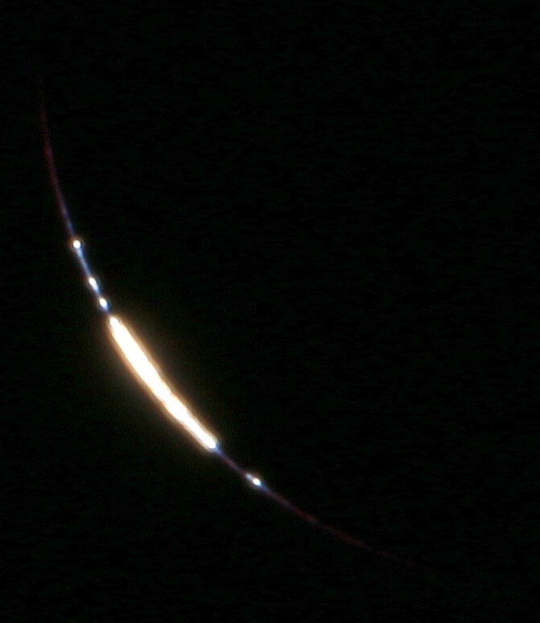
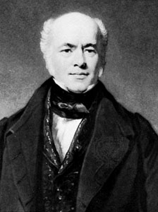
Method: Baily’s Beads Timing
Light shining through lunar valleys
  Moon moves at ~1000 m s⁻¹
  1 ms = 1 m on Moon
  1 m on Moon = 400 m on Sun
Accuracy limiting factors:
  Shape of Lunar Limb (~5 m; LOLA)
  GPS Location of Phone (~10 m)
10 m = 10 ms of shadow travel = 10 m on moon = 4 km on Sun

Slide 6
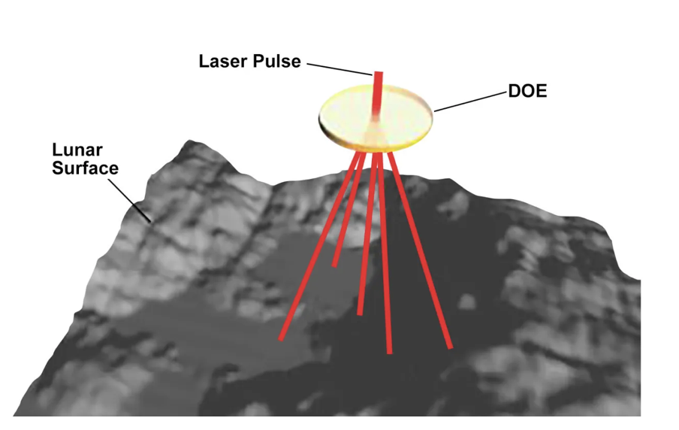
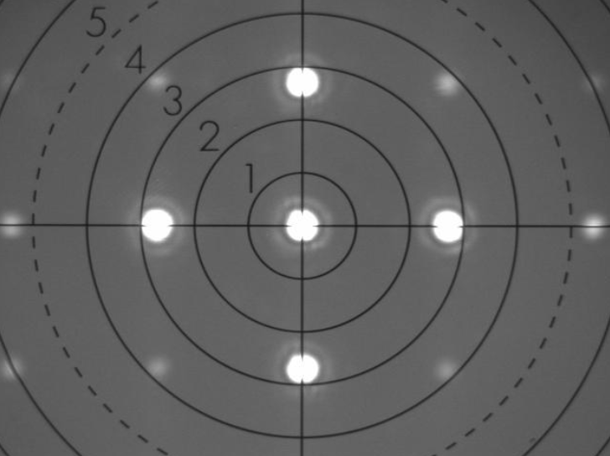
LOLA: The Lunar Orbiter Laser Altimeter
• In lunar polar orbit, 50 km altititude, LOLA “pings”
the surface and develops a 3D map with 5 m precision
• LOLA contains a diffractive optic that forms five beams

Slide 7
Citizen Science Goal: Involve as many people as possible in making the Baily’s Beads timing measurements
  Easy to use smartphone app
  Publicity!!!
Immense thanks to
the NASA Citizen Science and Education folks
SciStarter
Local Media
……..

Slide 8

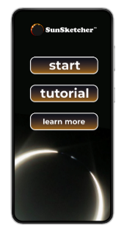
Funded by NASA Heliophysics Innovation in Technology & Science (HITS) program
A smartphone app for both iOS (Apple) and Android devices
Uses GPS location of phone to calculate times of second (C2) and third (C3) contacts
Sequence of 50 images taken at C2 and C3, cadence from 2 s down to 0.5 s
Timing of images recorded to accuracy of 1 ms
Image times adjusted by a random “jitter” of +/- 0.25 s, so that information from phones at same location can be “inter-woven” to create a higher cadence
One image taken at mid-totality – used to identify location of Sun in FOV and determine a “cropping box”, allowing for diurnal drift; applied to all 101 images
Images presented to user with request to allow upload to server at WKU
No PII collected!

Slide 9
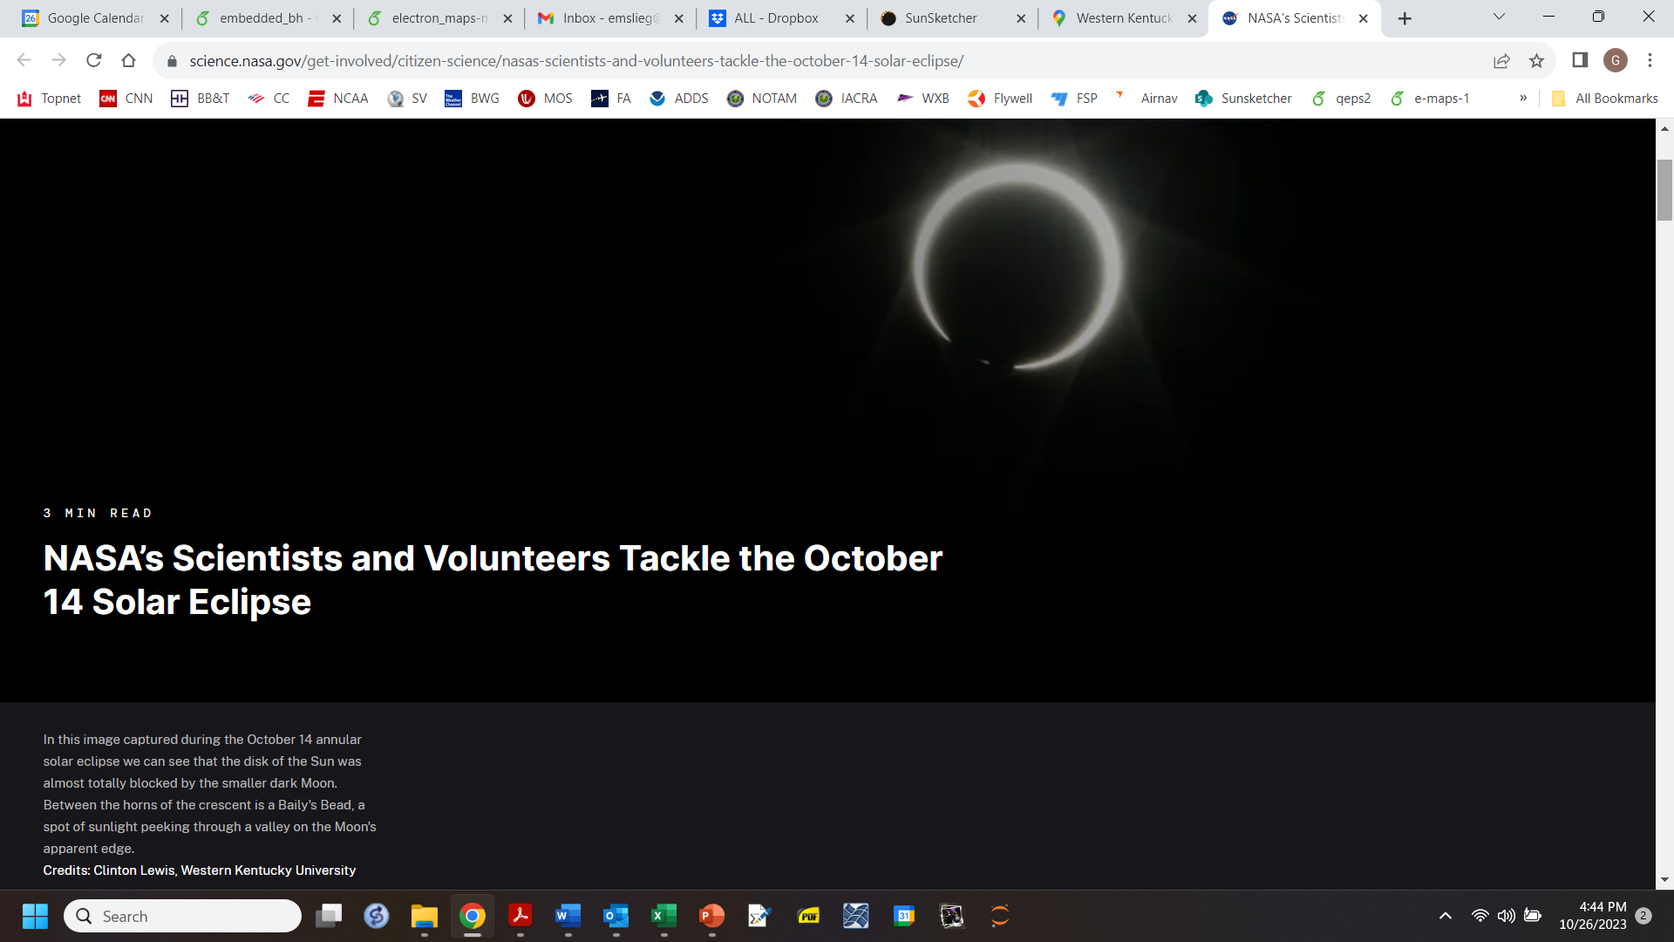
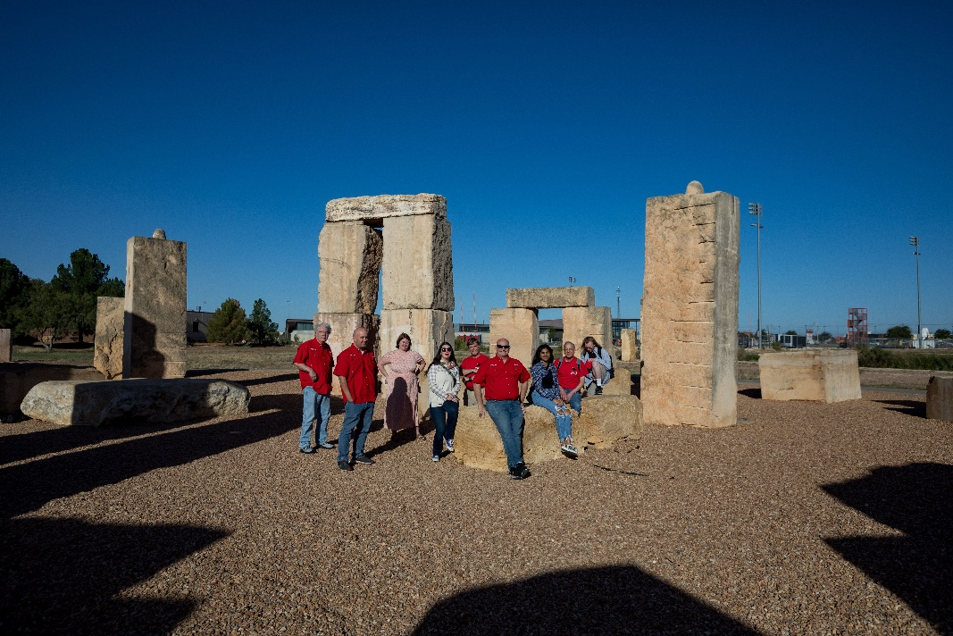
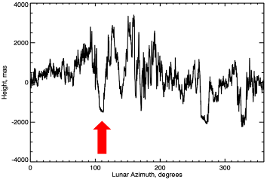

Slide 10
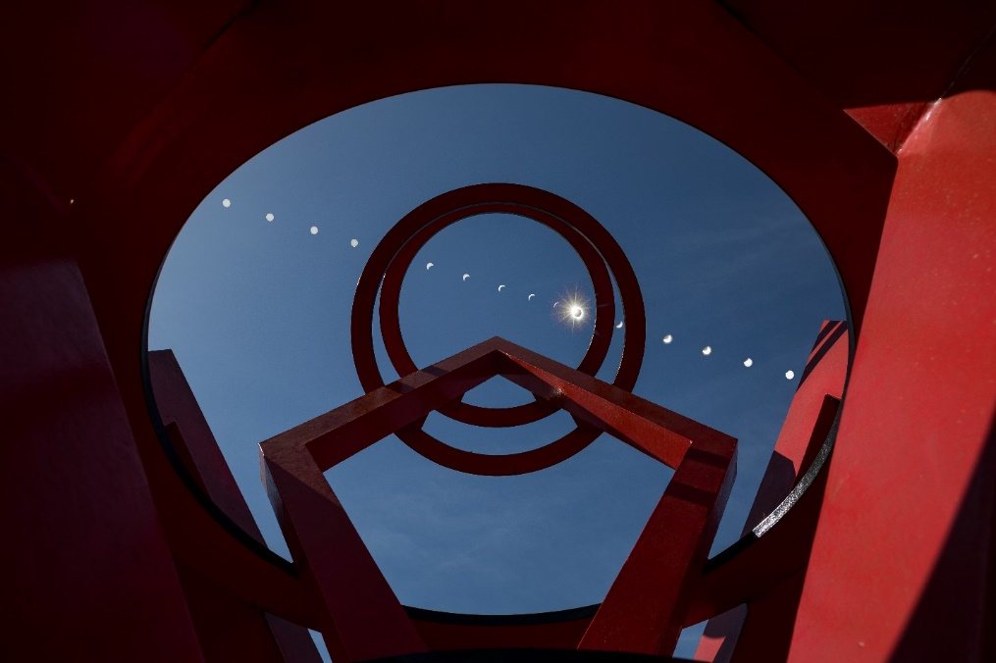
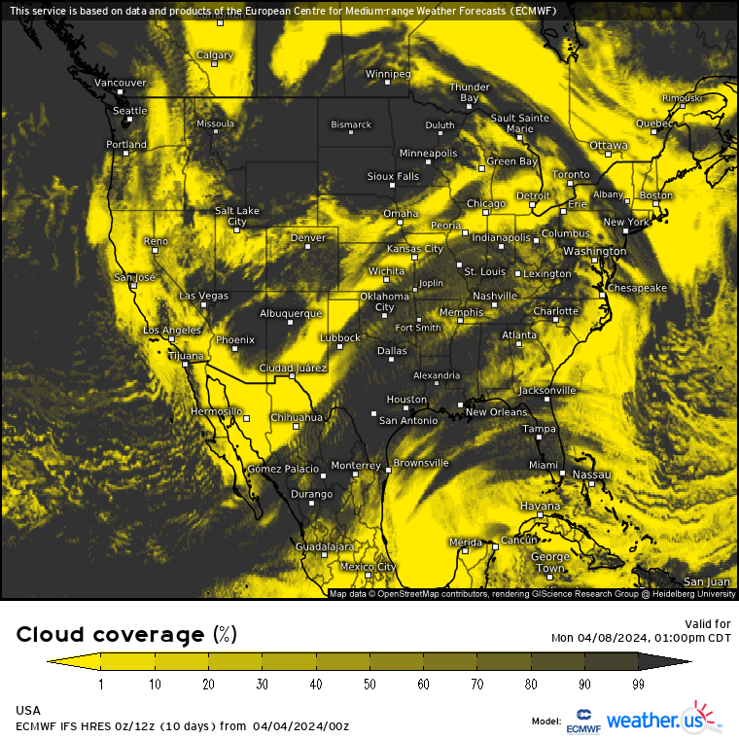
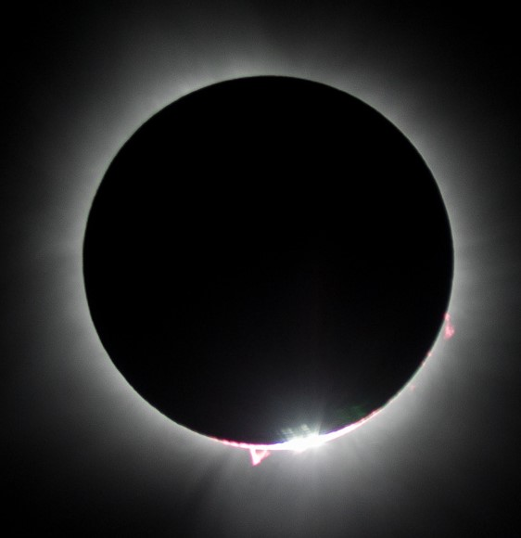
April 8, 2024
Actual cloud cover in New Harmony, IN
☺
The cloud cover forecast ☹
Actual view of totality from New Harmony, IN

Slide 11
Citizen Science!
Almost 40,000 users downloaded the app (but 5,000 AFTER the eclipse!)
Some 3,000 granted permission for their data to be uploaded
Excellent geographical coverage, both along and across the eclipse path
Nearly 100 GB of data collected

Slide 12
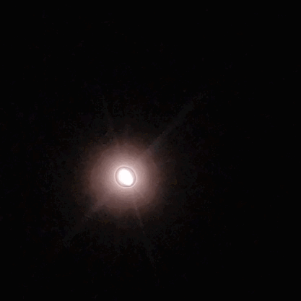
Raw SunSketcher Uploaded Image Sequence

Slide 13
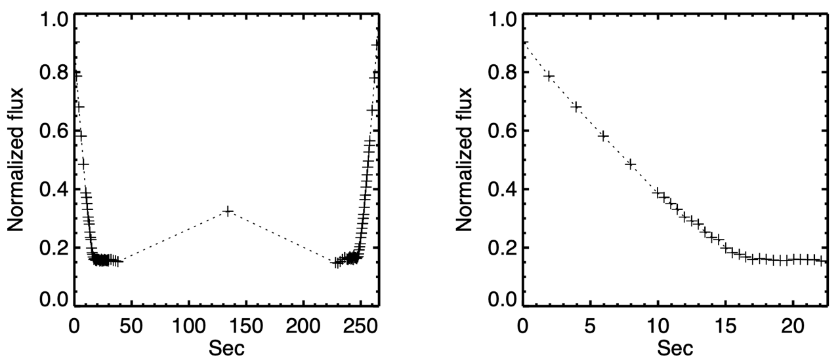
Light curve (one device)
Corona
Mid-Totality Image (used to determine crop area)

Slide 14
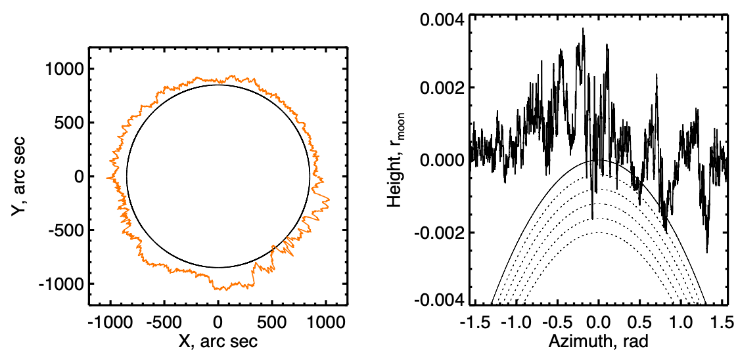
Modeling Bead Formation
The LOLA lunar limb data: circular (left) and
Rectilinear (right) coordinates

Slide 15
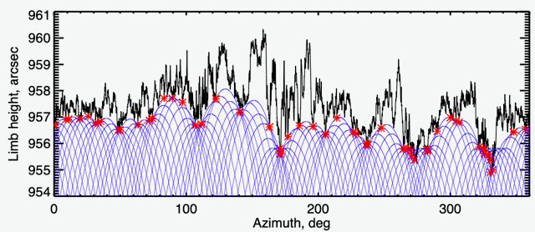
Baily’s Bead Locations 2024
Lunar Limb Profile from LOLA (as viewed from Carbondale, IL)
Model Solar Limb Profiles
Large number of Data Points!

Slide 16
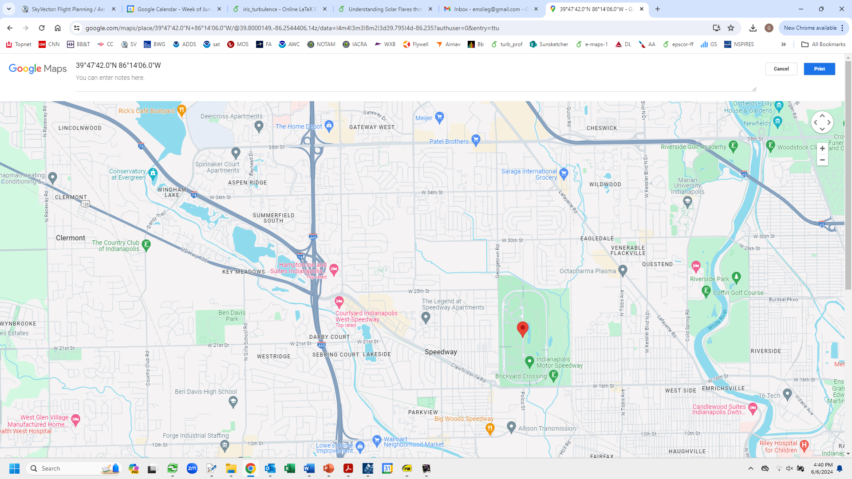
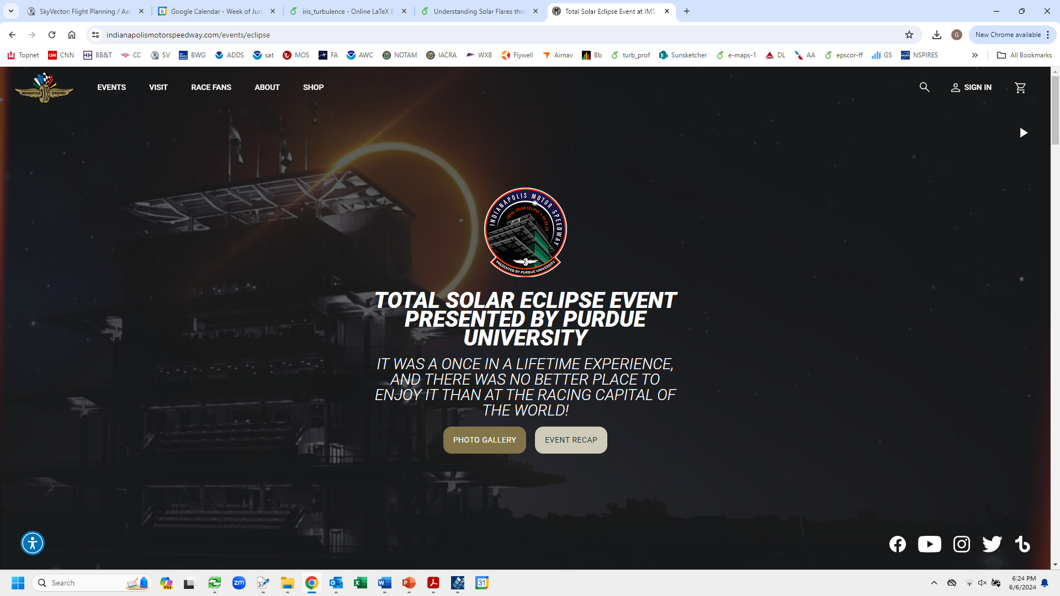
Preliminary Analysis
The “Indianapolis Speedway Gang”
7 observers, random (±0.25 s) jitter in timing
T₀+ [-0.197, -0.084, -0.038, 0,
+0.049, +0.054, +0.101] s
4 full (101 images) sets of data

Slide 17
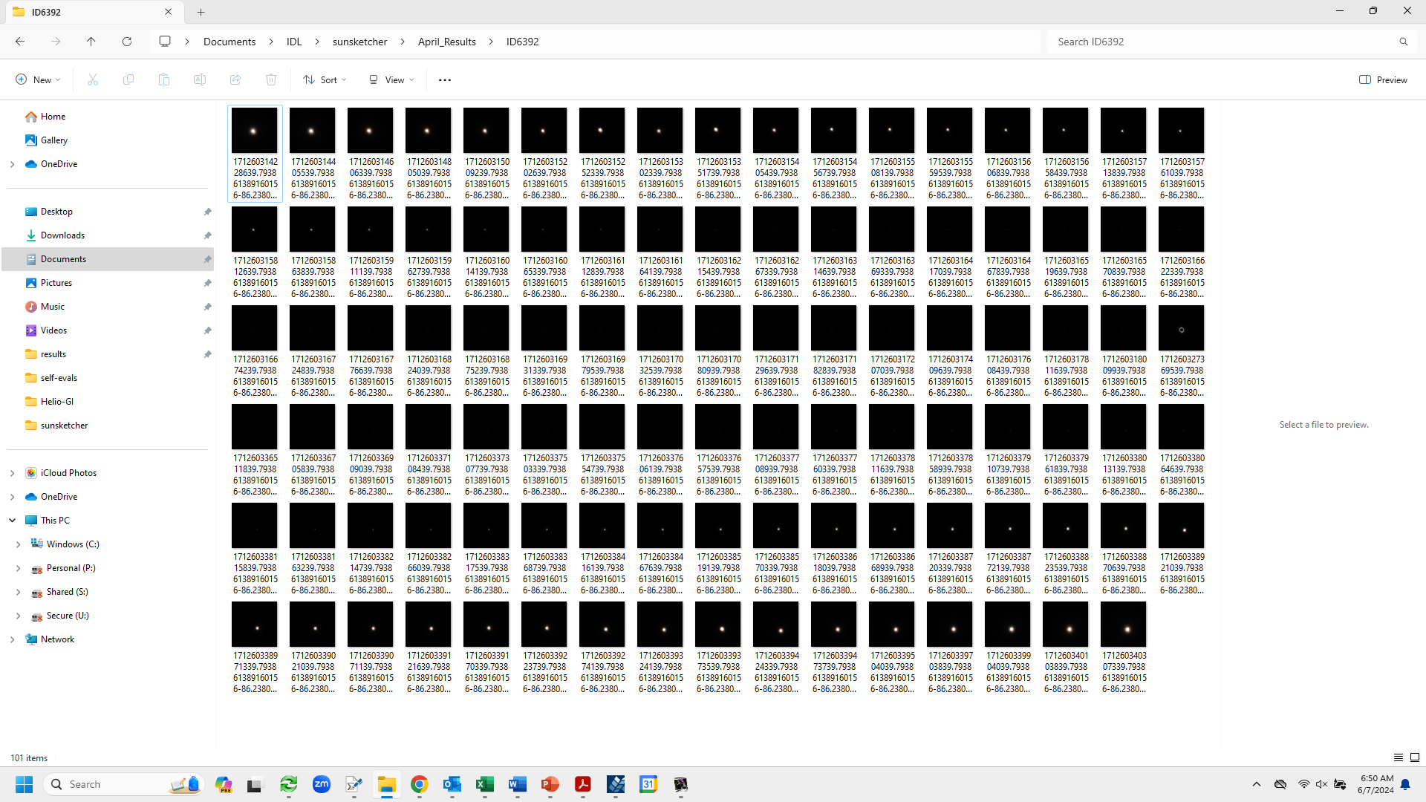
N=20
N=50
N=72

Slide 18
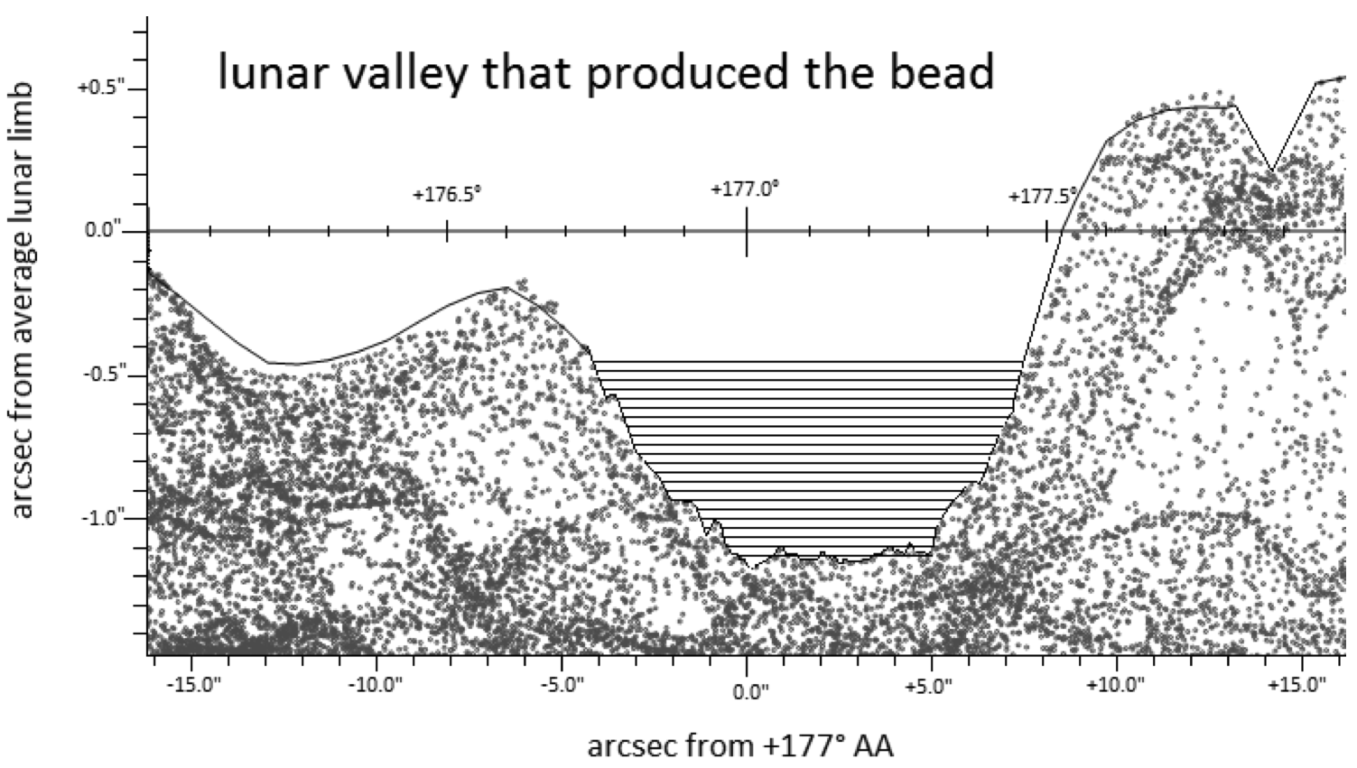
Lunar valley shapes
Baily’s Bead
(1’’ ~ 7000 feet)
Sigismondi et al. 2012

Slide 19
Disappearing Bead Intensity Profile
Lunar limb feature
h ~ (T-t)
^{T}
t
^{T}
A ~ (T-t)²
t

Slide 20
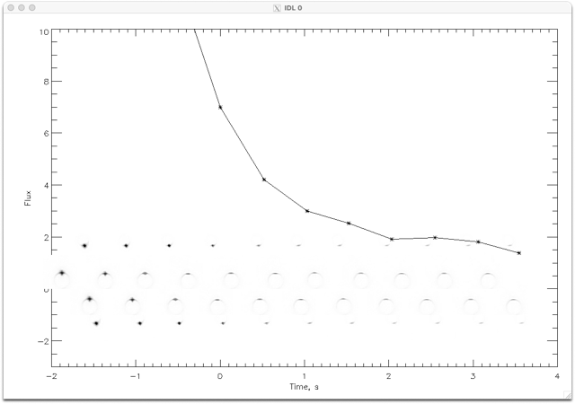
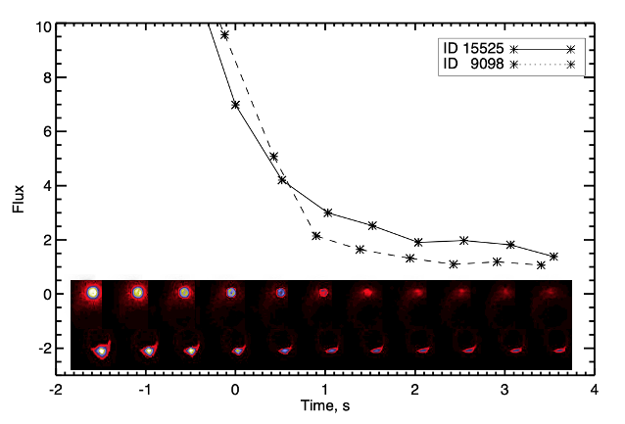
The Indianapolis Speedway Beads

Slide 21
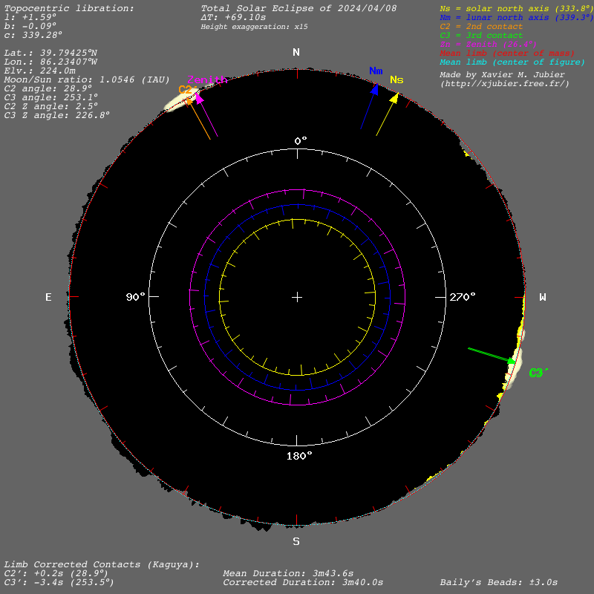
Analysis Procedure
Using model of solar limb profile from LOLA database, compute locations and intensity time profiles of Baily’s Beads at exact time and location of each observation
Compare with actual timing of beads present and adjust solar limb profile accordingly
Credit: X. Jubier, Eclipse Maestro

Slide 22
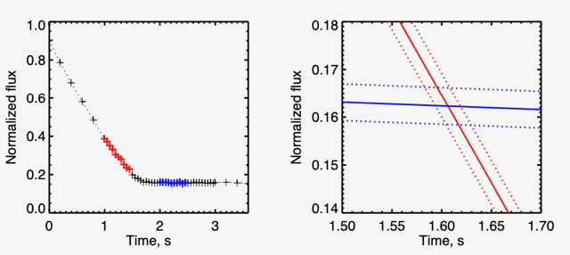
Identifying the Time of Bead Disappearance
“Bead Disappearance Time” – directly comparable to predictions for a prescribed solar limb profile

Slide 23
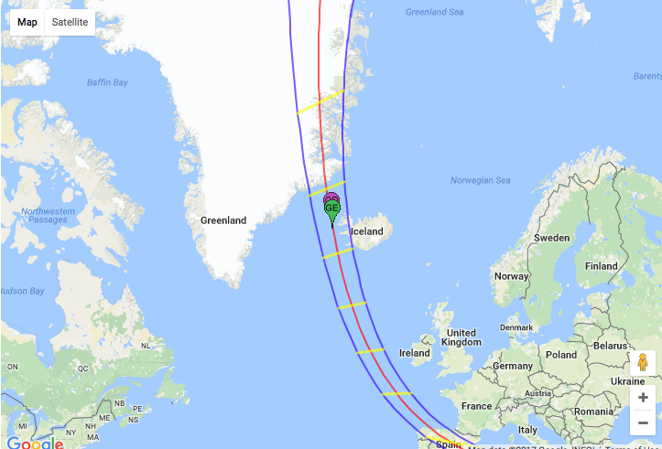
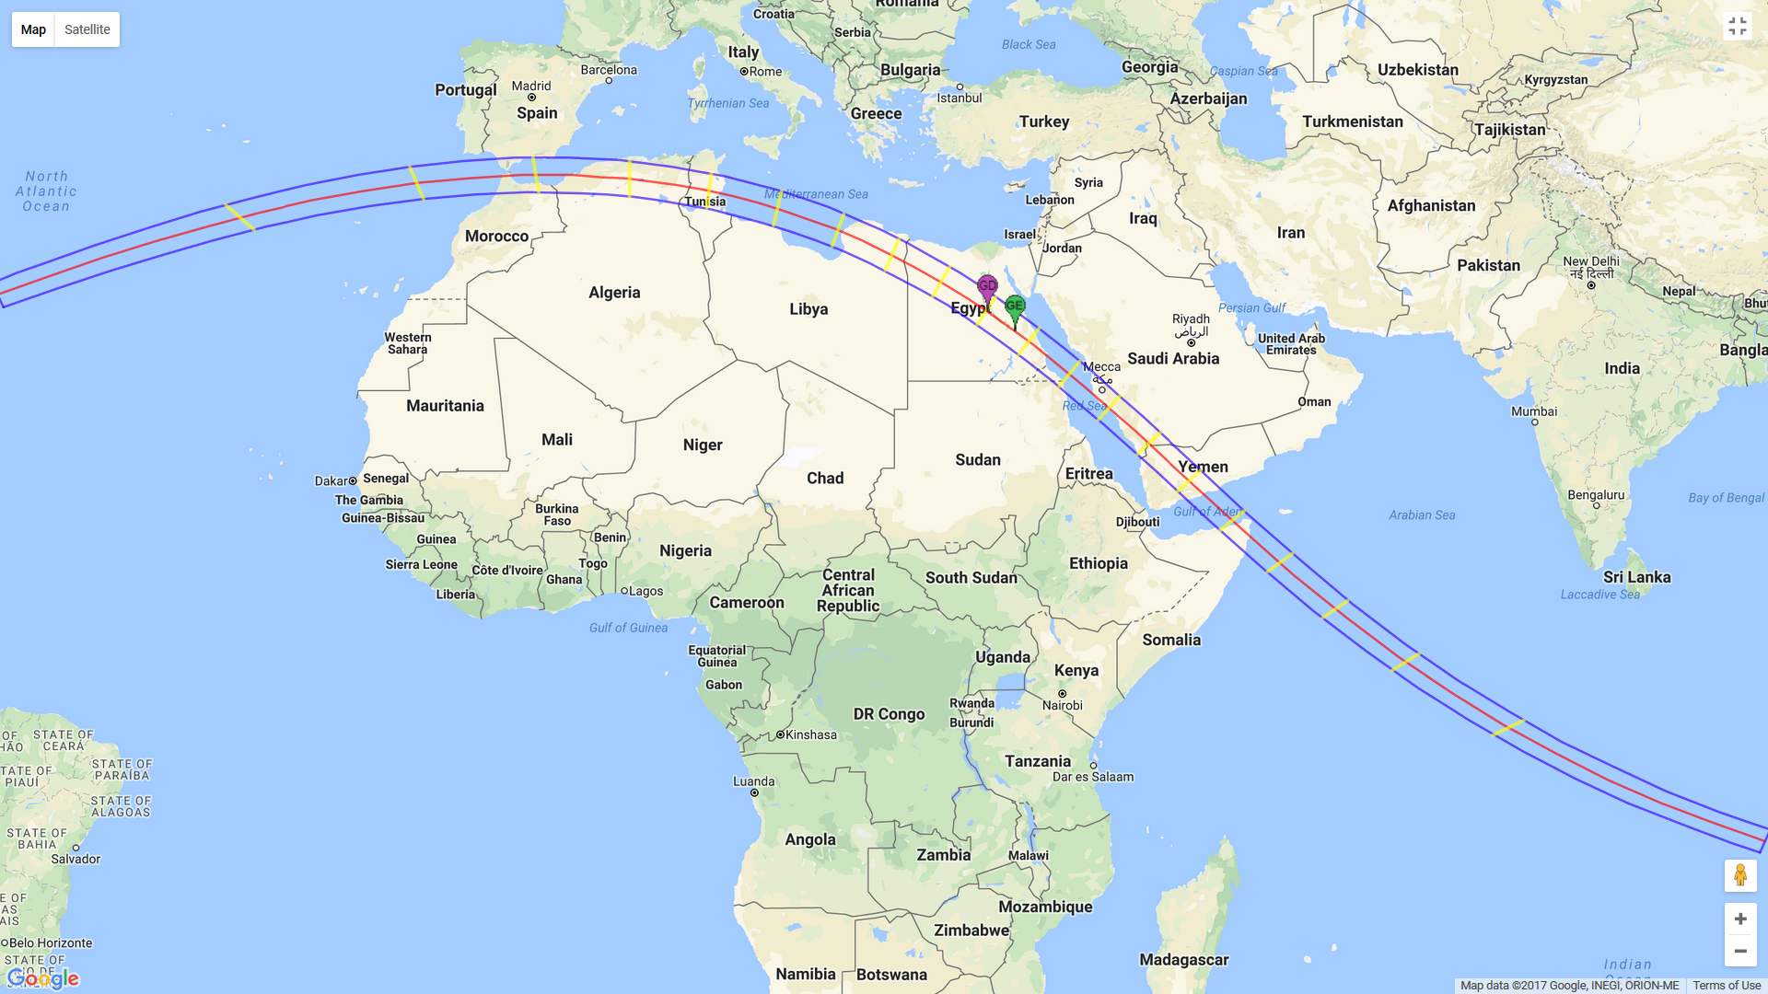
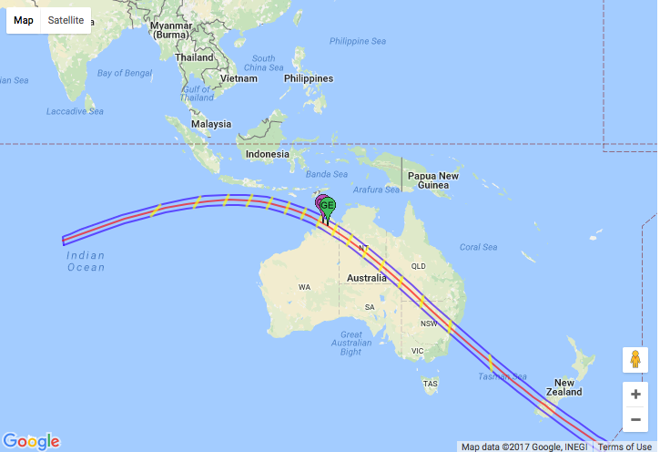
2026 !
2027 !!
2028 !!!

Slide 24


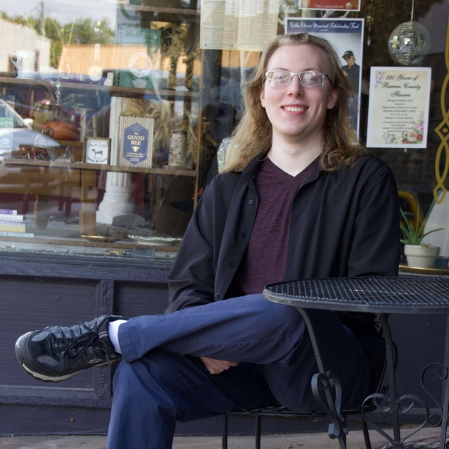

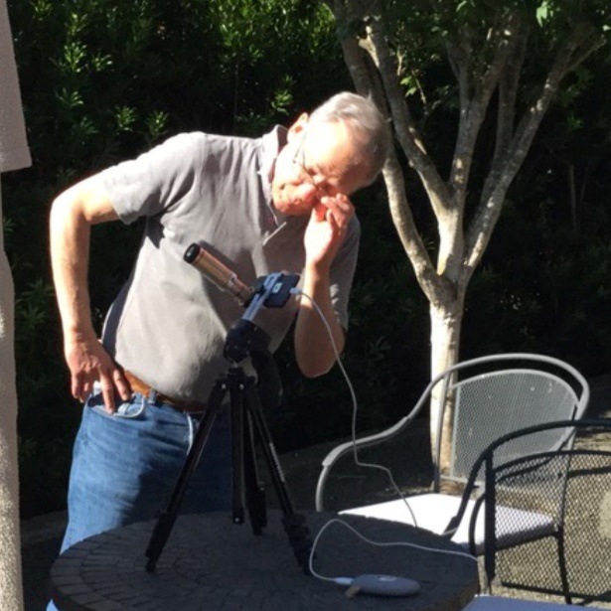

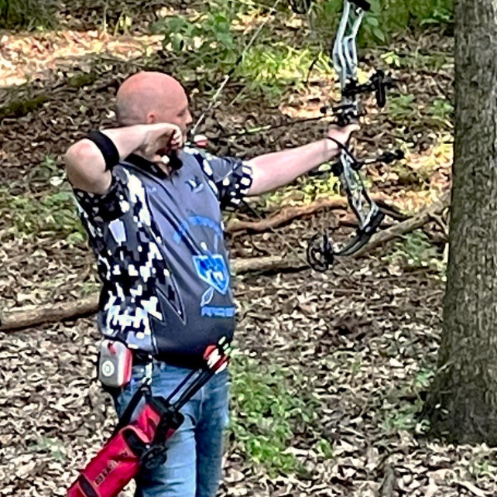


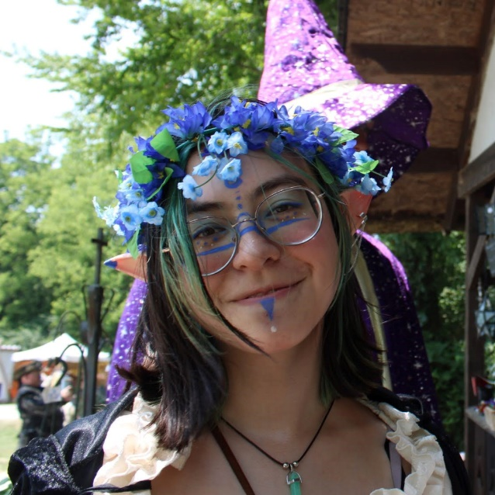



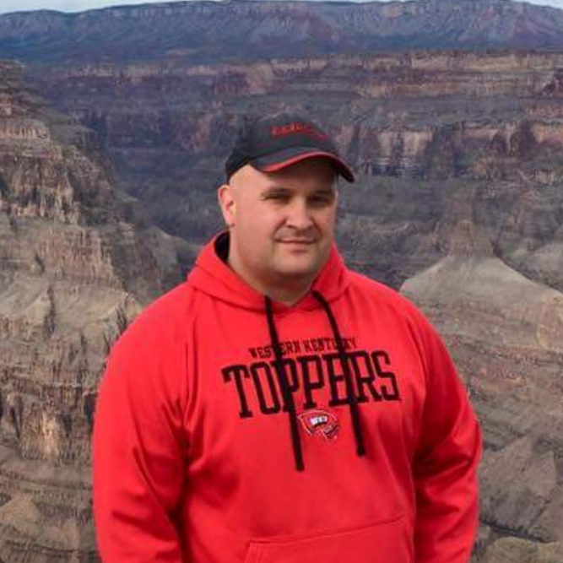
A Project with a Lot of “Multidisciplinary Secret Sauce”
Starr May
Nessa Unseld
Kelcee Gabbard
Travis Peden
Hugh Hudson
Greg Arbuckle
App Code Development and Integration
Eclipse Astronomy and Camera Specifications
Data Upload and Storage
User Experience
Human Subjects / Privacy / Legal
Testing and Publicity
Leah Moss
Andrea Florence
Kelly Miller
Tameka Ferguson
Tabby Cline
Shikha Sawant
Mark Simpson
Michael Galloway

