Slide 1
Energetic Neutral Atoms (ENAs) from solar flares?
H. S. Hudson
Glasgow and SSL Berkeley
Notes:
Layout of presentation 1/3 personalia, 2/3 flares
Thanks to the system for allowing an indulgent life of curousity-driven research
Disclaimer about reconnection and advert for Mark’s talk - be prepared for a different explanation of how flares work

Slide 2
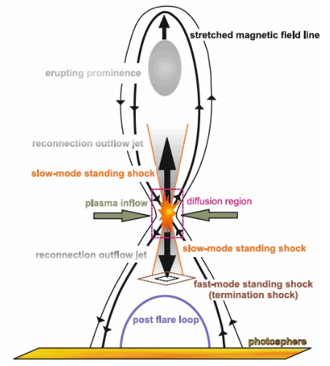
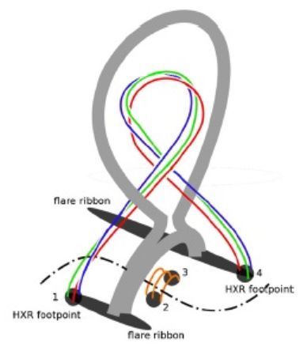
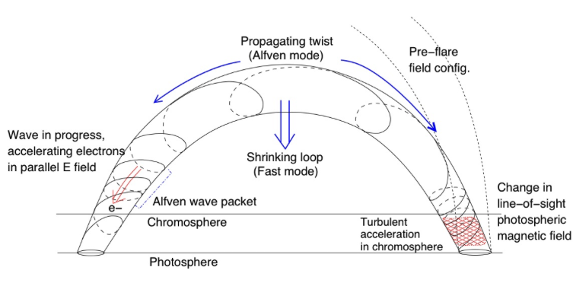
Energetic Neutral Atoms
• An entirely new flare-associated “neutral particle” has appeared (Mewaldt et al. 2009)
• The ENAs are the first guide to the “subcosmic rays” – an important but nearly-undetectable plasma component
• They are associated with CME/SEPs and may also come from flare γ-ray sources

Slide 3
Three flare configurations
Eruptive (Mann et al. toon)
- The most interesting from the
ENA point of view
2. Confined (Guo et al. toon)
- Also very interesting, but less
likely
3. Simple (Fletcher-Hudson toon)
- Very likely indeed, but not so
relevant

Slide 4
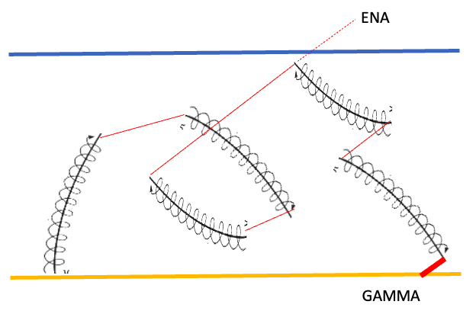
ENA and Ion Propagation
• An (ion/ENA ) unit spends most of
its time as an ion
• In a fully ionized plasma, it’s always
in the ion state
• At a boundary, the ENA may escape
or die collisionally
At the base of a coronal hole, quiet Sun:
n = 10⁸ cm⁻³ base density
H = 5 x 10⁸ cm scale height
σ = 2.3 x 10⁻¹⁷ cm² (Barghouty 2000)
Stripping probability nHσ = 0.4

Slide 5
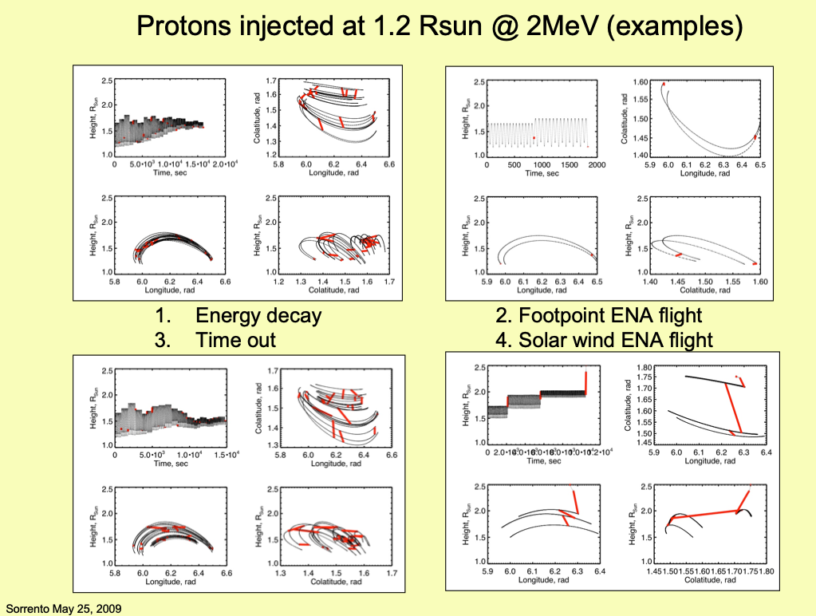

Slide 6
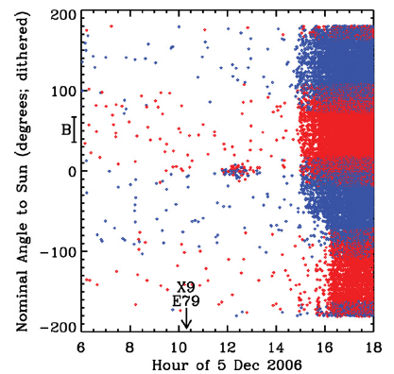
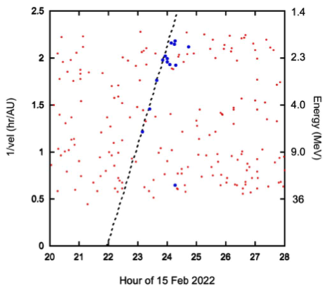
How detectable are ENAs?
Mewaldt et al. 2009
Cohen et al. 2024
• S/B ratio can be very high!
• S/N ratio => detector area requirement

Slide 7
How many particles?
Mewaldt et al. estimate a total of 1.8 x 10²⁸ ENA particles (hydrogen atoms) assuming isotropic emission in a hemisphere
RHESSI γ-ray observations imply a total of 1.3 x 10³¹ protons above 30 MeV
Assuming a spectral index of 3.5, this implies a total of 2 x 10³⁴ protons above 1.6 MeV
Thus: escape efficiency of order 10⁻⁶? How much loss to photoionization?

Slide 8
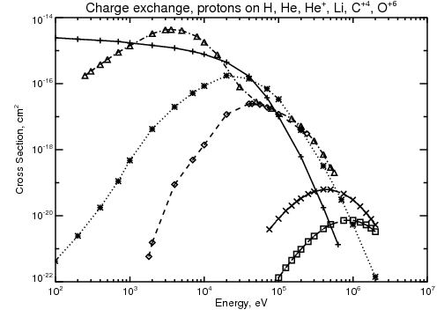
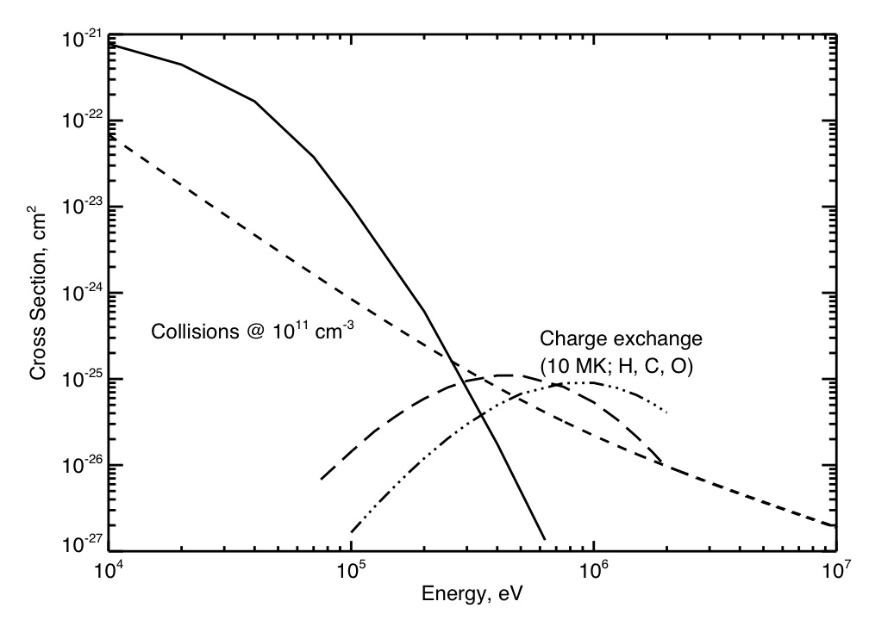
Some necessary physics
Fe?
Fe?
• Charge exchange cross-sections (H-like and He-like only)
• Charge exchange vs collisions
• Impact ionization σ_{i} = 2.3 x 10⁻¹⁷ E_{p}^{-0.897} cm² (Barghouty, 2000)

Slide 9
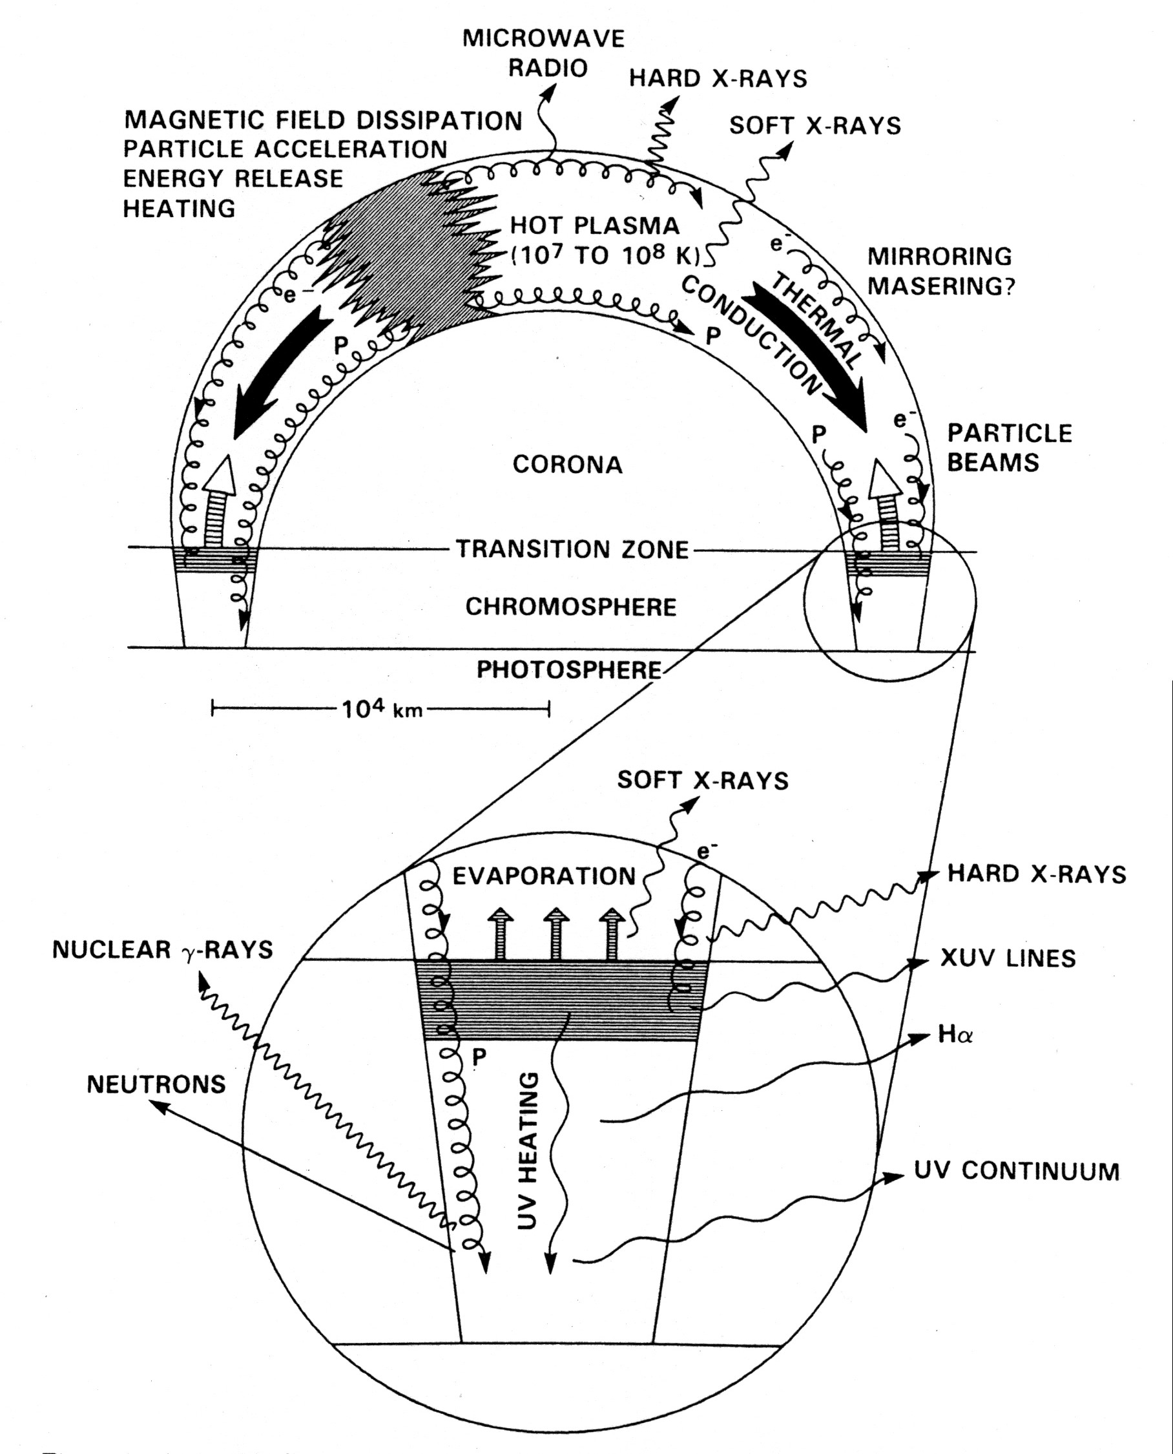
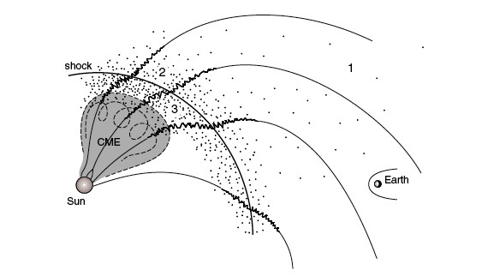
Whence flare ENAs?
Mikic & Lee, 2006
Likely ENA sources
Unlikely
Dennis & Schwartz, 1989
http://solarmuri.ssl.berkeley.edu/~hhudson/cartoons/

Slide 10
A flare/heliosphere ENA source
•• Any flare source of ENAs will likely have a
high density and therefore high “stripping opacity”
• A “stripping-thin” layer can develop at the top
of any flare structure rising high enough, but only
in eruptive or failed-eruptive events
• We don’t know enough about flare structures to
make firm estimates, but since 2009 we have
learned enough to guarantee success for SNAP

Slide 11
Conclusions
The Mewaldt et al. (2009) result is one of the most important for flare high-energy physics in this century, since it opens a vast new parameter space!
A simple estimate shows that ENAS may escape even from the quiet Sun
Eruptive and failed-eruptive flares can be imaged, linking SEP acceleration and flare acceleration physics

Slide 12
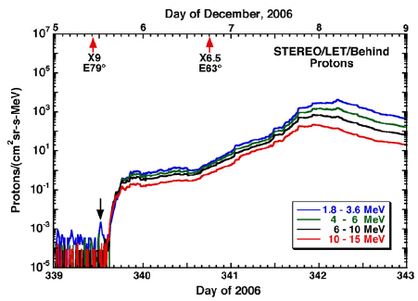
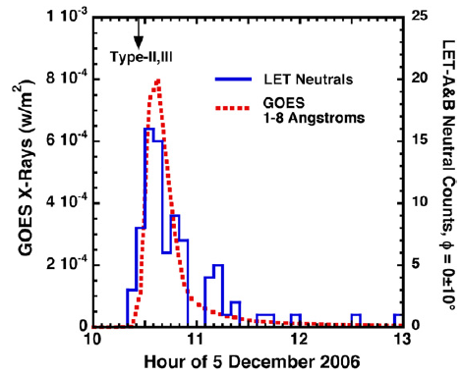
Mewaldt et al. Figures
• The STEREO observations provide both spatial and temporal signatures that clearly identify the particles as hydrogen
• The injection times closely match the GOES light curve of the flare

Slide 13
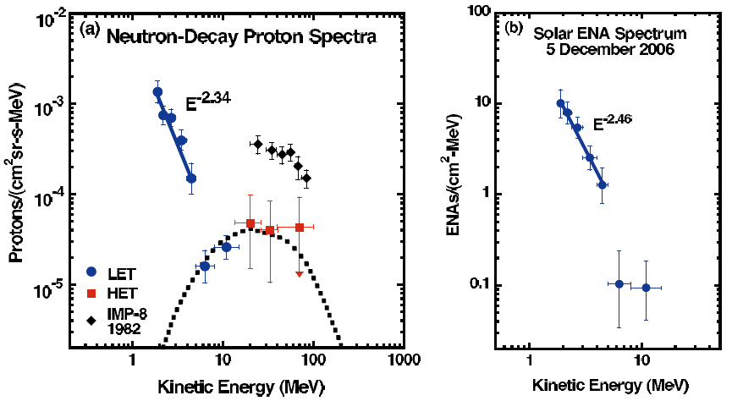
Mewaldt et al. Figures (II)
• The HET counts resemble those expected from neutron decay
• The LET spectrum appears to steepen > 5 MeV

