Slide 1
What is the SSN proxy good for?
Hugh Hudson^{1,2} and Brian Welsch¹
¹UC Berkeley ²University of Glasgow
1.

Slide 2
Outline
Query:
The sunspot number SSN, among many other proxies, show us something about solar activity. But what are they trying to tell us?
Presentation:
• Assessment of proxies
• Physical significance
• The longer term

Slide 3
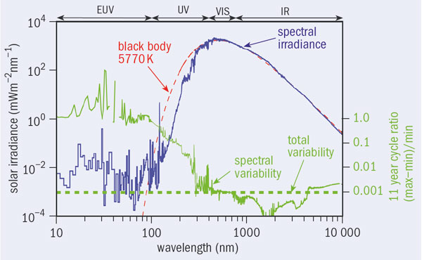
Solar Luminosity
• Radiant energy
- Photospheric
- Other (spots, faculae, corona, flares, CMEs)
• Solar-wind advection
• Non-traditional (neutrinos, axions, etc.)
Notes:
Note that the photosphere, for this purpose, is the quiet Sun and that we should regard spots, faculae, and network as “Other”

Slide 4
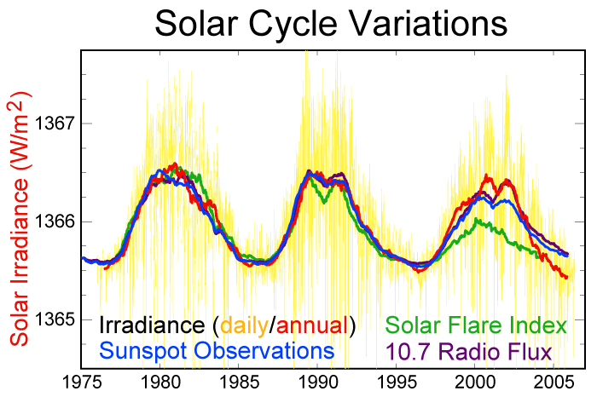
http://www.globalwarmingart.com
Notes:
Significant change in F10.7/SSN; very substantial change in flare index

Slide 5
The Proxies
We can track solar variability into the past, further and further into the past, but with ever-decreasing fidelity.
• F10.7: microwave radiometry, calibrated to 1%*, since 1947
• SSN: counts of sunspots, calibrated to a few %, since the 19th century
• The geomagnetic record
• The radioisotope record
*To think about: why is this accuracy so poor, and
could we benefit from an order-of-magnitude improvement? Mg II index has 0.15% rms in 2008!

Slide 6
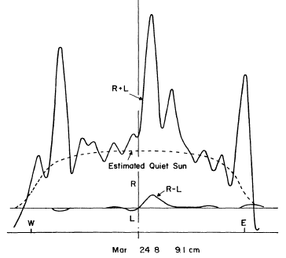
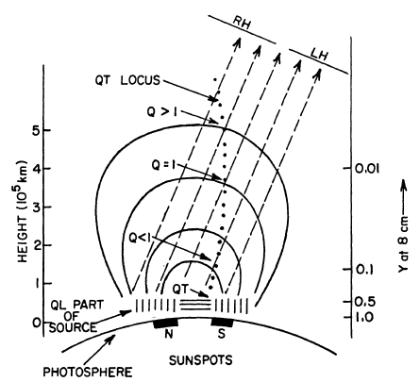
F10.7 as a physical quantity
Quiet Sun and “S-components”
Complicated radiative transfer
Kakinuma & Swarup (1962)
Notes:
The solar 10 cm flux has three parts: the quiet Sun (Q-component), the S-component, and flares (R-component). F10.7 in principle omits the flares.

Slide 7
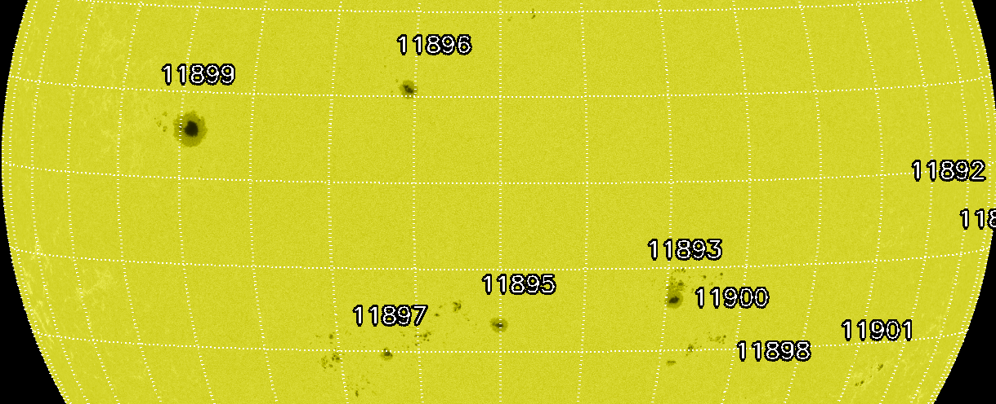
SSN = 272: 15 Nov. 2013
Notes:
Note the natural splitting in to SSN = NS + 10NG. Can this be tracked and utilized?

Slide 8
Difficulties in SSN interpretation
The dynamo source of sunspot magnetism is not well understood
The propagation of field from interior to surface is not well understood
The flows that aggregate the field into spots are not well observed
The fragmentation of spots is understood only qualitatively
Notes:
And yet…. Qualitatively, the surface flux-transfer dynamics seem to be quite well understood on the basis of very limited model complexity

Slide 9
The dilemma
We can measure these (and many other) proxies pretty well
Each tracks the solar non-photospheric luminosity
Each reflects solar magnetism in some different (and ill-understood) manner
But, how do we make quantitative use
of this information?

Slide 10
The magnetic energy flux
“Reliable, accurate maps of the Poynting flux are essential for quantitative studies of the buildup of magnetic energy before flares and coronal mass ejections.” (Fisher et al. 2012)
Theory and inference from observation are coming along; meanwhile, we have the proxies, e.g. RHESSI flare positions:
RHESSI flare longitudes

Slide 11
Maps of the Poynting flux, AR 11158
• Grayscale saturation at 2 x 10⁹ erg/cm²s
• B contour at 500 G

Slide 12
Conclusions
• There have been rapid strides in proxies of solar activity, including major recent discoveries
• With image-resolved data, we should be able to calibrate some of the proxies in terms of physical quantities
• Ideally, the calibrated proxy should match its theoretical prediction
Notes:
Regarding calibration of the proxies, I have in mind the separate calibration of the group and number components of SSN, for example.

Slide 13
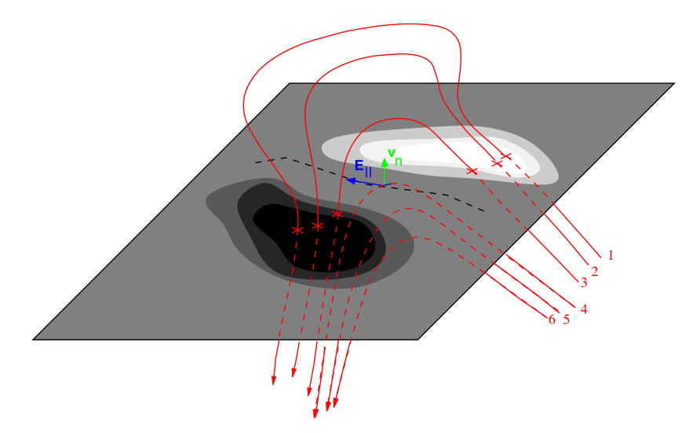
Emerging flux

Slide 14
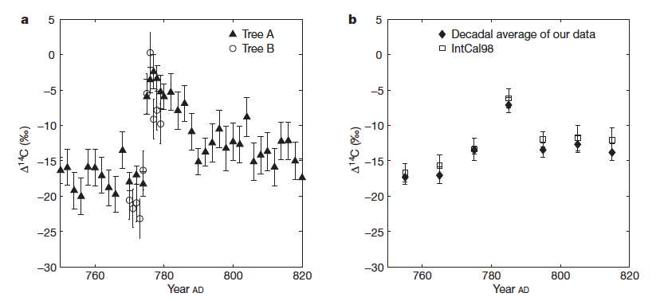
A neat proxy result: AD 775
Miyake et al. 2012
• Using 1-year sampling, Miyake et al. discovered the first radioisotope event
• The event was confirmed in German oak and ¹⁰Be
• A second event has now been found…. are these solar megaflares?

Slide 15
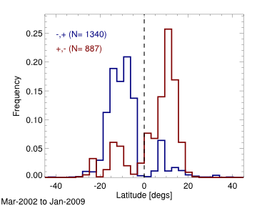
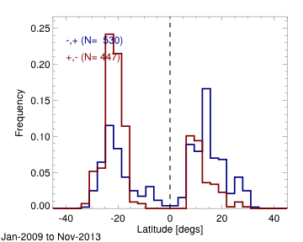
New work on sector boundaries in the photosphere: flares as a proxy
* The RHESSI flare catalog shows a clear hemispheric segregation that follows the Hale sector rule
• These plots, by Iain Hannah, extend the work reported by Svalgaard et al., ApJ 733, 49 (2011).
• A puzzle: the flare occurrence proxy characterizes the most intense and most localized magnetic energy flux. How can it so clearly show us the sector structure, which is the global dipole/quadrupole field of the Sun
Notes:
I’d only show these two slides if I had enough time, but of course they are really the most interesting ones.

