Slide 1
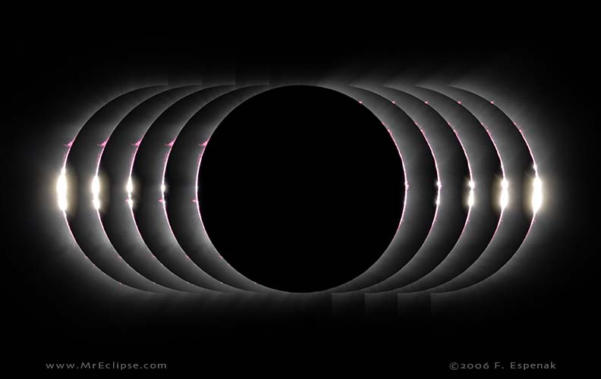
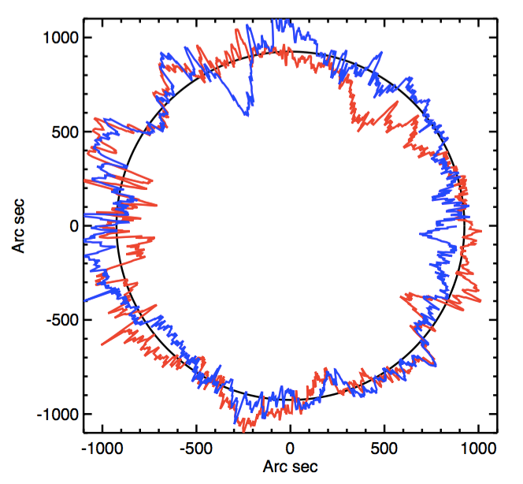
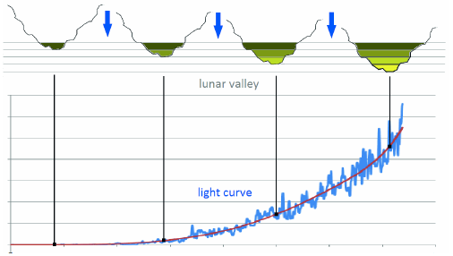
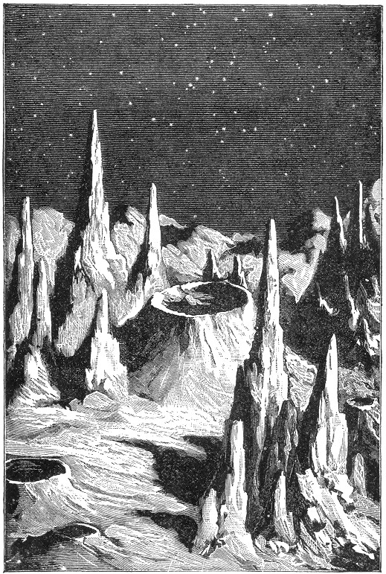
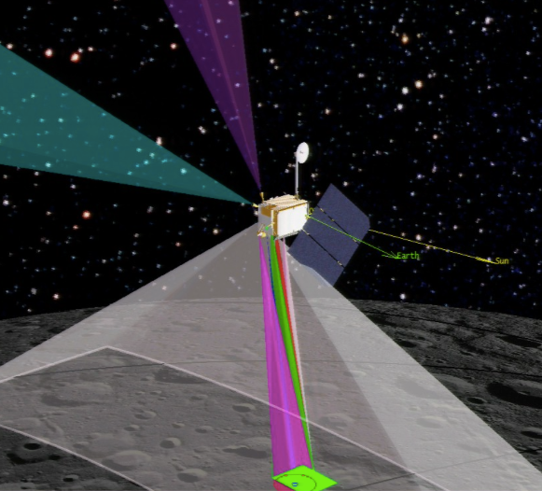
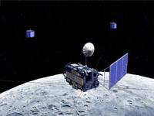
Eclipse Megamovie citizen science: The Diamond Ring Hugh Hudson (Berkeley and Glasgow), Mark Bender (Texas), Scott McIntosh (HAO), Juan Carlos Martínez Oliveros (Berkeley), Jay Pasachoff (Williams and Caltech), and Laura Peticolas (Berkeley)
Synopsis
The 2017 North American total eclipse has begun to encourage many outreach and citizen-science activiites. We describe here a part of the Eclipse Megamovie program, in which we deploy an app to enable anybody with a GPS-equipped smartphone to record correctly exposed images of Baily's Beads (leading to the "Diamond Ring" effect) for subsequent analysis. The multiply oversampled recordings of 2nd and 3rd contacts, across and along the track, will provide material for unique movie representations of this lovely astronomical phenomenon. After the fact, this highly oversampled dataset can be used to check and conceivably extend detailed satellite topography of the Moon from Kaguya and LRO.
In addition the high angular resolution inherent in the "knife-edge" motion will provide a unique view of the structure of the solar limb itself (e.g. Kuhn et al., 2012). The low angular resolution of the smartphone cameras is a handicap, but excellent time resolution and massive oversampling are great advantages. We anticipate public participation in image selection to get the best sequences of last-few-millisecond imagery for the science product here, which can follow the known motions of the solar limb due to p-modes (acoustic waves trapped in the solar interior) and granulation (solar convective motions). No comparable database exists, and so the final product of this crowdsourcing will be a public archive of the raw data and metadata for future studies.
“Bead photometry”
As the eclipse progresses, a bright spot will appear in the first deep valley (3rd contact), rapidly becoming bright (Raponi et al., 2013).
Figure 1. An excellent sequence of images from the Libya eclipse of 2006. The images are spaced 1 s apart at 1/1000 s exposure time. Note the simplification of the Bead structure within the last second. Photo ©2006 by Fred Espenak
Figure 2. The Watts (1963) lunar limb atlas, grossly magnified in the radial direction, for the extreme range of libration angles. This database has now been supplanted by the in-situ observations described below.
Figure 6. Sketch of the time series of Bead brightness as the Sun rises in a lunar valley.
Smartphone cameras as astronomical photometers
Technology has exploded with capability here. The smartphone cameras, with GPS metadata, have awesome properties that are at the fingertips of any owner – most people, most likely. The “Diamond Ring” program within the Megamovie project harnesses this remarkable capability for crowdsourced solar astrometry via the new lunar reference.
Citizen Science
Depending on the distribution of the app and the cooperation of the weather, the smartphone database could be very large. It will certainly be heterogeneous. Accordingly, a primary task for citizen volunteers is to identify time sequences through the eclipse. The sequence for a unique Baily’s Bead, which ideally would extend for the full hour and a half of totality, will have timing residuals that map to astrometry of very high precision. Another project would be to search for discrepancies in the selenography, perhaps due to time variations These are large database tasks that many volunteers can tackle via online Web programs.
Modern selenography
Technology has exploded with capability here as well. The fanciful imagined surface structure (Warren, 1879) has been supplanted within the recent few years by the very precise measurements of the Lunar Reconaissance Orbiter and Kaguya. These data are as precise as 5 m (!) and support astrometry well (Lamy et al. 2015).
Conclusions
Two remarkable technological advances have arrived just in time for the 2017 eclipse: smartphones and in-situ lunar topograpical mapping (LRO and かぐや).
The Megamovie “Diamond Ring” program aims at capturing its brilliance for a movie, and at creating a database of precise timing at the 2nd and 3rd contacts all along the path of totality.
The crowdsourcing data generation will lead to citizen-science analysis projects, after the fact, as modeled on SETI@home and similar very successful enterprises.
Figure 3. A19th century view of the Moon.
Figure 4. A sketch of NASA’s Lunar Reconaissance Orbiter.
Figure 5. A sketch of JAXA’s Selene/Kaguya mission (かぐや).
References
Kuhn, J. et all, 2012, Science 337, 1658 – The precise limb shape
Lamy, P. et al., 2015, Solar Phys. 290, 2617 – Astrometry via selenography
Raponi, A. et al 2013, arXiv 1201.0707 – Baily’s Beads via timing
Warren, H.D. 1879, “Recreations in Astronomy” (ex Wikipedia) – A fanciful view
Watts, C.B. 1963, “The Marginal Zones of the Moon” – The standard photographic atlas of the lunar limb

