Slide 1
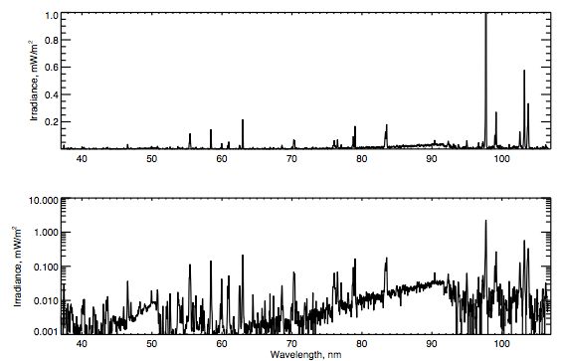
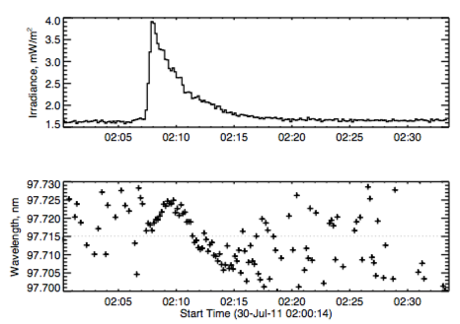
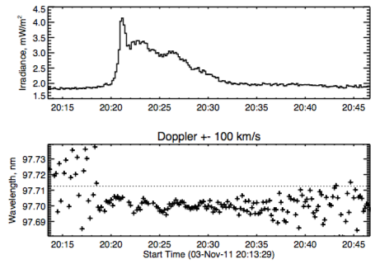
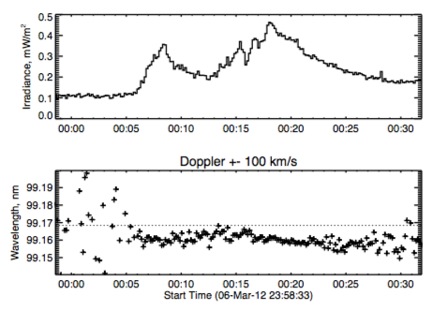
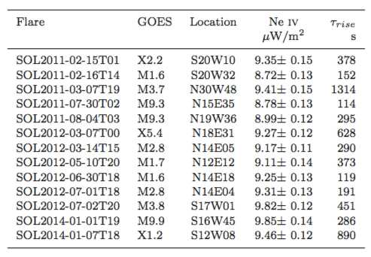
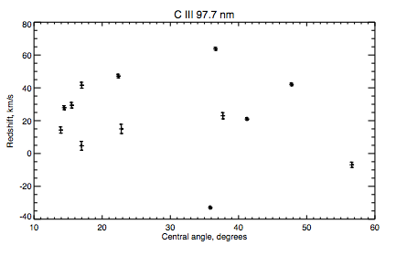
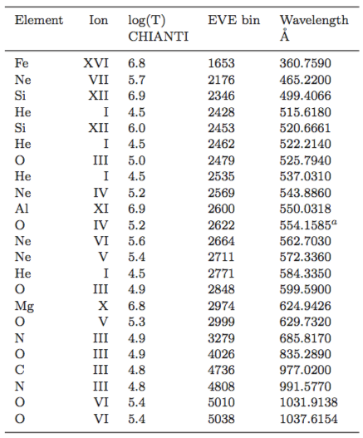
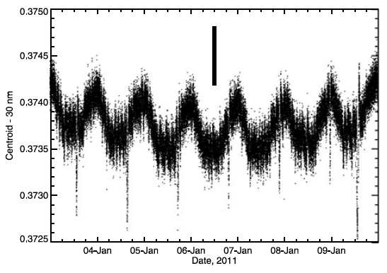
EVE Doppler Signatures in Major Flares Hugh Hudson (Berkeley and Glasgow), Phil Chamberlin (NASA/GSFC), Alec MacKinnon (Glasgow) and Tom Woods (LASP)
MEGS-B vs. MEGS-A
Our previous published work on EVE Doppler measurements (Hudson et al. 2011) used MEGS-A. This instrument observes high-excitation lines well, but has the technical problem that these lines do not form outside flare times, and so rest reference spectra are not easily found. This is important because of the wavelength/spectrum coupling (an optical design property; see Woods et al., 2012, and Chamberlin, 2016).
For MEGS-B these problems are unimportant. We can use pre-flare emission safely as a rest reference. Accordingly, the results presented here focus on transition-region lines with peak formation temperatures below 1 MK; such lines are always available in the spectra. In this analysis we use the line set in Table 2 here, omitting the He lines and two others upon close inspection. See Figures 2 and 3 for “blend maps” and line profiles in one flare event.
Background: This poster describes SDO/EVE spectroscopy of the Sun as a star in the EUV (see Hudson et al., 2011 Woods et al. 2012, and Chamberlin, 2016 for details). In this presentation we discuss the behavior of the transition-region lines, aiming at an eventual “calibration” via AIA imagery of the phenomena we see in this novel way. Future stellar observations may thus recognize common paradigms.
Table 1. Major flares for which MEGS-B spectroscopy is available. The rise time is from GOES, the log derivative time.
Figure 4. Time series of Doppler measurements for two flares in C III 97.7 nm. SOL2011-07-30 (left) shows a swing from red, in the impulsive phase, to blue in the gradual phase. SOL2011-11003 shows a persistent blueshift. At this wavelength 10 pm = 31 km/s.
Figure 5. Another flare with blueshifts in transition-region lines, in this case N III 99.1 nm
Figure 1. Representative flare excess spectrum from EVE/MEGS-B, in linear and log versions, showing the wealth of lines available. This represents one 10-s data integration differenced against a 200-s integration prior to the SOL2011-07-30 (M9.7), taken at flare maximum time.
Table 2. Useful lines in the MEGS-B flare spectra. We exclude the He lines here.
Figure 6. Redshifts at GOES maximum for all flares in the C III line, plotted here against central angle. Typical uncertainties are of order 1 km/s here. As one can see from the time-series plots (Figs. 4 and 5) the variation of the mean Doppler flows is well measured by EVE. Various other correlations have been sought and not found; the working hypothesis is that there is no systematic pattern and that the uncorrelated variance comes from the details of the flare structures. In the next phase of analysis, we intend to carry out a detailed survey of AIA imagery in an effort to identify this structural dependence.
Conclusions
EVE/MEGS-B sees transition-line Doppler shifts well. In this survey we are finding mean velocities of +-10s of km/s:
C III, the strongest line, can exhibit either blue or red shifts, with precision of order 1 km/s.
N III tracks C III well, suggesting that EVE can measure mean temperature gradients.
There is a large uncorrelated flare-to-flare variance that we hope to identify, via AIA, with flare structural detail.
The pattern of Doppler shift vs temperature is not as simple as one sees in the classic work of Milligan & Dennis (2009).
The body of work enabled by EVE should really help to disentangle paradigms for related stellar observations.
Figure 2. “Blend maps” from CHIANTI (Dere et al. 1997; Landi et al. 2013). Each panel shows one of the lines in Table 2, omitting He, across the range of a standard Gaussian fit (0.22 nm) and the temperature range 10⁴-10⁷ K. The color scale covers five decades of CHIANTI extended-flare DEM intensity for the temperature range 10⁴-10⁷ K.
Figure 3. Standard Gaussian fits for the chosen lines as seen in SOL2012-07-30, using a standard six-parameter model to extract one line and a quadratic background term. The plots are normalized to the flare excess peak (black), with blue and red showing the preflare and peak flare spectra, respectively.
References
Chamberlin, P.C., Solar Phys. 291, 1665 (2016) – EVE/MEGS
Dere, K. et al. 1997, A&A Supp., 125, 149 (1997) – CHIANTI
Hudson, H. et al., Solar Phys. 273, 69 (2011) – EVE spectral shifts
Landi, E. et al., ApJ, 763, 86 (2013) – CHIANTI
Milligan, R.O. and Dennis, B.R., ApJ, 699, 968 (2007) – Flare Doppler patterns
Woods, T. et al., Solar Phys. 275, 115 (2012) – EVE
Figure 3. Doppler signature of SDO orbital motion as detected in He II 30.4 nm (Hudson et al. 2011). The vertical bar is 3 km/s.

