Slide 1
Solar Coronal Events with Extended Hard X-ray and Gamma-ray Emission
Hugh Hudson*
Space Sciences Laboratory,
UC Berkeley, and the University of Glasgow
*With thanks to our ISSI team (A. MacKinnon, R. Vainio); see
http://www.issibern.ch/teams/elucompofsolflare/

Slide 2
Mid-coronal Disturbances associated with CME flares
Coronal hard X-ray events, SOL1969-03-30 (Frost & Dennis, 1971; Enome et al. 1971)
“Sustained” γ-ray events, SOL1982-06-03 (Forrest et al, 1985)
Meter-wave Type II/IV bursts (e.g., Kundu 1965)
I think these phenomena belong together, and with novel plasma dynamics we may be able to explain them

Slide 4
SOL1969-03-30 HXR
• Coronal origin (by occultation)
• Hard spectrum, J_{ν} α (hν)⁻²
• Low peak microwave frequency
• Association with type II/IV burst
• Drifting cm-wave source
• SEPs
• Un-imageable scale (RHESSI) • CME association
SOL1982-06-03 γ-ray
• Very high energies (GeV)
• Pion decay radiation
• Long duration, up to hours
• Association with type II/IV burst
• Neutrons
• SEPs
• Coronal origin (Fermi)
• CME association
Two big mysteries:
• What are these things? (Can’t see them in AIA!)
• How can the GeV particles be related to the SEPs?

Slide 5
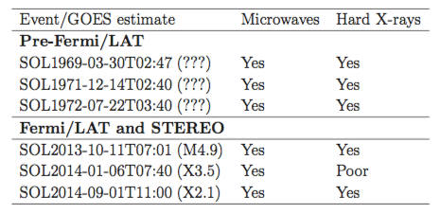
Frost-Dennis Events
• Early (pre-Fermi) history: Cliver et al. 1986
• Fermi-era occulted events: Pesce-Rollins et al. ICRC 2015
Share et al. preprint 2017

Slide 6
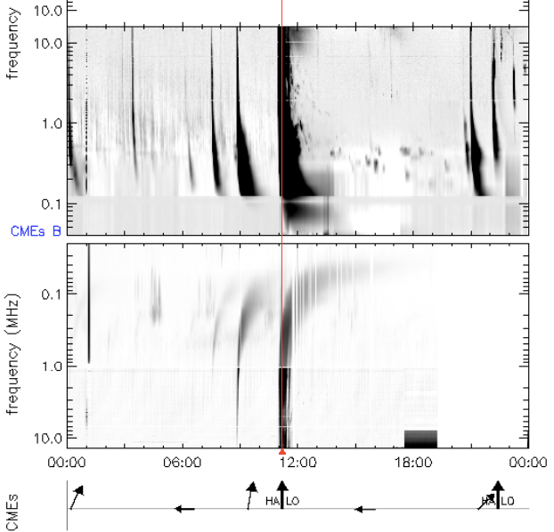
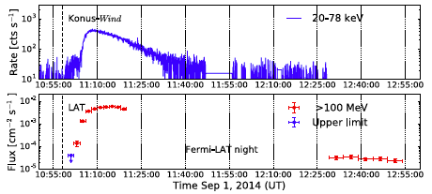
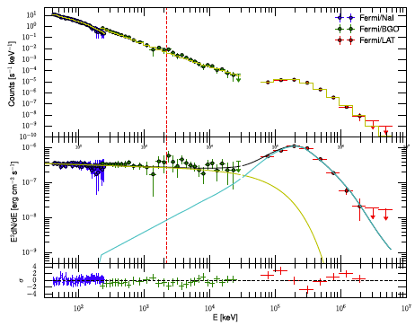
SOL2014-09-01 (a recent archetype)
• Ackermann et al. 2017 overview paper
• N14E126 “X2.4”, Pesce-Rollins et al. 2015 • Height of sources > R
• CME, II, IV, pions, HXR, LDGRF..., exactly on prototype morphology

Slide 7
The loss-cone problem for SEPs
• The SEPs presumably come from CME-driven shock waves.
- On open fields at 3 R, the particles would just go away and never interact to produce pions and γ-rays.
- On closed fields, e.g. at 3 R, the loss cone is negligible (of order 10⁻³ sr), so the 1st adiabatic invariant strongly prevents precipitation.
• These considerations do not readily fit the observations, interpreted as large fluxes of relativistic SEPs near the source active region on SGRE time scales

Slide 8
The Kelvin Force
• L. Kocharov et al. (1996) quote: “…the effect of focusing of energetic particles is always essential as compared with scattering, no matter how small the value of the mean free path…”
• The Parker equation for cosmic-ray transport incorporates the focusing term, which must not be neglected
• K. Shibasaki, in preparation 2017: this “Kelvin force” is not commonly incorporated in MHD

Slide 9
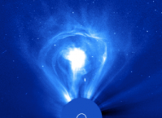
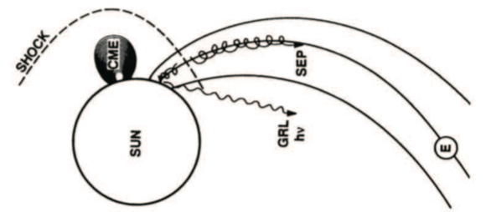
The “Lasso” model
The Lasso model just describes the LDGRF protons as those SEPS corralled by closed coronal field.
Cliver et al. (1993)

Slide 10
The Lasso model
Shock acceleration takes place in large closed-field structures (“loops”) ✓
These then retract, leading to further (betatron and Fermi) acceleration ✓
The restructuring gives better loss-cone access, leading to the observed radiations ?

Slide 11
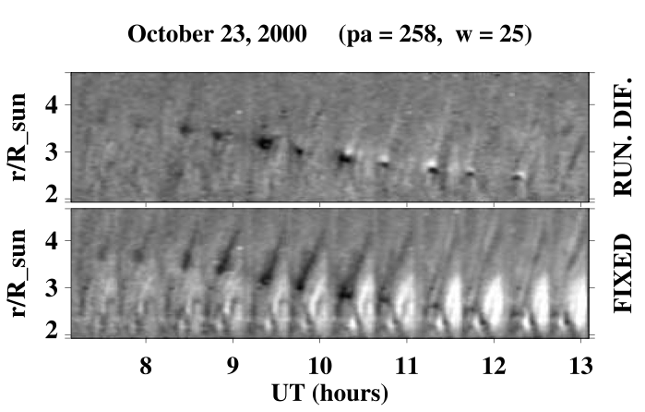
Large-scale coronal loop retractions
Sheeley et al. 2004

Slide 12
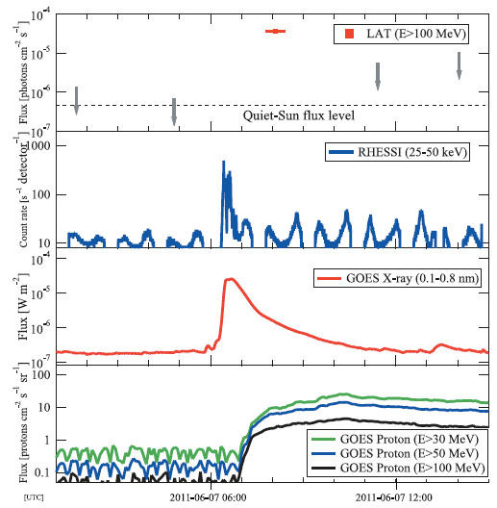
SOL2011-06-07 LDGRF
Note the image evidence for retracting fields following this LDGRF (SGRE)
Ackermann et al. 2012

Slide 13
Lasso model concerns
Is the CME/shock geometry realistic?
Are the trapping time scales OK?
How do we relate the electron (positron?) signatures to the ions?
Are the Lasso model’s “predictions” observable?
- is a shock observed in a good geometry?
- can we detect the retracting structures?
- do we see consistent γ-ray centroid motions?

Slide 14
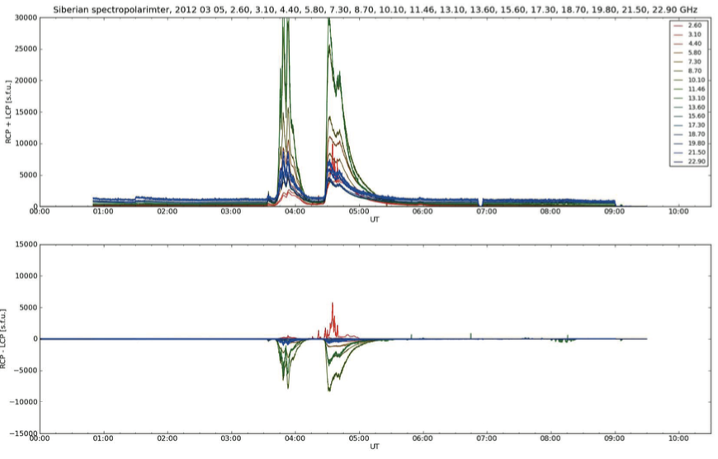
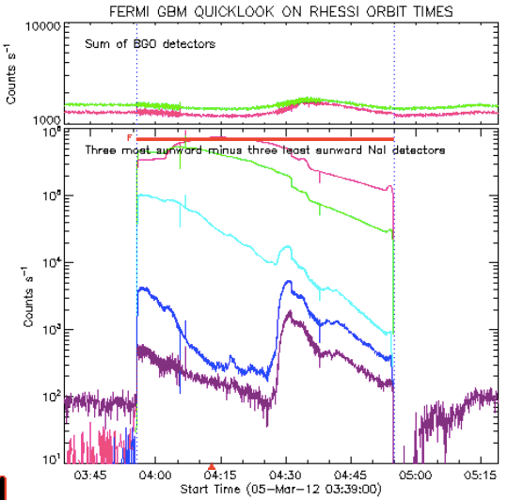
Microwaves and hard X-rays SOL2012-03-05
Good Siberian microwaves (courtesy Kashapova)
HXR spectroscopy (courtesy Fermi)

