Slide 1
Two things learned about SFEs?
Hugh S. Hudson
U of Glasgow, UC Berkeley, WKU

Slide 2
What is an SFE?
“Solar Flare Effect”, a.k.a. “ crochet”
First example in the Carrington event
Three days in September 1859 via the earliest recording magnetometer

Slide 3
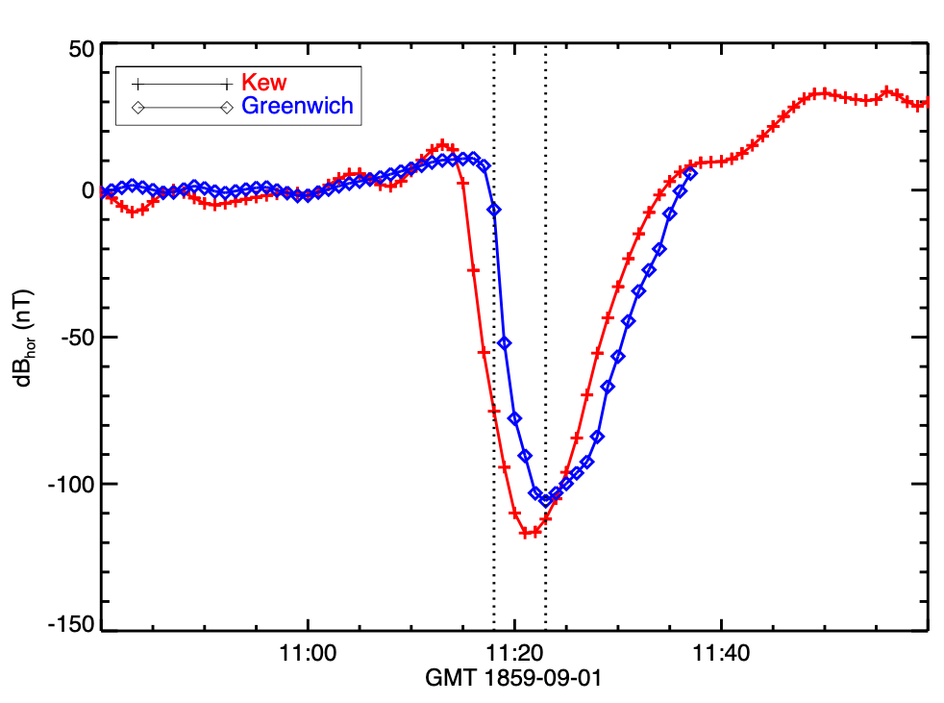
The original crochet/SFE
The Carrington event had a well-observed SFE, with two sites (Kew and Greenwich)
• SOL1859-09-01 (X86+15)
• Recent digitizations by
Beggan et al. (2024)
• A 10% measure, but what
about systematic errors?

Slide 4
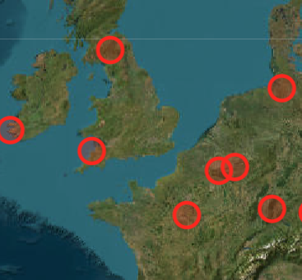
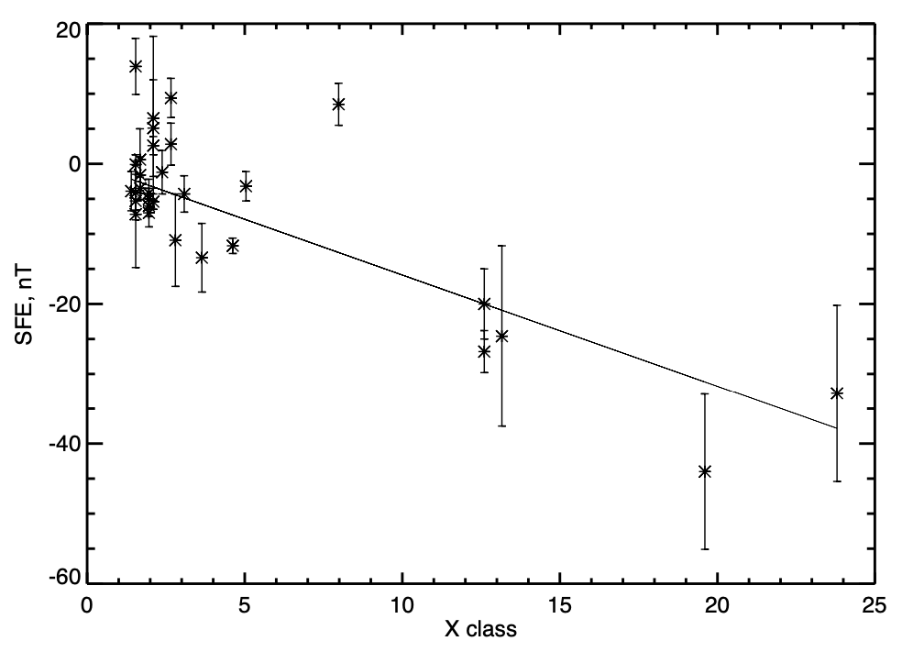
Intermagnet near Kew/Greenwich
• The Hartland site (HAD, in the UK) is the
closest geographical counterpart
• Note that the sampling is not optimal
in the Nyquist sense
• HAD has observed about 40 X-class
flares near local noon

Slide 5
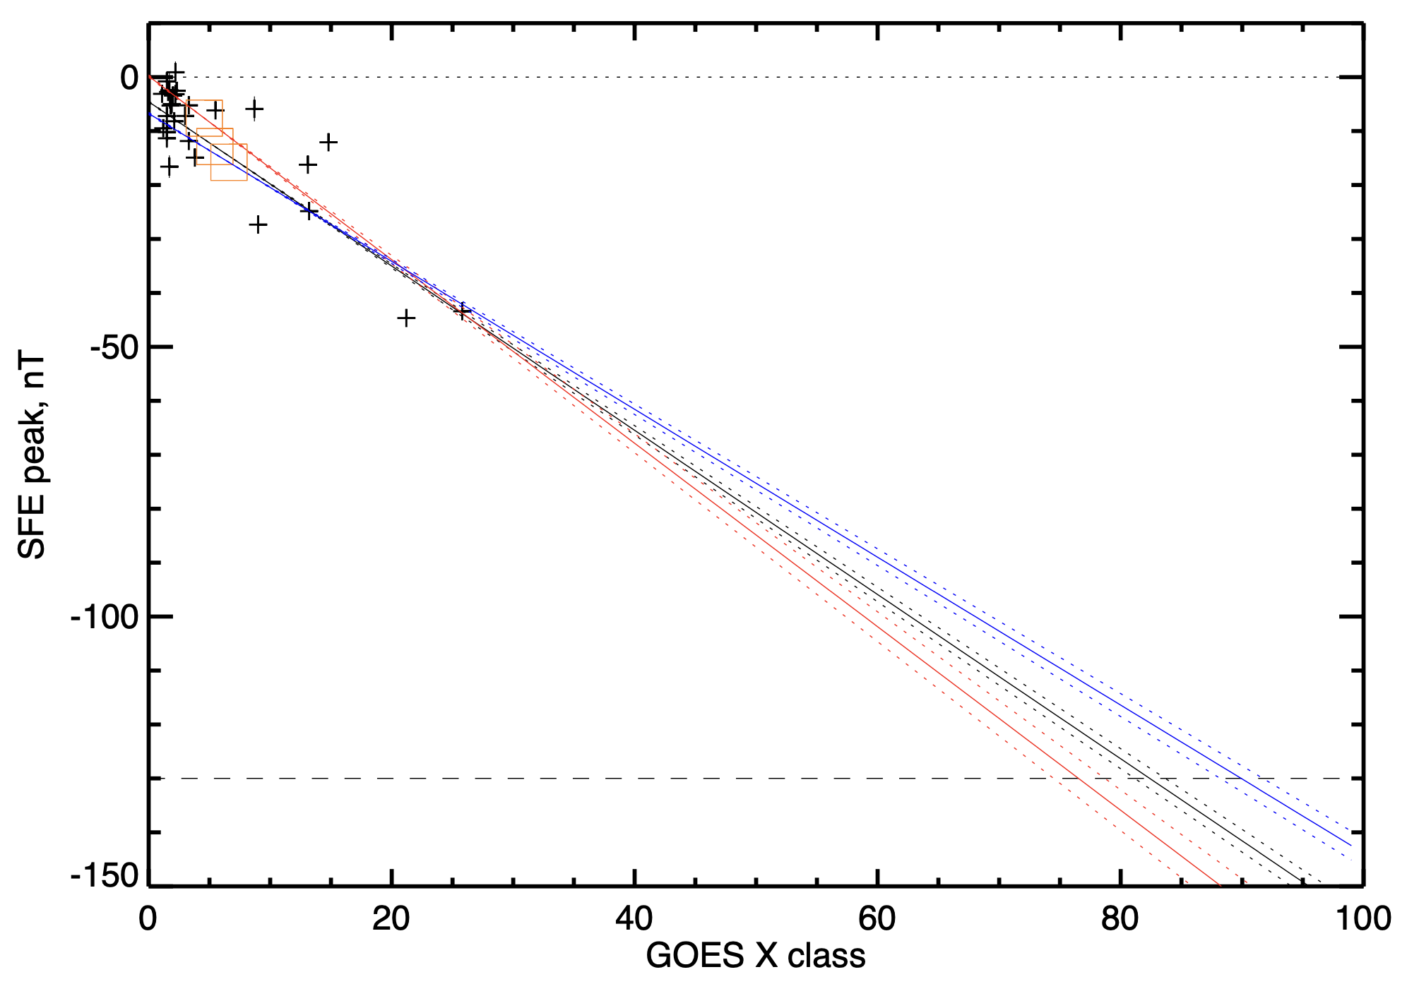
Correlation (final)
Winter
Carrington
X86+-15
Summer
Carrington

Slide 6
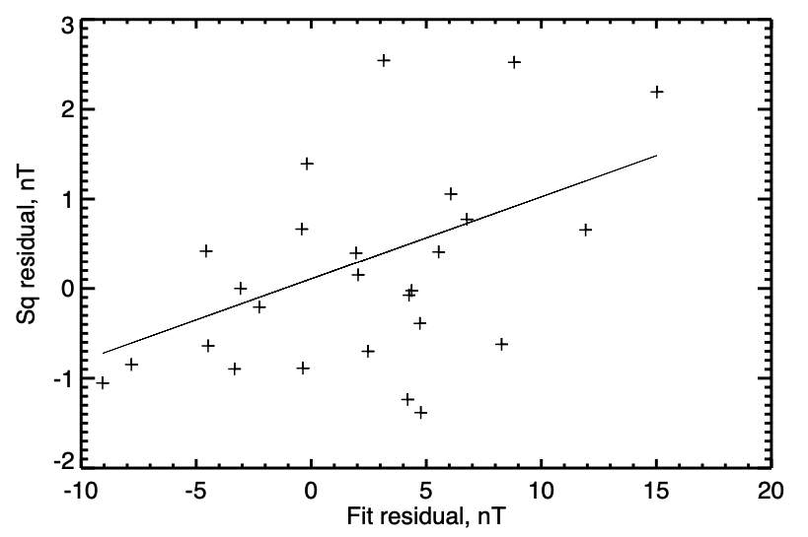
Sq dependence?

Slide 7
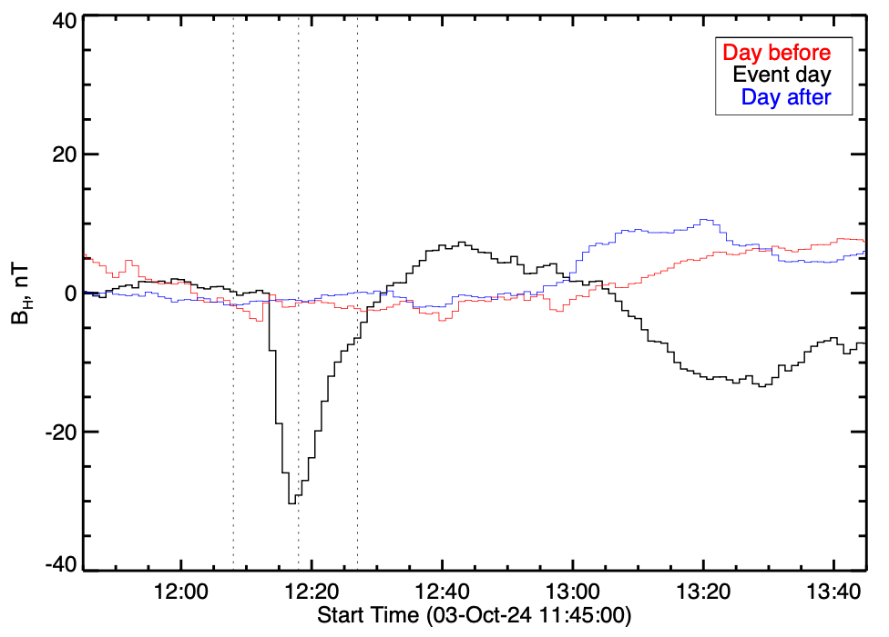
SFE mini-storm?
Variances of data prior to
and after event:
IDL> print,mean(mombef[1,*])
1.76603
IDL> print,mean(momaft[1,*])
5.65851

Slide 8
Conclusions
The SFE amplitude correlates with Sq
Disturbed conditions follow an SFE

