Slide 1
Magnetic Implosions and their Consequences
Hugh Hudson
SSL, UC Berkeley and U. Of Glasgow
The conjecture: a flare or CME must reduce ∫B²dV
in the coronal half-space. Energy is conserved.
The significance: the geometry and timing of the
implosion are observables that can guide us to
the nature of the instability.

Slide 2
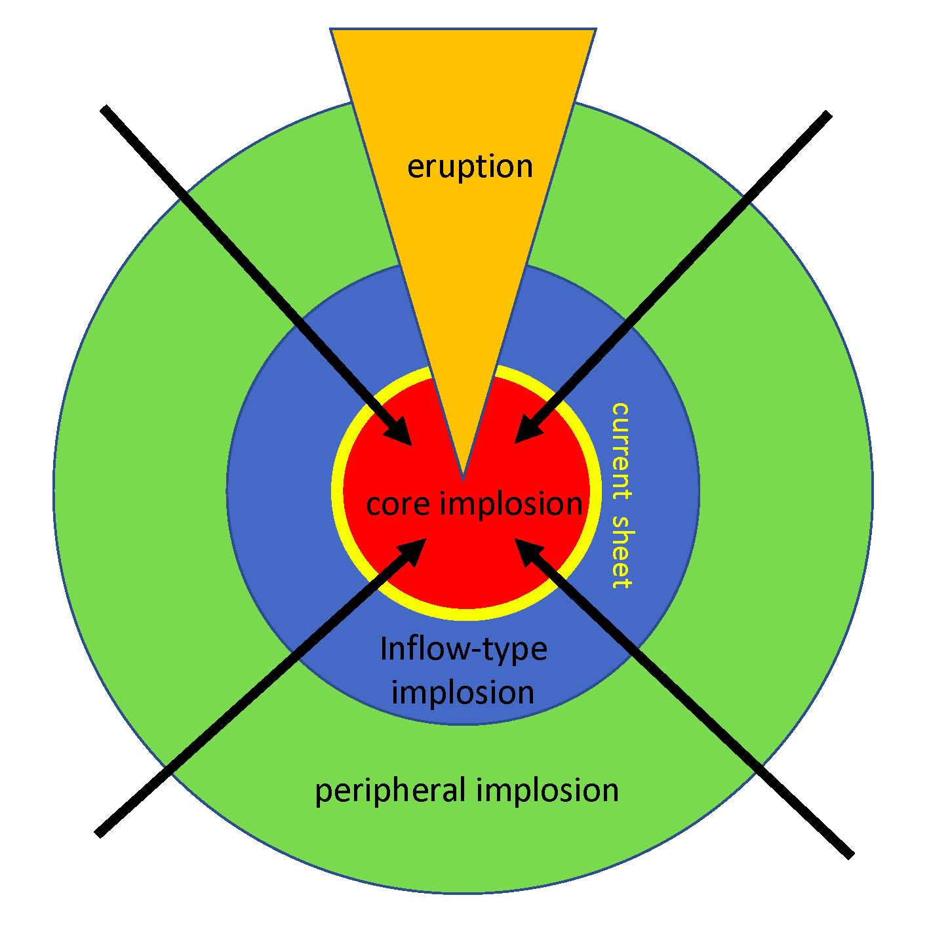
Key cartoons
Hudson & Cliver2001
- - - Magnetoisobar
…… Magnetic field post
___ Magnetic field prior
Wang Juntao 2018

Slide 3
Theoretical history ADS search: abstracts (implosion, flare)
Sakai, J. 1990ESASP.311....7S
Craig, I. 1991PASAu...9..225C
McClymont & Craig 1996ApJ...466..487M
Hudson, H. 2000ApJ...531L..75H
Spicer, D., 2000 “So what? That’s in all the plasma physics textbooks!”
Janse & Low 2007A&A...472..957J
…
Barczynski et al. 2019arXiv190405447B

Slide 4
Observational history
Liu, R et al. 2009ApJ...696..121L
Liu, R. & Wang, H. 2009ApJ...703L..23L
Liu, R. & Wang, H. 2009ApJ...703L..23L
Ji, H. et al. 2011ASInC...2..213J
Ji, H et al. 2011ASInC...2..213J
Sun, X. et al 2011sdmi.confE..63S
Liu, C. et al. 2012ApJ...745L...4L
Gosain, S. et al. 2012ApJ...749...85G
Shen, Y. et al. 2012ApJ...750...12S
Ji, H. et al. 2012EAS....55..229J
Simões et al. 2013ApJ...777..152S
…
Wang, J. et al. 2018ApJ...859...25W

Slide 5
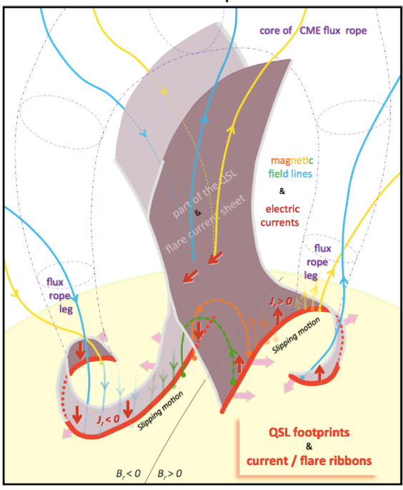
My new favorite cartoons
Russell et al. 2015
Janvier et al. 2013

Slide 6
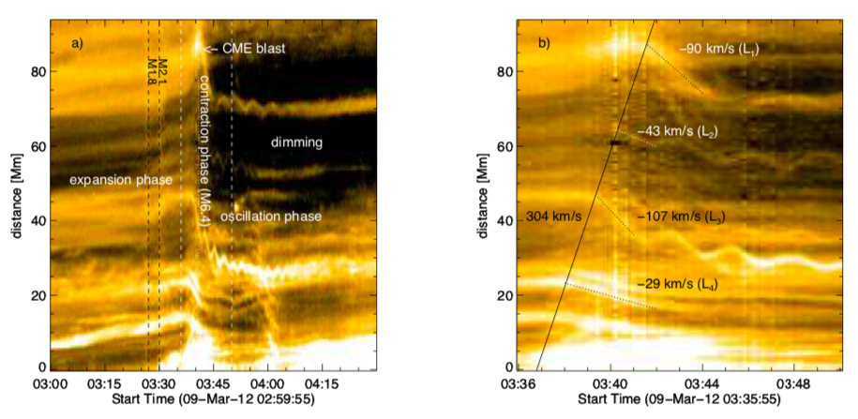
Implosion, QPP, Dimming
Simões et al., 2013

Slide 7
Conclusions
A process of implosion, reducing ∫B²dV in the half-space, must supply the flare/CME energy on short time scales.
Implosion is more fundamental than reconnection, and can be a driver.
There are broad implications of the physical restructuring.
Observationally it is tricky, probably because it is a process in 3 dimensions and we don’t really know what the actual plasma instability is.

Slide 8
Challenges
Observational: Can we detect implosions in non-eruptive flares?
Theoretical: Does an implosion (ie, energy release) always require global magnetic reconnection?

Slide 9
