Slide 1
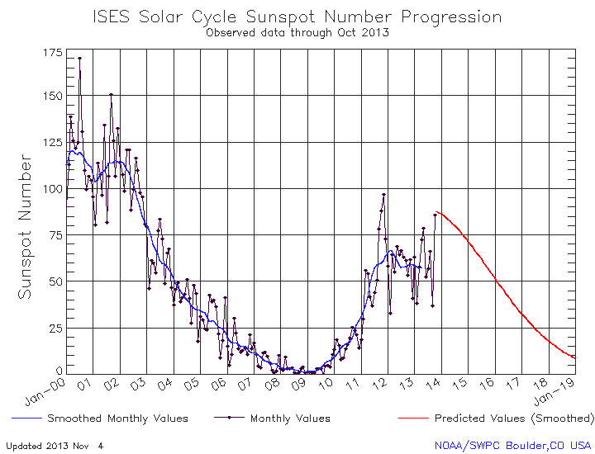
A Synthesis of Solar Cycles 22-24
Hugh Hudson
UC Berkeley and University of Glasgow
1.

Slide 2
Predictions
Pesnell, 2012

Slide 3
Outline
(Slightly revised) Thesis
Various measures of solar activity (“proxies”) guide us to the behavior of the solar magnetic field. The proxies have limited precision and – and maybe less physical understanding - and conclusions are elusive.
• How have the recent cycles developed?
• How good are the proxies?
• What are the proxies proxies of?

Slide 4
How have the recent cycles developed?
Clette-Lefevre 2012
• We see that a systematic change has occurred on solar-cycle time scales: there is a “relative diminution” of F10.7 (Svalgaard, Tapping) of some 20%.
• The uncertainty bands in the ratio are at 3σ (Clette & Lefevre)

Slide 5
What is different about Cycles 22-24?
• F10.7 began in 1947
• The space age began at the IGY, 1957
• Before this, our knowledge fades into the increasingly mythological past…

Slide 6
What is different about Cycles 22-24?
• F10.7 began in 1947
• The space age began at the IGY, 1957
• Before this, our knowledge fades into the increasingly mythological past…

Slide 7
What is different about Cycles 22-24?
• The 23/24 minimum was exceptional:
- Prolongation
- Penn-Livingston sunspots
- TSI decrease
- Cosmic-ray increase
- F10.7 diminution
- etc.
• But otherwise things seemed quite normal

Slide 8
How do we understand the proxies?
• F10.7, SSN, Spot area, Ca K, K-index, GCR flux, Ap, flare index, TSI, Spectral Irradiance, open flux, …
• Each has a different and highly model-dependent relationship with the magnetic observables in the photosphere
• None has any physically understood relationship with the field in the solar interior (the dynamo and/or relic field)

Slide 9
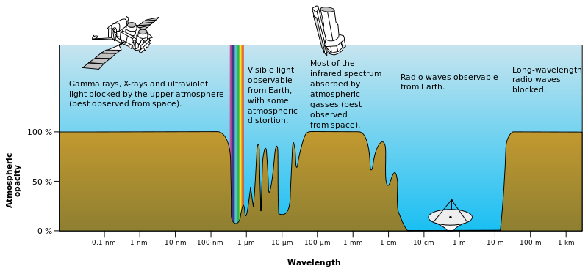
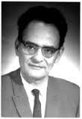
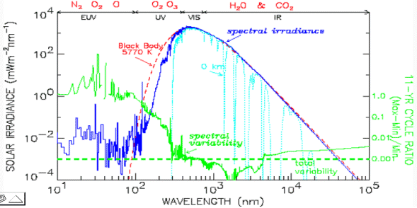
Why do F10.7 and space research matter, as regards proxy measures?
f_{L} = 2.8 B₁₀₀₀ GHz
Covington

Slide 10
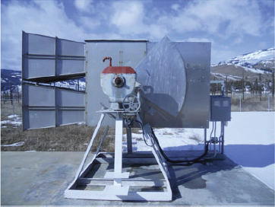
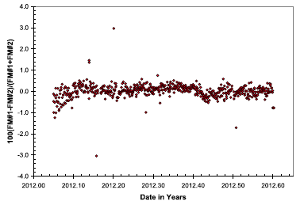
Calibrating F10.7
• “The F10.7 values are deemed to be accurate to one solar flux unit
or 1% of the flux value, whichever is the larger.” (K. Tapping, Space Weather 11, 394, 2013)
• The aperture of the calibration horn is only reported at the 1% level

Slide 11
The F10.7 results
October 2013
Tapping, 2013

Slide 12
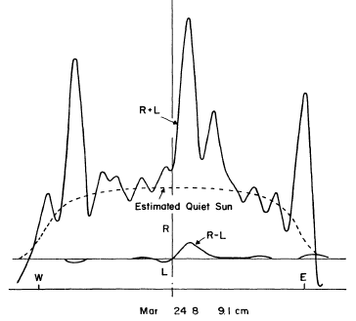
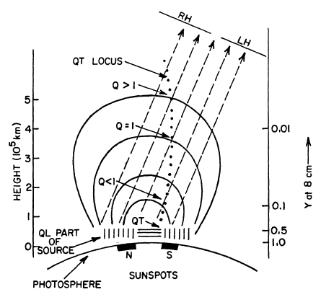
F10.7 as a physical quantity
Quiet Sun and “S-components”
Complicated radiative transfer
Kakinuma & Swarup (1962)

Slide 13
Multiple frequencies (Japan)
• The Japanese program began a few years after Covington
• Its leader, H. Tanaka, helped to put the calibrations on a firmer footing
• Its four (7) frequencies (1-9.4 GHz) span the S-component gyroresonance peak

Slide 14
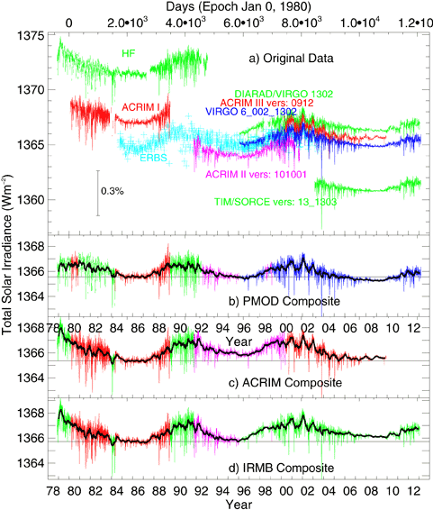
Total Solar Irradiance
Notes:
• The TSI is a basic and very precise proxy
• So far as we can tell, the low-frequency variations are entirely due to solar activity
• There is a difference of opinion about minimum-to-minimum variation
• The measurements are absolute, and only empirically calibrated between instruments
• SORCE, with the best TSI measures, is not taking data now
Courtesy PMOD, Davos Dorf

Slide 15
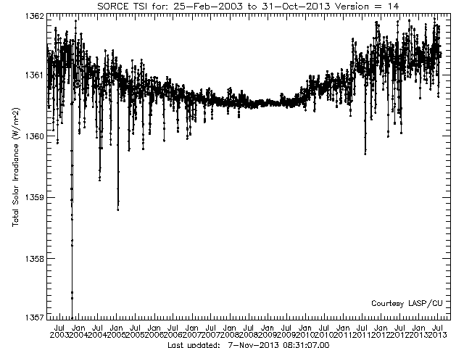
The SORCE/TIM Record
• Spots, faculae, and network contribute
• The “dips” differ systematically across 23/24
• The minimum is flat (convection dominates)
• Data residuals are expressed in ppm

Slide 16
Total Solar Irradiance
• Discrepancies of 0.04% per decade
• 1/KH time for convection zone 0.03%

Slide 17
TSI as a proxy
• TSI (and spectral irradiance) can be measured
quite precisely, relative to other proxies
• TSI is related to B in a highly non-linear and model-dependent manner that is only understood empirically.
- At solar maximum, faculae/network dominates
- In other stars it’s the opposite – the spots dominate
• Irradiance is not luminosity

Slide 18
What are the proxies proxies of?
• The “Sun-as-a-star” mean field
• The photospheric magnetic field
• The heliospheric open flux
• The plasma Poynting flux

Slide 19
Sun-as-a-star field

Slide 20
Heliospheric open field
Owens & Lockwood 2012
• The open flux must be eliminated by reconnection beneath the Alfvenic critical point. The concept of “interchange reconnection” as an explanation for variations suffers from the standard 2D misconception
• Heliospheric open flux is not a fundamental property of solar interior dynamics

Slide 21
What about the dynamo?
• It would be very nice to have a proxy-based tool that could complement helioseismology in understanding solar interior dynamics
• No predictive theory of the cycle exists, and likewise no adequate theory of surface flux concentration (hence no guidance for the proxies)
• Nevertheless, we learn a great deal qualitatively from the statistical properties of stellar magnetic fields

Slide 22
A magnetic “k-ω diagram”: Eigenstates of the dynamo?
• Stenflo’s concept of a magnetic “k-ω diagram” should be the route to a tool for the use of magnetic proxies to probe the solar interior
• Imaging data is much better for this purpose (it incorporates “k”) but doesn’t extend so far in time (1/ω)
• See Stenflo & Güdel (1988) for a discussion

Slide 23
A Magnetic “k-ω Diagram”
Stenflo & Güdel 1988

Slide 24
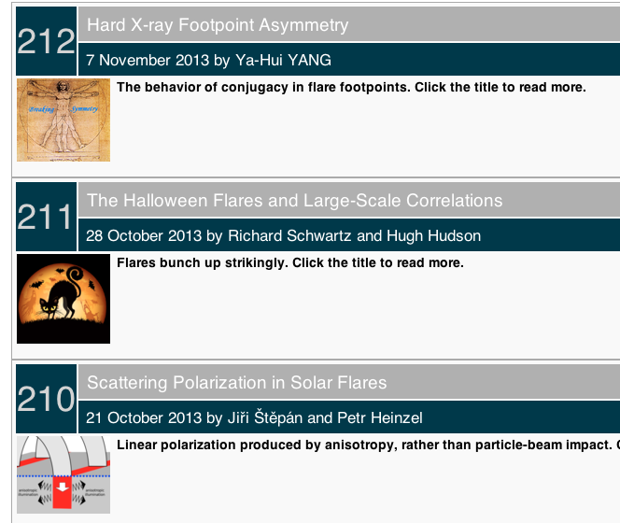
Flare occurrence as a proxy
http://sprg.ssl.berkeley.edu/~tohban/wiki/index.php/RHESSI_Science_Nuggets

Slide 25
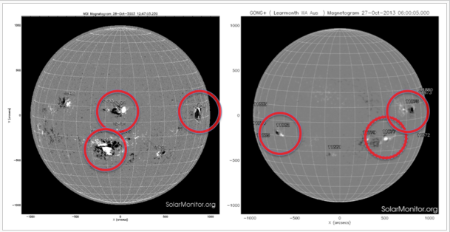
Flare occurrence as a proxy
October 2003
October 2013
http://sprg.ssl.berkeley.edu/~tohban/wiki/index.php/RHESSI_Science_Nuggets

Slide 26
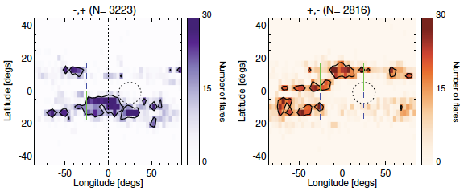
Flare occurrence as a proxy
Svalgaard et al. 2011
• RHESSI flares occur at “Hale Sector” boundaries
• It’s a striking effect; ask Leif to explain

Slide 27
Flare occurrence as a proxy: RHESSI flare longitudes

Slide 28
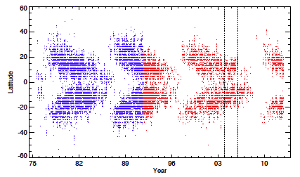
Flare occurrence as a proxy: Flare productivity
• M,X flare count per (M,X) region
Hudson et al., 2013

Slide 29
Flare occurrence as a proxy: The Poynting flux as an objective
• Active regions, and flares, appear where “magnetic flux emergence” happens
• In physics language, this means “where there are concentrations of plasma Poynting flux”
• Flares can precisely locate the result of the most intense of these concentrations

Slide 30
Conclusions
Some of the proxies are quite precise
All are related in complicated ways to the magnetic flux at the solar surface, and in no case do we have adequate physical understanding
The space-age data can, in principle, characterize the magnetic k-ω diagram usefully
The plasma Poynting flux may also be a useful target for the interpretation of proxy data

