Slide 1
Geomagnetic effects of flare radiations: SFEs
Hugh S. Hudson
U of Glasgow, UC Berkeley, WKU

Slide 2
Synopsis
I’ve been working with the geomagnetic data obtained at the Glasgow teaching observatory
SFEs (crochets) have caught my interest!
An unusual SFE: MNRAS 532, 3120–3125 (2024)
Calibrting the Carrington event
Goal at ISSI: learn more about atmospheric currents driven externally

Slide 3
What is an SFE?
“Solar Flare Effect”, a.k.a. “ crochet”
First example in the Carrington event
Three days in September 1859 via the earliest recording magnetometer

Slide 4
The basic idea
Solar hard radiation increases the ionization in Earth’s atmosphere
Dynamo action via high-altitude winds drive transient currents
Ground-based magnetometers observe deflections
The Earth’s atmosphere and the resulting current systems are complicated!

Slide 5
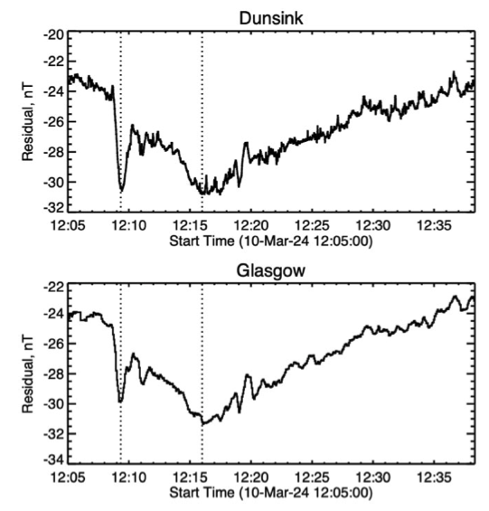
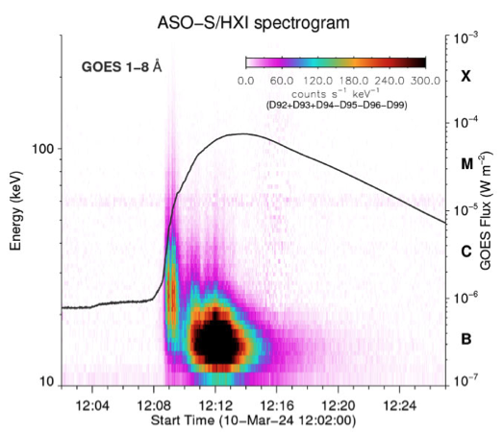
SOL2024-03-10 and an SFE
• A strong SFE from an M7 flare: about 7 nT
• An unusual early-impulsive spike

Slide 6
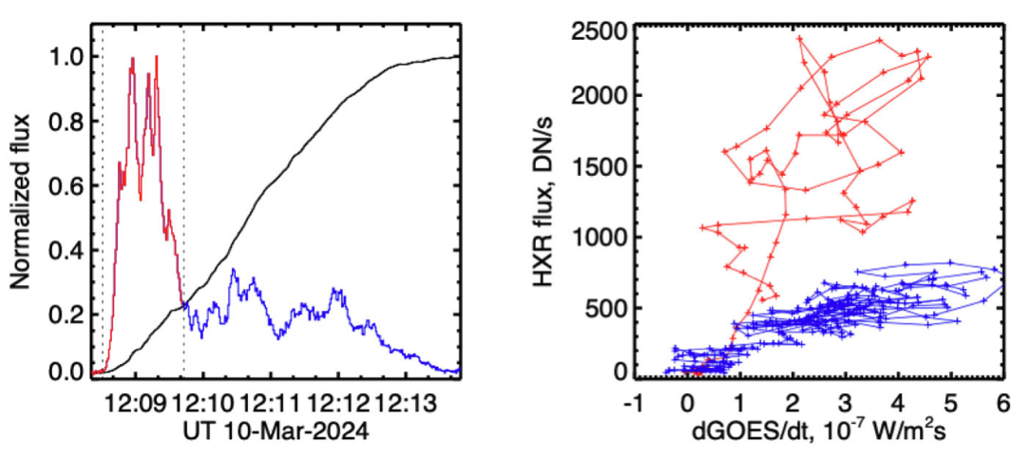
Neupert-effect complications
30 keV
1-8 Å
• “Early-impulsive” flare
• Short time scales
• The troposphere?

Slide 7
SFE physics
The SFE current system is reputed look like Sq, but it has a very different spatial and temporal pattern.
Geomagnetic sampling of SFE currents is complete (the Intermagnet array) but inherently low-resolution (~100 km).
There may be chemistry.
My naïve question: Do SFEs involve FACs?

Slide 8
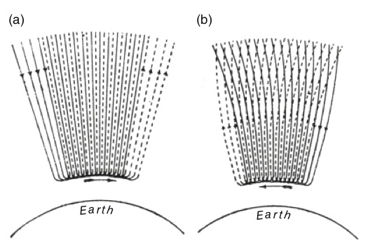
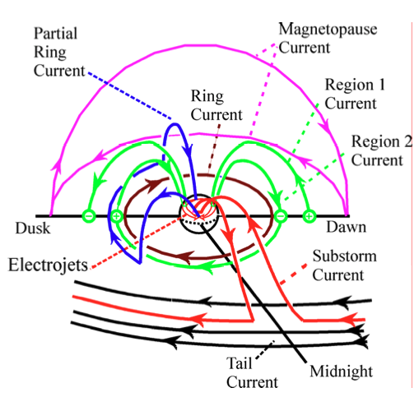
Field-aligned currents, FACs (Birkeland currents)
Birkeland 19th century?
McPherron 21st century

Slide 9
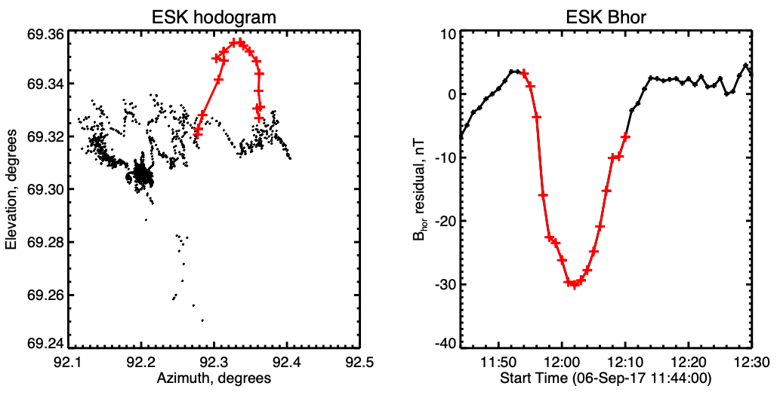
Hodograms
• Biot-Savart says that a compass deflection
(azimuth here, or geomagnetic “declination” )
hints at a vertical current (Birkeland)
• But this may be ambiguous

Slide 10
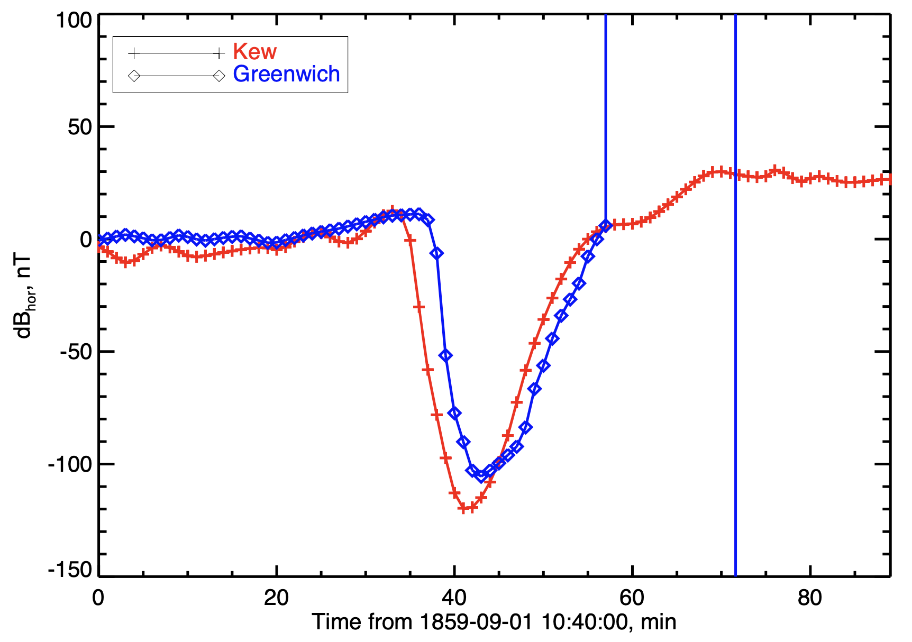
Useful application of SFEs
The Carrington event had a well-observed SFE, with two sites (Kew and Greenwich)
• SOL1859-09-01 (X???)
• Recent digitizations by
Beggan et al. (2024)
• A 10% measure, but what
about systematic errors?

Slide 11
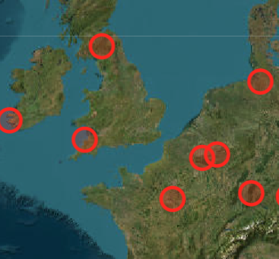
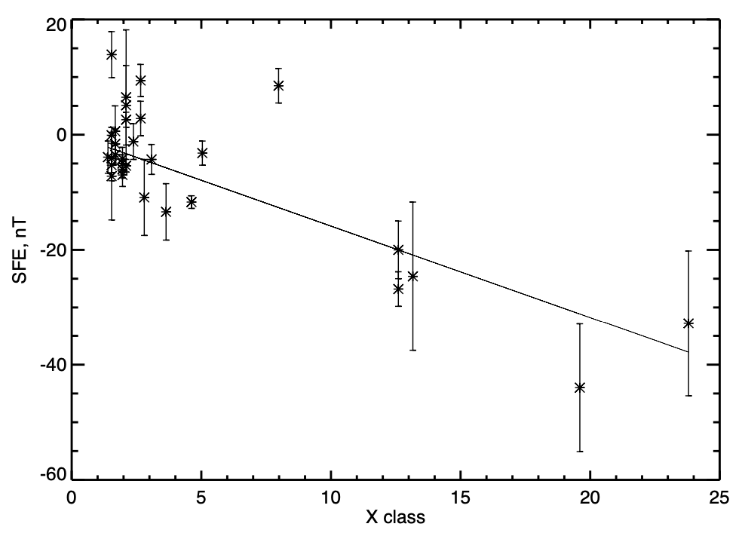
Intermagnet near Kew/Greenwich
• The Hartland site (HAD, in the UK) is the
closest geographical counterpart
• Note that the sampling is not optimal
in the Nyquist sense
• HAD has observed about 40 X-class
flares near local noon

Slide 12
Conclusions
The geomagnetic field is really well measured, and a treasury for undgraduate lab work
There is probably a lot to learn from SFEs
Improved data have let us “calibrate” the effective GOES class of the Carrington event (hint: it was a superflare, but not a superduperflare).

Slide 13
Prospectus: ISSI activities?
Systematic study of GOES Lyα vs SXR contributions to SFEs: SFE physics
Do SFEs have tropospheric or Birkeland currents?
General study of SFEs in Intermagnet data
- The existing literature is very weak
- There are some very clean events
- Toy models with the Biot-Savart law
- Summed-epoch analysis

