Slide 1
Solar Flares Observed in White Light and in the EUV
H. Hudson (SSL, UC Berkeley and U. of Glasgow)

Slide 2
Outline of Presentation
0) This will be an overview of flare research work in 2010-2012
SDO (launched February 2010) is producing spectacular new observations of solar flares, especially in conjunction with RHESSI and STEREO
A flare at the extreme limb allows a determination of the absolute height of the WLF/HXR sources (HMI)
There are several new results from EVE

Slide 3
Starting with HMI
This instrument, on SDO, obtains 6-point spectroheliograms at high spectral resolution and 45-s sampling
The data are continuous since launch (Feb. 2010)
The observations, similar to those of MDI on SOHO, use the line profile to infer continuum intensity as well as Doppler and Zeeman modifications of the specific line: a Fe I line at 6173.34 Å
This instrument is a wonderful gift to research on white-light flares, because at last we have systematic imaging spectroscopy at high resolution (but, only 45-s cadence)

Slide 4
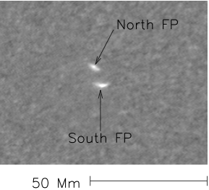
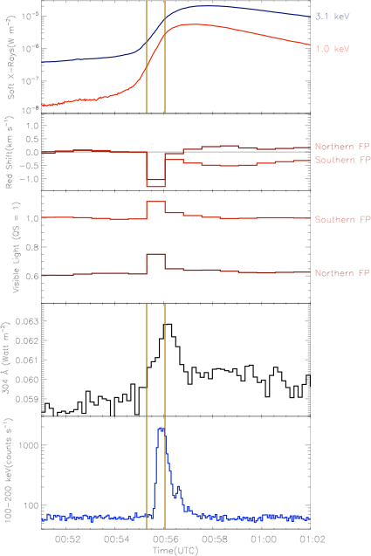
HMI, EVE, RHESSI
GOES
HMI Doppler
HMI Intensity
EVE 304 Å
Observations from Martínez-Oliveros et al. 2011.
EVE shows impulsive emission in
He II 304 Å
RHESSI
SOL2010-06-12 white-light flare

Slide 5
Why study white-light flares?
To “Follow the energy:” to be visible at all, the white-light continuum must contain a dominant amount of a flare’s energy
To understand the mechanisms of the flare impulsive phase
Hard X-rays (>50 keV) and soft X-rays (few keV)
Illustrating the
Impulsive phase and gradual phase

Slide 6
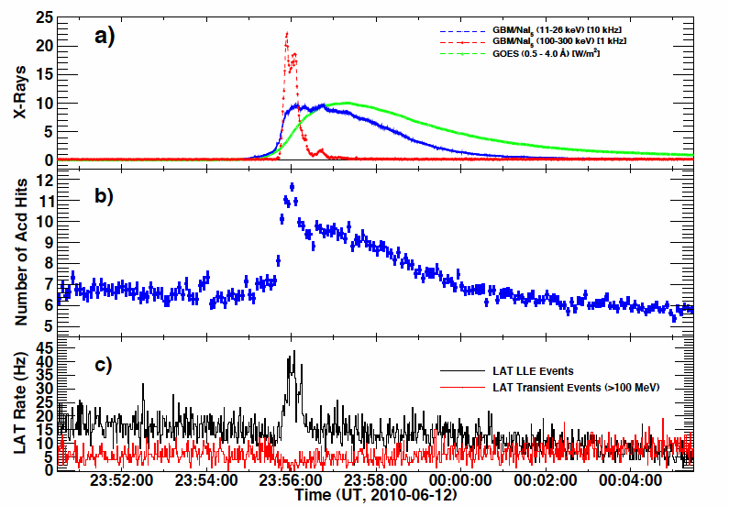
SOL2010-06-12 γ-ray flare
10-50 keV?
~100 MeV photons!
Ackermann et al, 2011

Slide 7
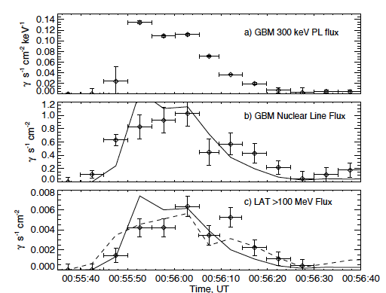
SOL2010-06-12 Timing
Ackermann et al, 2011

Slide 8
Comments on SOL2010-06-24
This simple M-class flare produced strong γ-ray emission, as detected by Fermi/LAT
Otherwise, it seemed to be a classical WL/HXR event, but now with excellent spatial registration and full imaging spectroscopy
One of the key new questions regarding such events is the problem of momentum conservation in the excitation of interior acoustic disturbances (“sunquakes,” alas not detected in this event)
The few-sec timing discrepancy between >300 keV and >100 MeV supports the Shih et al. finding from RHESSI: these particle populations are strongly associated

Slide 9
SOL2011-02-24 Limb Flare
Martínez-Oliveros et al, ApJ 753, 26 (2012)
First high-resolution analysis of WLF and HXR in a limb flare, with STEREO location
First direct determination of source heights, thanks to STEREO
WLF and HXR source centroids match within small uncertainties
There are puzzling results for source absolute heights

Slide 10
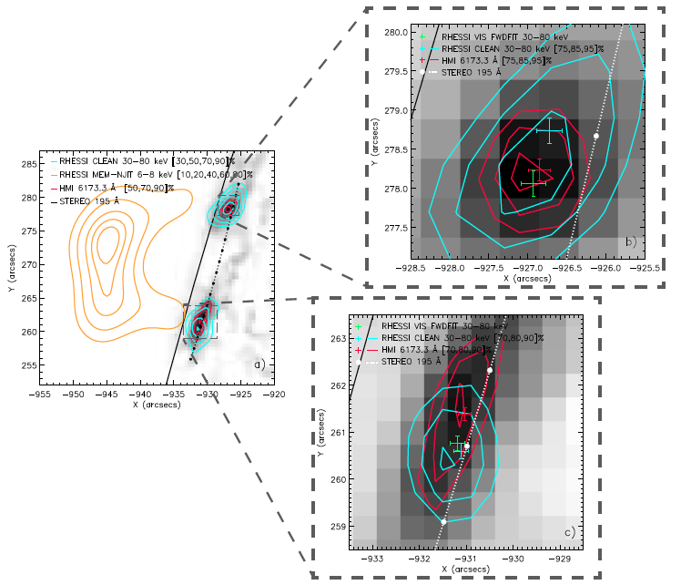

Slide 11
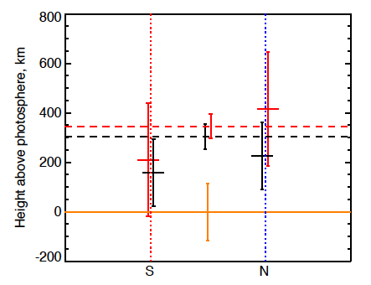
Abstract view of error estimates
Red, HXR; black, WLF; Heights for τ = 1
Limb inferred via
STEREO image
Footpoints

Slide 12
Comments on SOL2011-02-24
In favorable conditions, RHESSI and HMI can obtain sub-arc-s positioning*
In even more favorable conditions, STEREO can tell us exactly where the flare was in heliographic coordinates
For this first favorable example, we draw two conclusions
(1) the WLF/HXR source centroids match
(2) the source heights are near the level estimated for τ = 1 at each wavelength
• The HXR result is inconsistent with thick-target beam penetration in any simple model of the atmosphere, and we presently have no explanation for this
• We are working on surveys via HMI and RHESSI
*radial coordinate

Slide 13
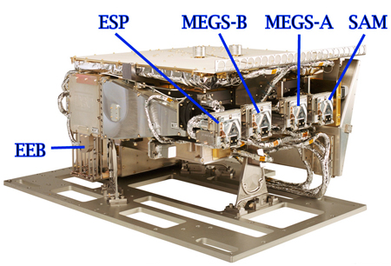
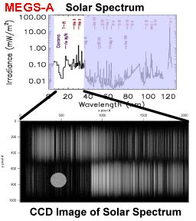
EVE on SDO
• EVE aims at characterizing the solar EUV spectrum as a well-calibrated spectral irradiance
• Although not designed for flare research, it is making the first well-sampled EUV spectra of the Sun as a star
The EVE experiment
Example of MEGS-A data

Slide 14
Why is EVE important?
Its MEGS open new domains in parameter
space, from which we can discover new things
about flares, in addition the irradiance goals
Spatial resolution X Sun-as-a-star
Spectral resolution Δ 1 Å
Time sampling O 10 s
Spectral range Δ MEGS-A 64-370 Å plus
• SNR O > 100 @ He II 304 Å
• Calibration O

Slide 15
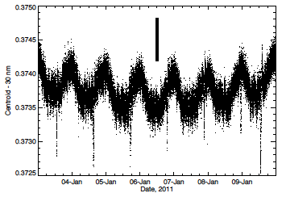
EVE: Doppler shifts
+−3 km/s
• The EVE MEGS-A has great stability and excellent sensitivity
• Flare Doppler signals are also detectable
• There is some position sensitivity
From Hudson et al. 2011. With only 1 Å resolution, but <0.01 Å random error (@10 s), EVE clearly resolves SDO’s orbital Doppler shifts

Slide 16
HMI, EVE, RHESSI
GOES
HMI Doppler
HMI Intensity
EVE 304 Å
Observations from Martínez-Oliveros et al. 2011.
EVE shows impulsive emission in
He II 304 Å
RHESSI
SOL2010-06-12 white-light flare

Slide 17
EVE: The Fe Cascade
• EVE shows many ionization states of Fe (IX – XXIV here)
• The CME-related dimmings are easy to spot
• Low Fe states (as well as He II etc) are impulsive

Slide 18
EVE: A new flare phase?
• Woods et al., ApJ 739, 59 (2011)
• The EUVLP contains comparable EVE total energy
• Is this Svestka’s “giant arches” rediscovered?

Slide 19
EVE: A new flare phase (II)
“Fe Cascade” view

Slide 20
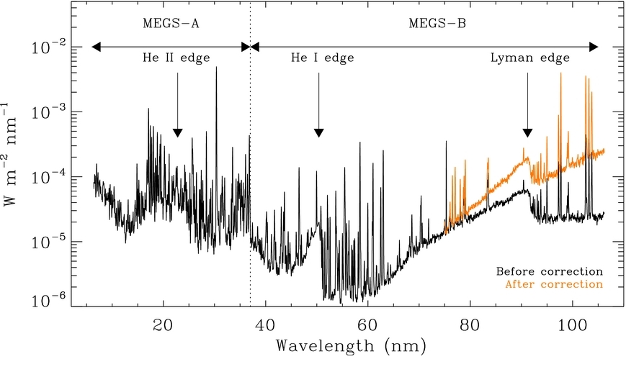
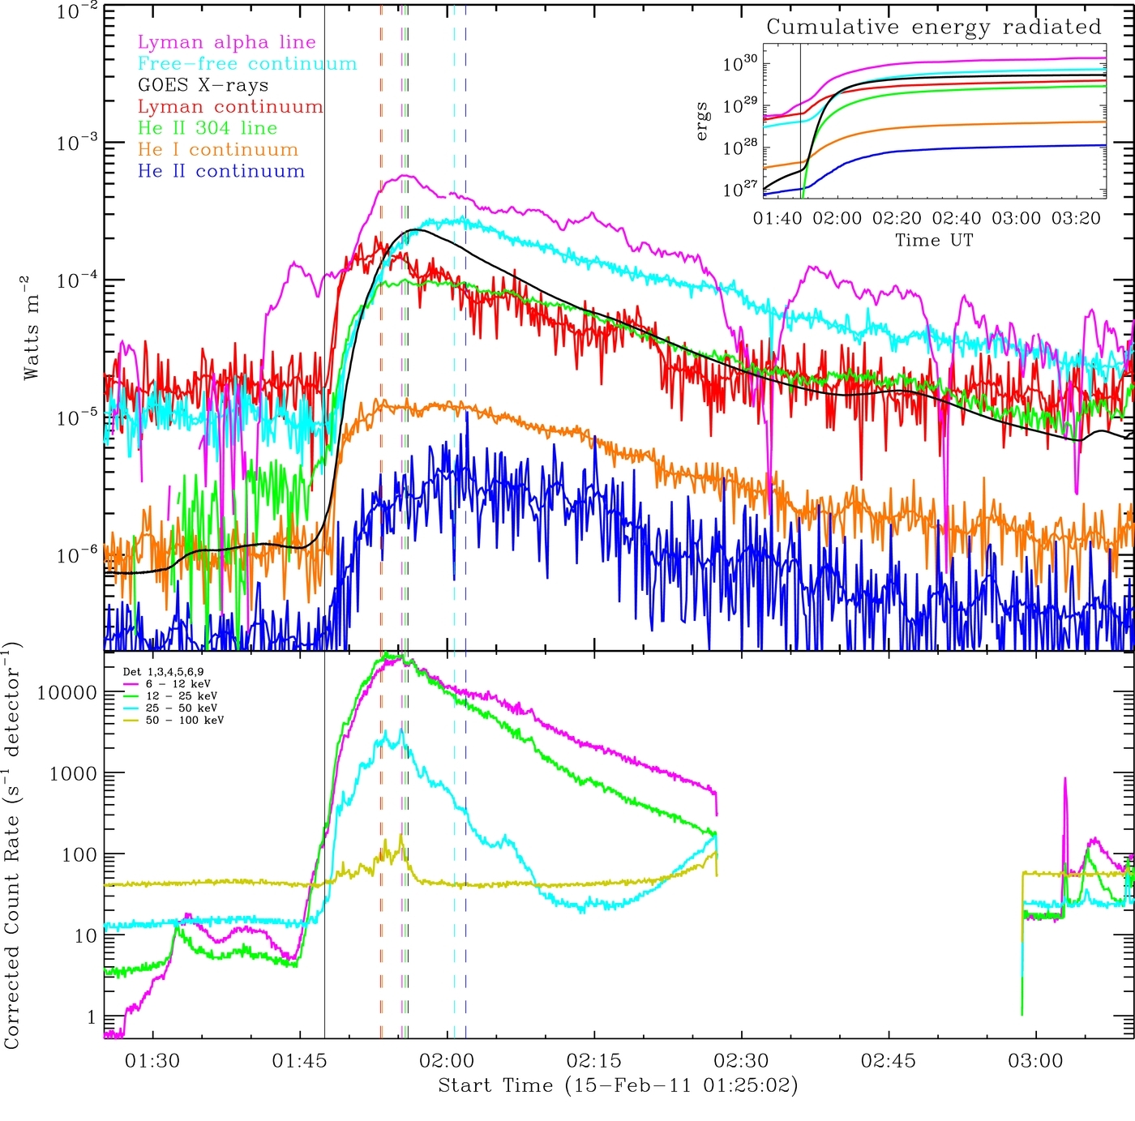
EUV Continua and Energy Budget
• Energy partition in EUV/SXR continuum contributions for
flare/CME SOL2011-02-15T01:56 (X2.2)
• Movie on Milligan et al., ApJL 748, 14, 2012

Slide 21
EUV Continua in Context
• Spectral energy distributions, νf_{ν} = λf_{λ}, for SOL2011-02-15
• Blue lines show EVE He I and He II continua
• Gold line shows free-free continuum from hot plasma
• Red dashed line shows 10,000 K blackbody
• Right, same with quiet Sun spectrum, with dotted line showing blackbody at 5,280 K

Slide 22
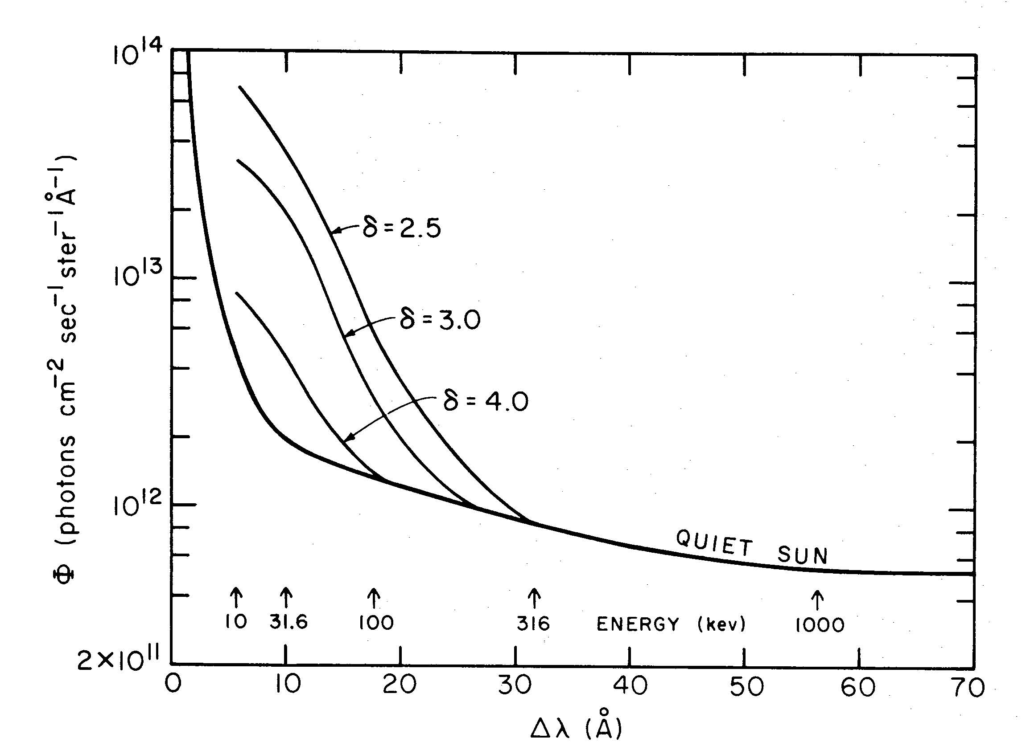
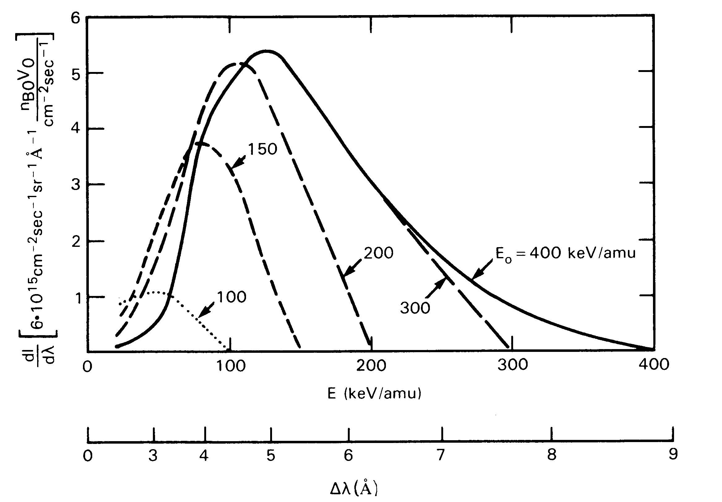
Remote sensing of accelerated particles
Orrall & Zirker (1976), for hydrogen
Peter et al. (1990), for helium
• Accelerated particles penetrating a neutral atmosphere can charge-exchange and emit Doppler-shifted radiation
• Detection would be a boon, because we would have a remote-sensing technique for ions, which only weakly emit bremsstrahlung and for which the γ-ray threshold energies are high
• Searches thus far have been ambiguous but limited

Slide 23
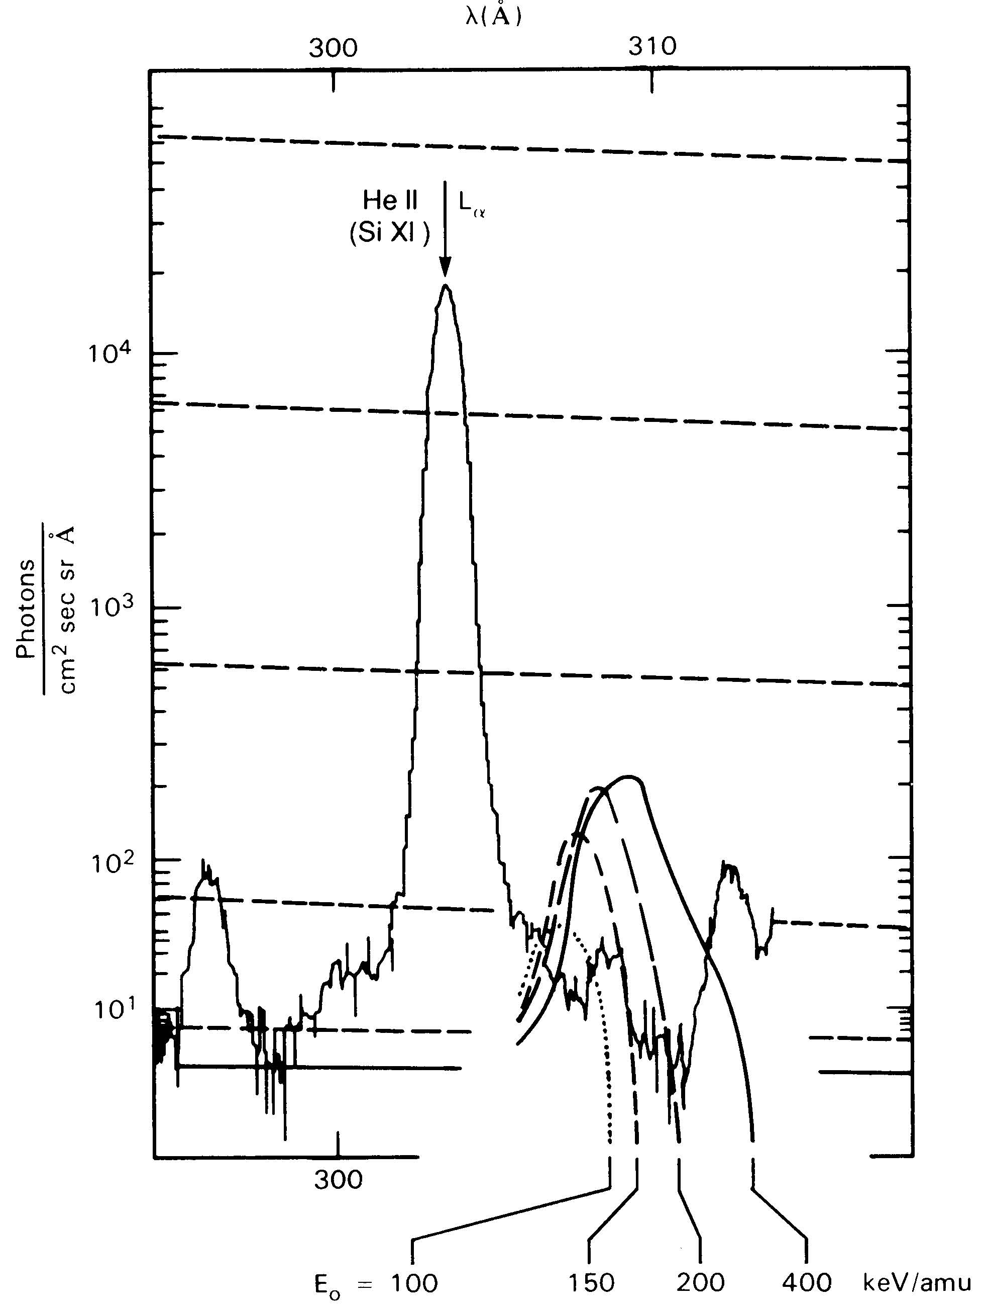
Charge-exchange signatures: EVE
Peter et al. (1990) expectation
EVE realization: 8 major flares, no bright 304 Å wings whatsoever. The plots show difference spectra and have no hint of broaden wing emission

Slide 24
Conclusions
The EVE spectroscopy adds a new dimension to flare research
The MEGS-A spectra are precise and have stable calibrations
The results thus far extend our knowledge of flare energetics, now including the behavior of the EUV continuum
There is a clear and novel view of CME-related coronal dimming
The spectra do not show the Orrall-Zirker effect in He II Ly-α
Some of the flare literature thus far:
Martinez-Oliveros et al., SoPh 269, 269 (2011)
Hudson et al., SoPh 273, 69 (2011)
Woods et al., ApJ 739, 59 (2011)
Raftery et al,, ApJ 743, 27 (2011)
Chamberlin et al., SoPh 279, 23 (2012)
Reale et al., ApJ 746, 18 (2012)
Milligan et al., ApJL 748, 14, (2012)
Hudson et al. ApJ 752, 84 (2012)
Hock et al., arXiv1202.4819H (2012)
Milligan et al., ApJ 755, 16 (2012)

