Slide 1
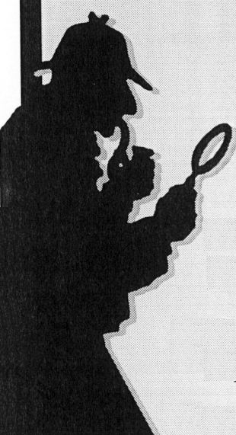
I have been studying EVE
H. S. Hudson
Space Sciences Laboratory, University of California, Berkeley, USA
Astronomy & Astrophysics Group, Glasgow

Slide 2
Motivation: global spectrum
WLF
THz
EUV
Hudson et al. 2009

Slide 3
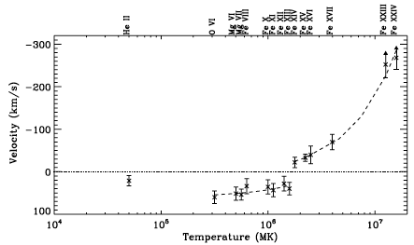
More motivation
Milligan & Dennis 2009

Slide 4
Still more motivation
Kowalski et al. 2010

Slide 5
…and yet more motivation
Peter et al.1990

Slide 6
Flare SOL2010-06-12T00:57
Martinez-Oliveros et al. 2011

Slide 7
Flare SOL2010-06-12T00:57
Martinez-Oliveros et al. 2011
Eve 304A

Slide 8
Sun-as-a-star EUV tools
SOHO/SEM: broad EUV band at 30.4+-4 nm
SDO/EVE MEGS-A: far-UV, 1 A resolution, 10 s cadence (data available)
SDO/EVE MEGS-B: near-UV, 1 A resolution, 10 s cadence (to be released in a week or so)
SDO/EVE ESP (broad EUV bands, 0.25 s cadence)

Slide 9
Line detail, total and subtracted
Flare vs preflare
Impulsive vs gradual

Slide 10
Doppler shift?

Slide 11
EVE 304A for SOL2010-06-12T00:57

Slide 12
Calibration 0.0006 nm => 0.0006/30.4 c or about 6 km/s

Slide 13
Calibration 0.0006 nm => 0.0006/30.4 c or about 6 km/s Amazing!

Slide 14
304 time series, one day

Slide 15
Flux and Doppler, one day

Slide 16
EVE 304 narrow vs SEM

Slide 17
EVE 304 vs SEM, broad

Slide 18
EVE 304, SEM, EVE broad

Slide 19
Broad passband

Slide 20
Comments on EVE
Lots of lines to work with
He II spectrum in the impulsive phase (can see Ly-β and a hint of Ly-γ in SOL2010-06-12)
Need bigger flares
Looking forward to near UV (out to 1500A, I think) as a part of WLF characterization

Slide 21
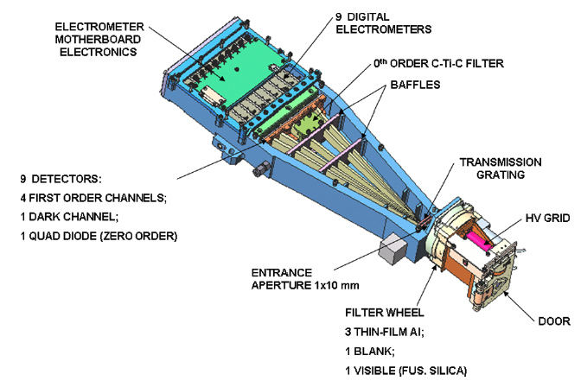
EVE ESP and SOL2010-06-12

Slide 22
ESP 304A for SOL2010-11-06

Slide 23
EVE 304 narrow vs SEM

Slide 24
Conclusions
The SDO data for the Sun “as a star” are rather fine
There are many applications of these data
- Global flare spectra
- Doppler shifts / flare dynamics
- Charge-exchange components
- Seismology (classical)
- Seismology (coronal)

