Slide 1
In HOPE, is dT/dt interesting?
Hugh S. Hudson
U of Glasgow, UC Berkeley, WKU

Slide 2
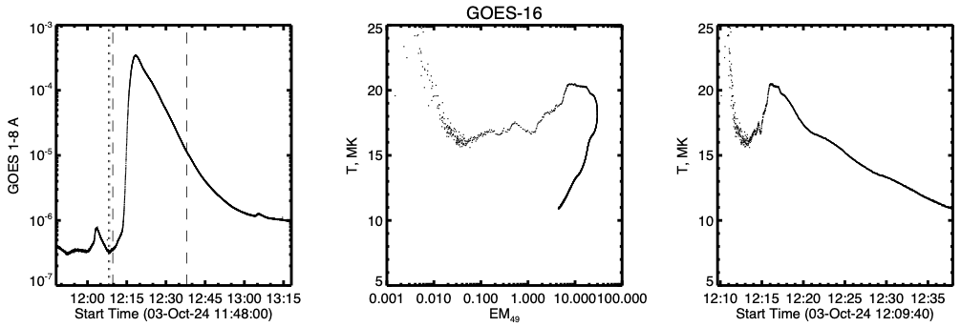
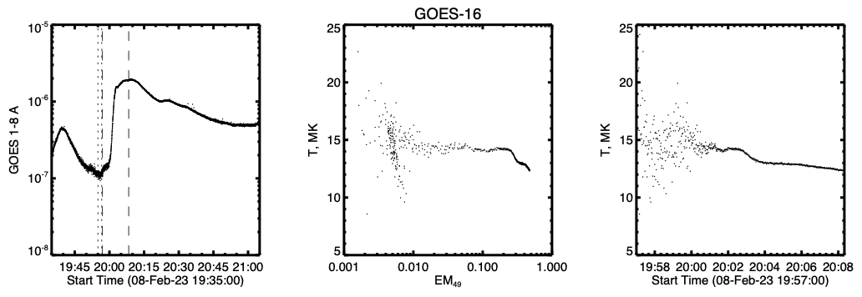
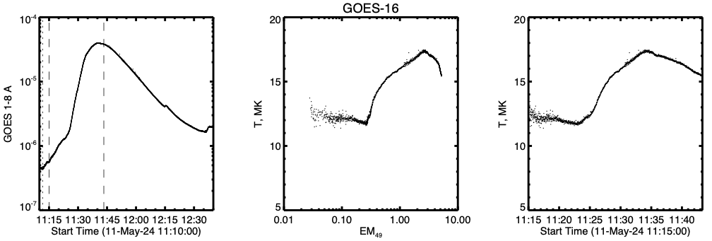
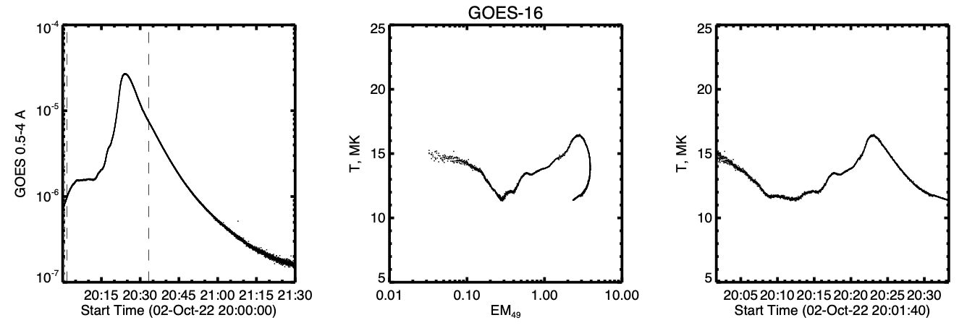
The central panels here show the [DEM, T] correlations
for the most recent four examples I’ve looked at:
• The precursor invariably shows a “horizontal
branch” in which T remains roughly constant
• For minor events, this hot onset can be hotter
than the flare itself
• We do not know yet if this property extends to
“Hyder events” (purely filament eruption)

Slide 3
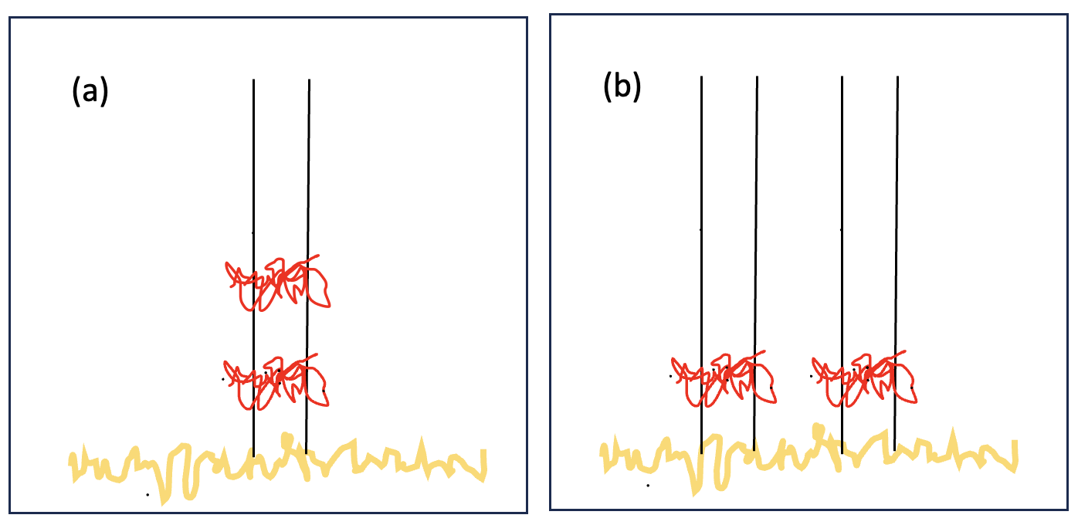
Sun-as-a-star limitations
Monolithic
Filamentary
• Note that this dichotomy applies to all astronomical observations

Slide 4
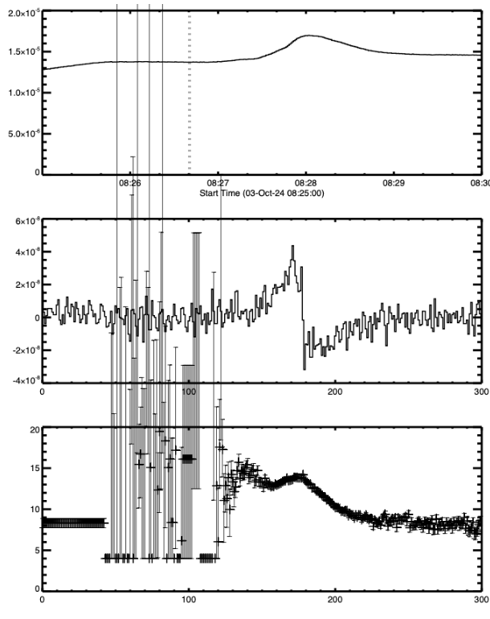
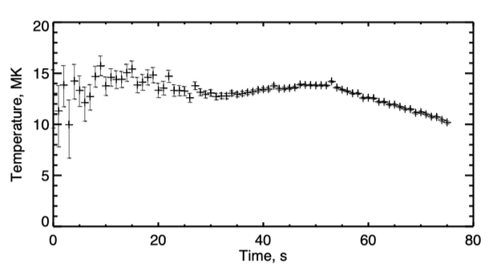
How to fit?
Fast event SOL2024-10-03T08
(M1.5, ”feels-like” class C4)
Possible models
• Heaviside function?
• Ramp up + level?
• Flare fast-rise/slow-decay?

