Slide 1
Hard X-ray Diagnostics of Solar Eruptions
H. Hudson
SSL, UC Berkeley and
U. Of Glasgow

Slide 2
Background information
Meter-wave radio phenomena require (types I-V etc.) require non-thermal electrons.
These also emit X-ray bremsstrahlung, but not very efficiently (~10⁻⁵).
With the X-rays, we can study energetics more directly.
Limb occultation, plus imagers on Yohkoh and RHESSI have greatly expanded our knowledge.
See Krucker et al., A&A Rev 16, 155 (2008) for full details.

Slide 3
History I
March 30, 1969 occultation event (OSO-5; Frost & Dennis 1971)
Two occultation events observed by OSO-7 (Hudson 1978; Hudson et al. 1982)
Direct imaging: Hinotori May 13, 1981
Stereoscopic observations: Kane, 1983
CME significance: Kiplinger 1995
Moving coronal source: Hudson et al. 2001
RHESSI: Krucker et al., A&A Rev 16, 155 (2008) for full details of many events

Slide 4
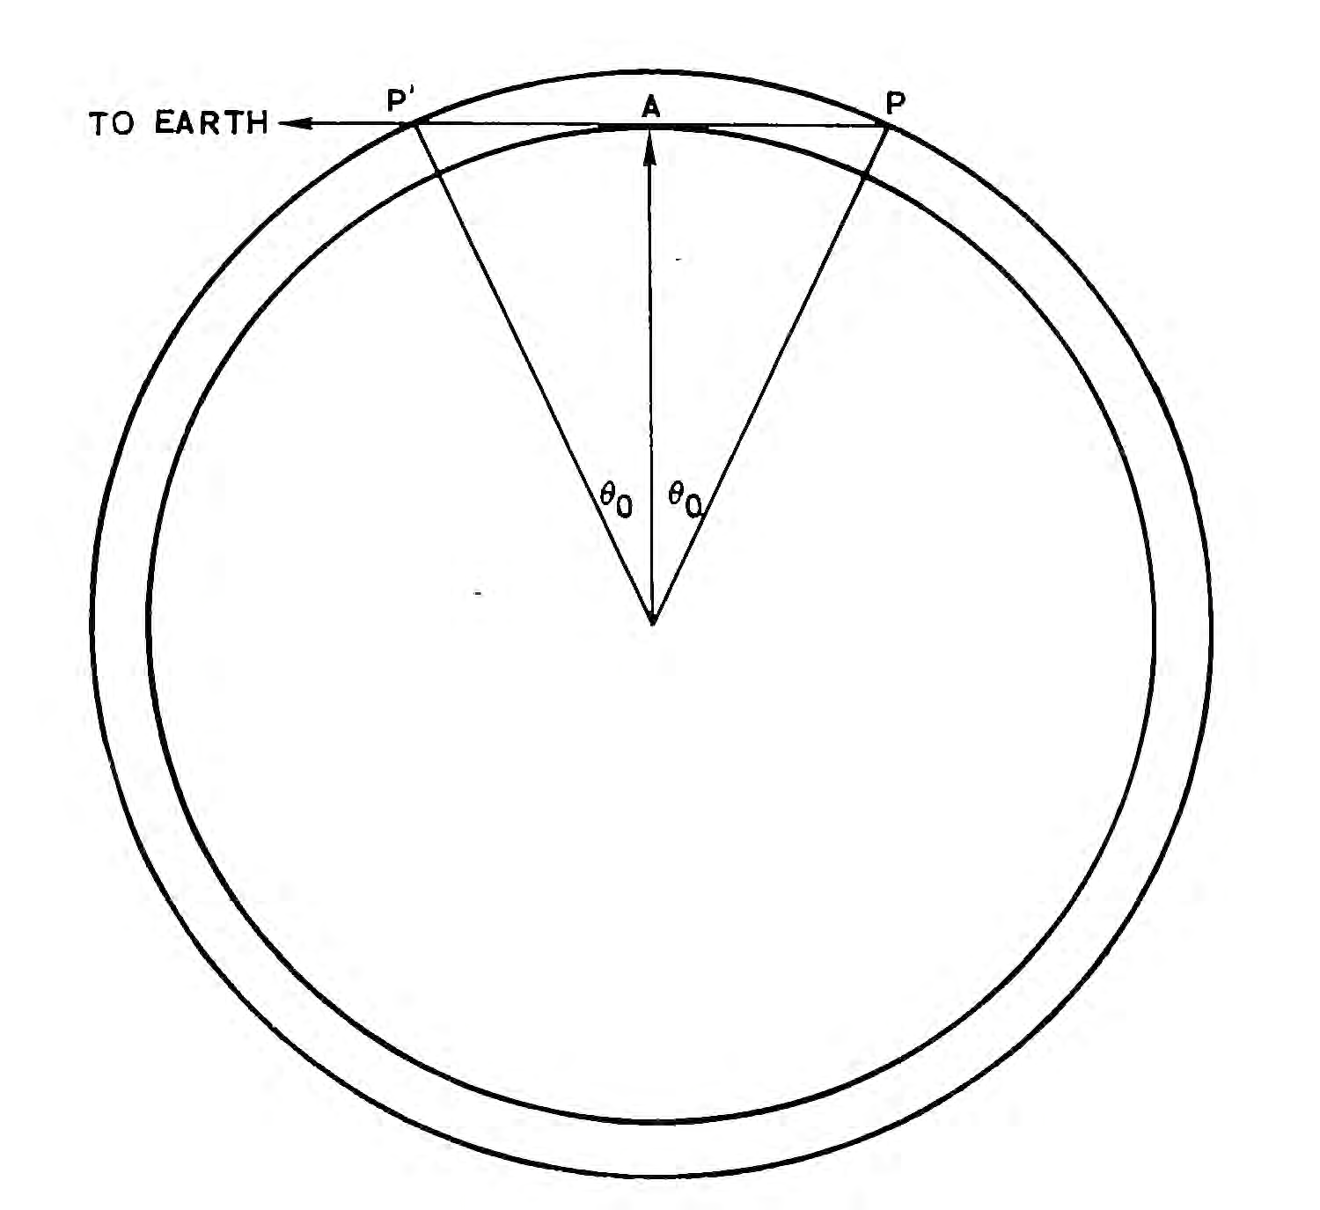
Limb occultation
SOL1969-03-31
McKenzie, 1975

Slide 5
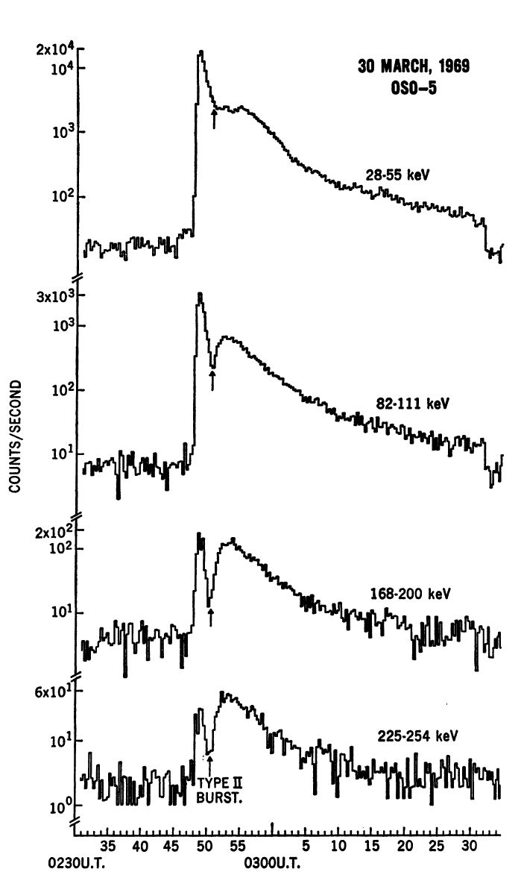
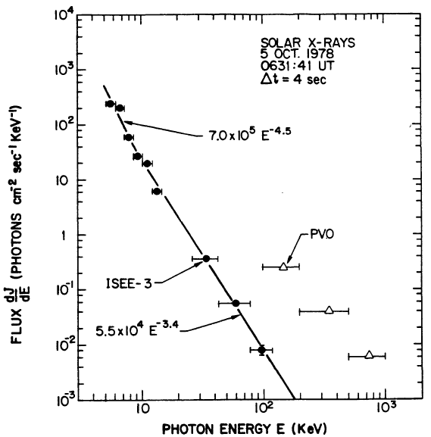
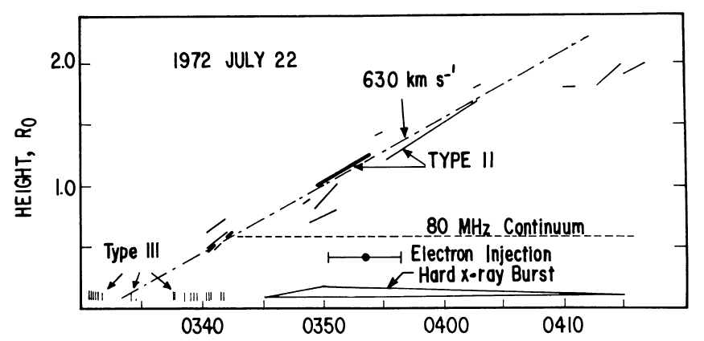
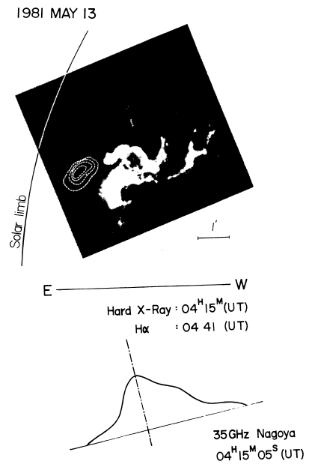
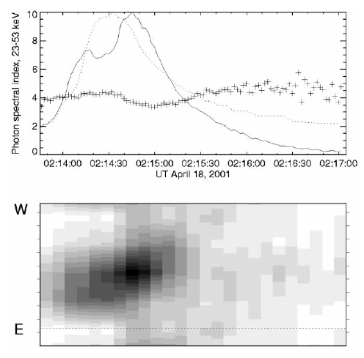
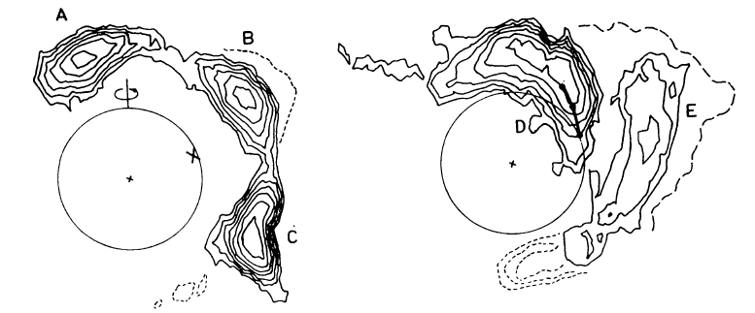
History II
Hudson et al. 1978
Kane 1983
Frost & Dennis 1971
Palmer & Smerd 1972
Kawabata et al. 1983
Hudson et al. 2001

Slide 6
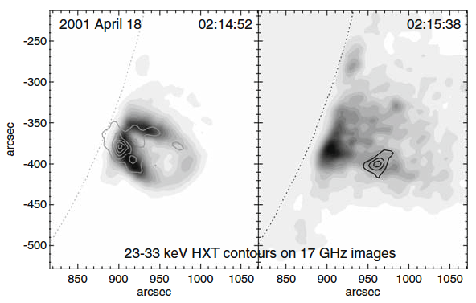
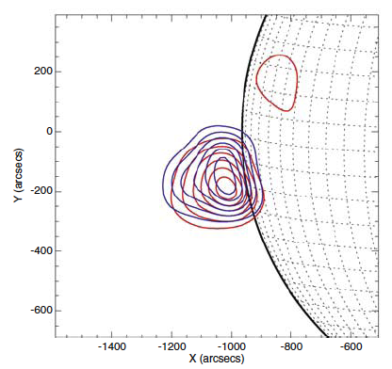
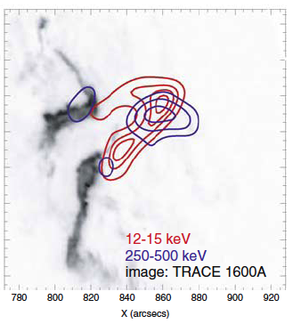
Coronal Hard X-ray Sources
SOL2000-04-18: Yohkoh/SXT observation, 23-33 keV, occultation height ~88 Mm. For this event one could infer that the non-thermal pressure dominated the core plasma pressure (Hudson et al. 2001).
SOL2002-10-27: RHESSI observation, 10-30 keV, occultation height ~100 Mm (Krucker et al. 2007). This event was also see on-disk from a Mars perspective.
SOL2005-02-20: RHESSI observation, 250-500 keV, height ~40 Mm (Krucker et al. 2008). With RHESSI imaging one does not absolutely need the accident of occultation since we can just use projection to get a crude altitude. These high photon energies are remarkable and imply a highly non-thermal plasma inclusion in the corona.

Slide 7
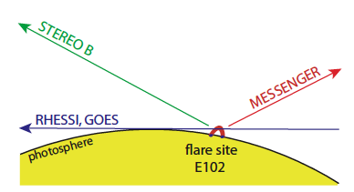
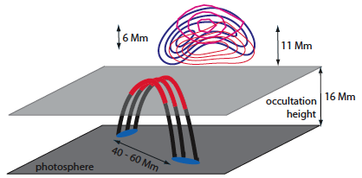
RHESSI Occultation Event
• Observations of SOL2007-12-31 reported by Krucker et al. (2010).
• Thin-target bremsstrahlung observations require rapid heating:
dT/dt = 4.5 n₉⁻¹ keV s⁻¹ .
• For the observed limit on ambient density, this source requires
dT/dt ~ 5 MK/s. This is faster than the Coulomb (e,p) relaxation can permit, and so there is no core thermal distribution for electrons in this plasma.

Slide 8
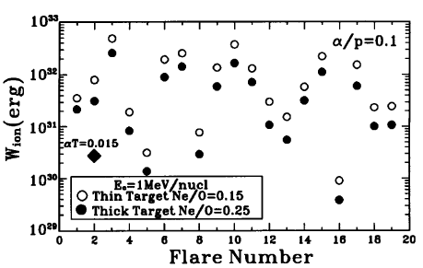
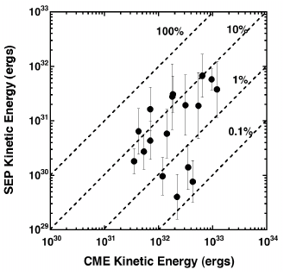
Particles and Energetics
Electron acceleration to >10 keV (to ~100 kT) dominates the impulsive-phase energy release (Kane & Donnelly, 1971; Brown, 1971; Hudson, 1972; Lin & Hudson, 1976).
SEP protons may contain 10% of the total flare energy (Mewaldt et al., 2008).
Ion energy in the impulsive phase may compare with electron energy (Ramaty et al. 1995).
Ramaty et al. 1995
Mewaldt et al. 2008

Slide 9
Action at a Distance
In resistive MHD models, Ohm’s Law imposes the requirement of local heating.
This is not what we observe! Particles can have enormous ranges, approaching the physical scale of the corona.
Models this superficial may be forced to resemble the data, but can never self-consistently describe the physical processes involved with any precision.
The several strong lines of evidence that particles contain important parts of the flare/CME energy – most of the impulsive-phase energy – means that we cannot ignore their property of “action at a distance”.

Slide 10
Conclusions
Highly accelerated non-thermal particles dominate the energetics of all phases of a solar flare.
The particles have long stopping ranges, and the energy they transport does not dissipate locally.
Flare theories and models need to account for this “action at a distance.”

Slide 11
Extra stuff

Slide 12
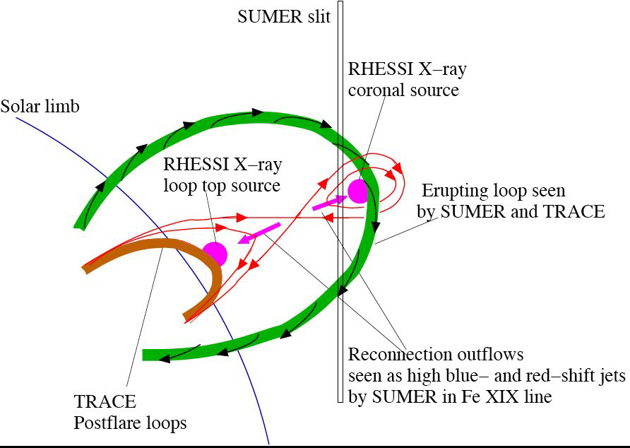
Courtesy Jiong Qiu

Slide 13
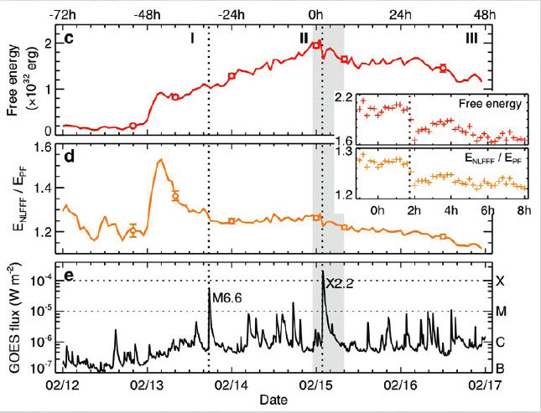
Sun, 2010

