Slide 1
Hot Onsets of Solar Flares: Significance and Utility
Hugh Hudson
UC Berkeley; Glasgow

Slide 2
History, implications, utility
• History: The effect had been noted many times in the past for individual events.
• Implications: We now see that it is a universal property of flares, so theory and modeling need to catch up.
• Utility: We can get advance notice about flare occurrence, helpful for scheduling observations (e.g., rocket launches).

Slide 3
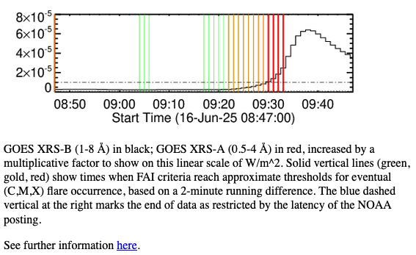
Utility

Slide 4
Flare precursor phenomena
Filament activation (the Skylab astronauts)
Pre-event microflares (Harrison cartoon)
Dm spike bursts
Preflare EUV dimmings
“Turbulent” line broadening (Harra)
Faint microwave emission (Van Hoven & Hurford 1984)
Global coronal shear flows
…
Hot onset precursors (Hudson et al. 2021, Silva et al. 2023, Battaglia et al. 2023, Telikicherla et al. 2024, Hudson 2025)… “HOPE”

Slide 5
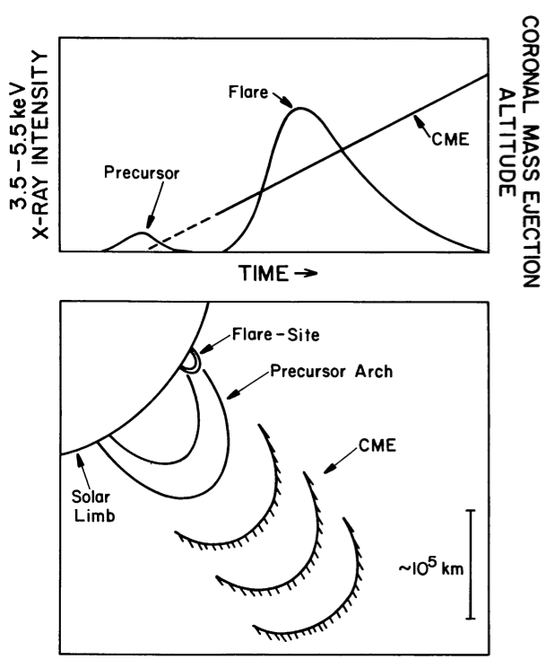
The most influential precursor cartoon
Harrison 1986
• Influential
• Frequently shown
• Quite misleading

Slide 6
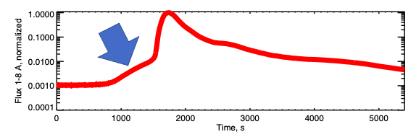
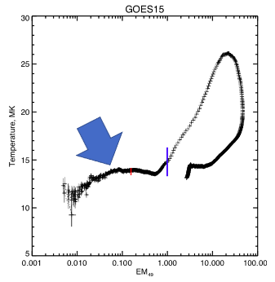
A slow HOPE
• SOL2011-08-09 (X6.9) has a
HOPE lasting for minutes
• The GOES T vs. GOES EM
“loopdeloop” plot has an
apparently smooth horizontal
branch.

Slide 7
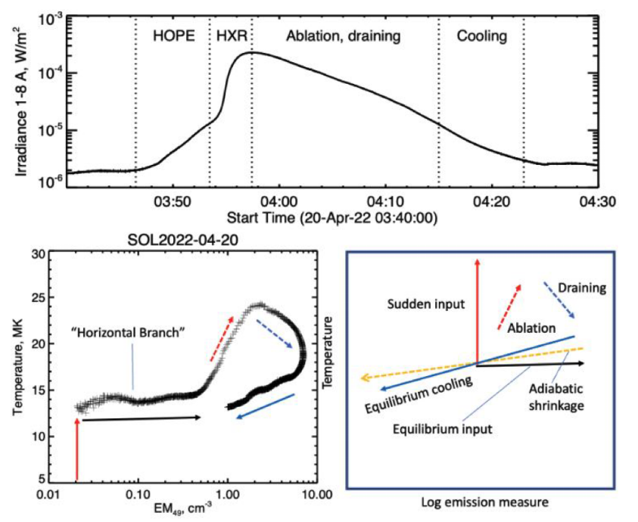
Description of the HOPE [Em, T] correlation trajectory

Slide 8
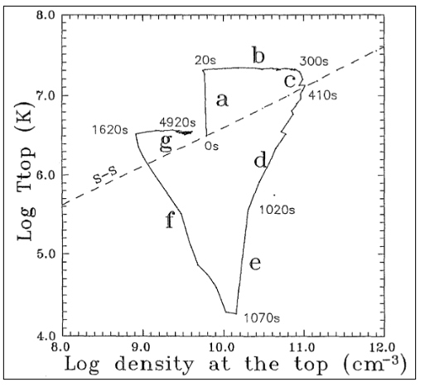
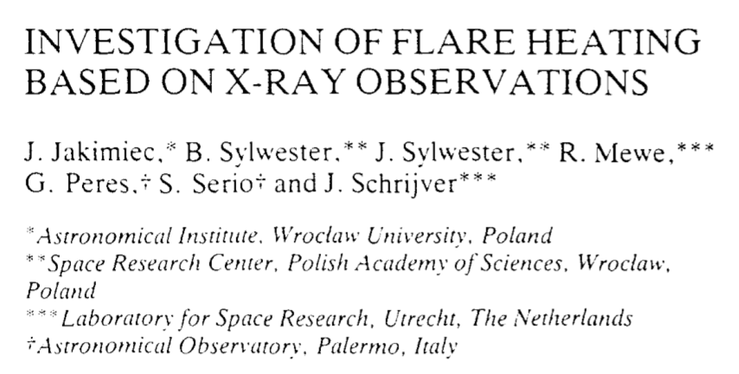
History of the [EM, T] graphic

Slide 9
About HOPEs
Virtually every flare shows this behavior
The initial temperatures (the “horizontal branch”) tend to be at 10-15 MK
The HOPE precedes the hard X-ray ”impulsive phase” (Kane) and represents different plasma physics
It is not “pre-heating”; we can’t measure dT/dt
It is not the Neupert effect

Slide 10
Deflagration wave?
The HOPE development is imperceptibly slow
Sound and Alfvén speeds imply much more rapid development
It has a regulated temperature
Deflagration wave?

Slide 11
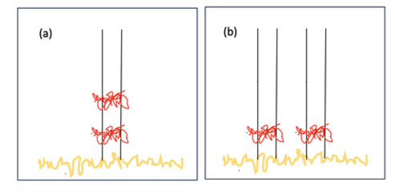
Deflagration wave
Monolithic. What controls T?
Deflagration. T related to medium?

Slide 12
Questions
• The HOPE phase is the energy buildup time
- why so brief an interval?
• HOPE represents the actual flare instability
- why not an Alfvénic time scale?
- why does the impulsive phase get all
the energy?
• Is this a Sweet-Parker phase?
- why does it proceed so rapidly?
• What regulates the plasma temperature?
• Is this a deflagration wave, reflecting domain
restructuring and flux transfer?
• Are there radio signatures?

Slide 13
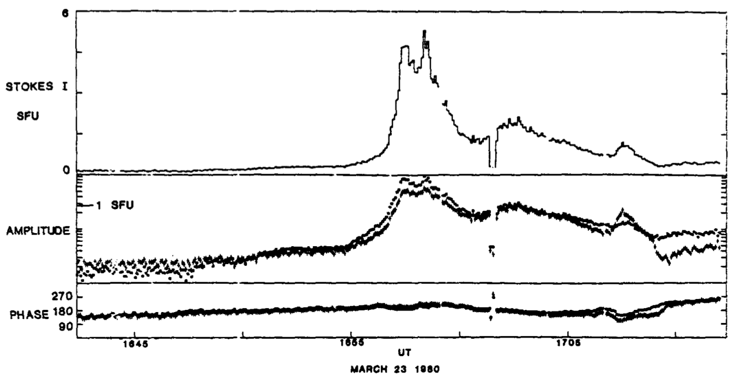
Some “radio HOPE” history
SOL1980-03-23 (C7)
10.6 GHz
Van Hoven & Hurford (1984)
• Interferometer sensitivity (better than 1 SFU!)
• Circular polarization diagnostics

Slide 14
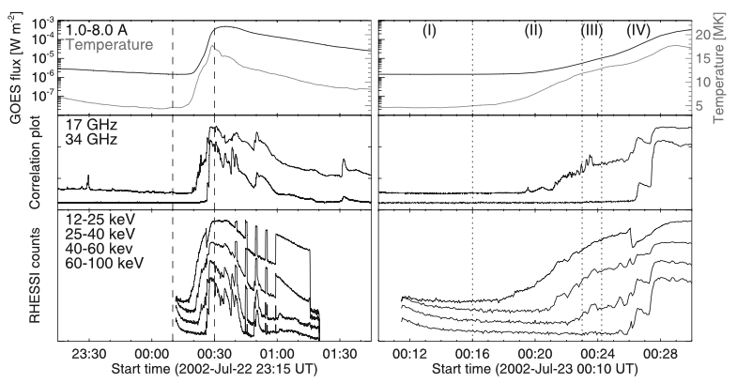
RHESSI and Nobeyama
Asai et al. 2006

Slide 15
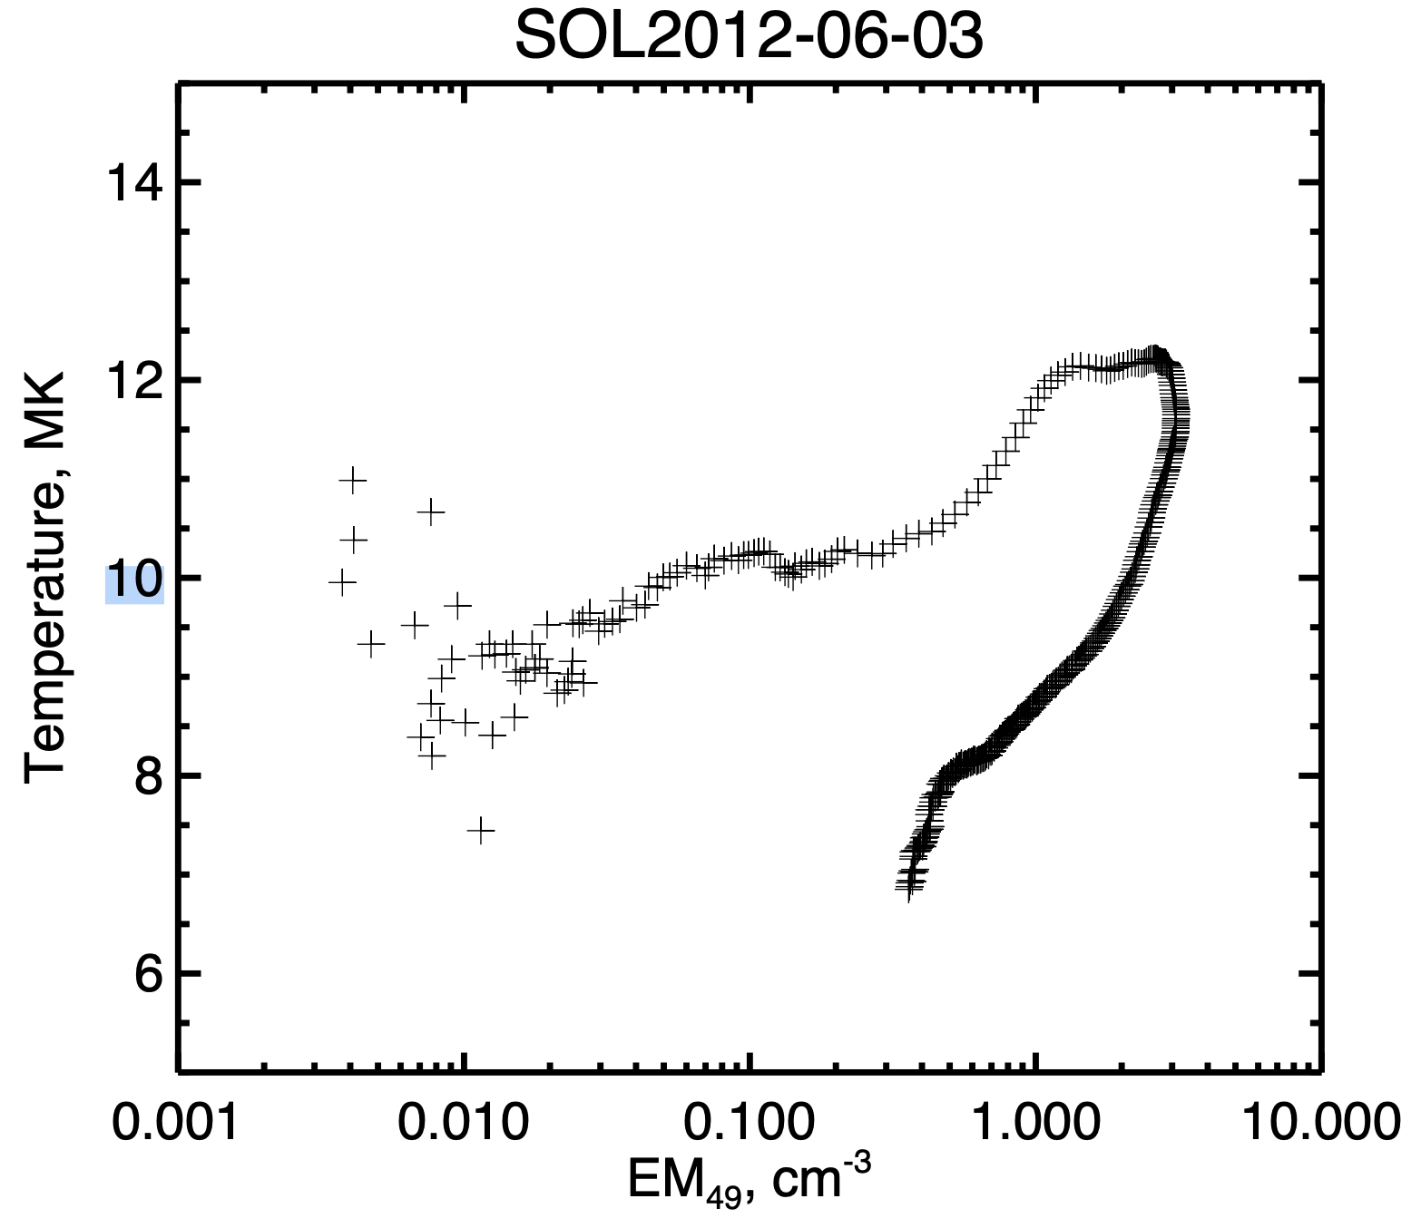
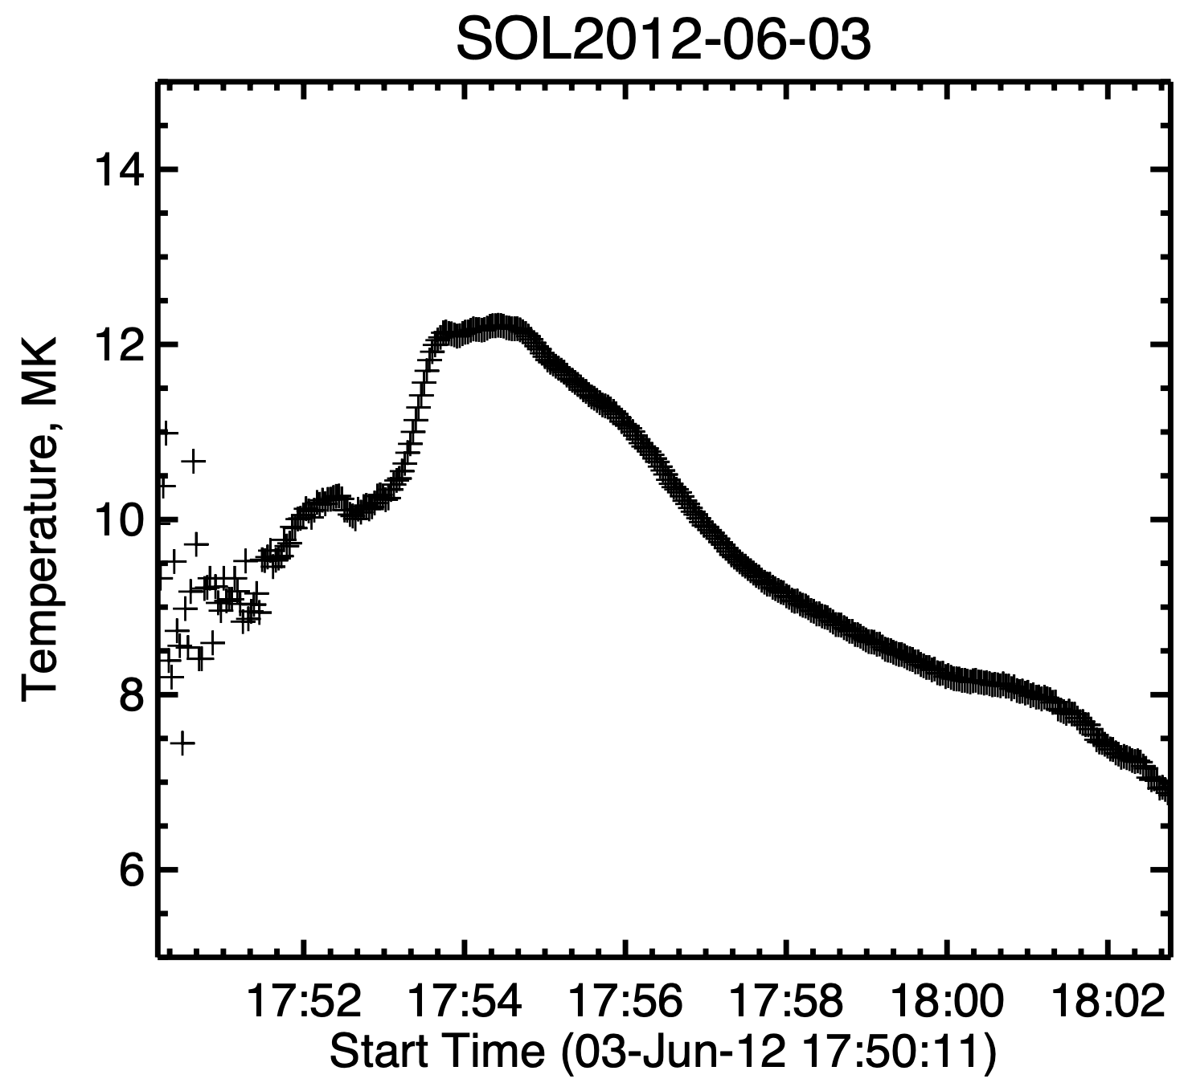
HOPEs at radio wavelengths
Correlation plot, GOES T vs EM
- Horizontal branch
- Neupert loop
Timeseries plot, GOES T vs time

Slide 16
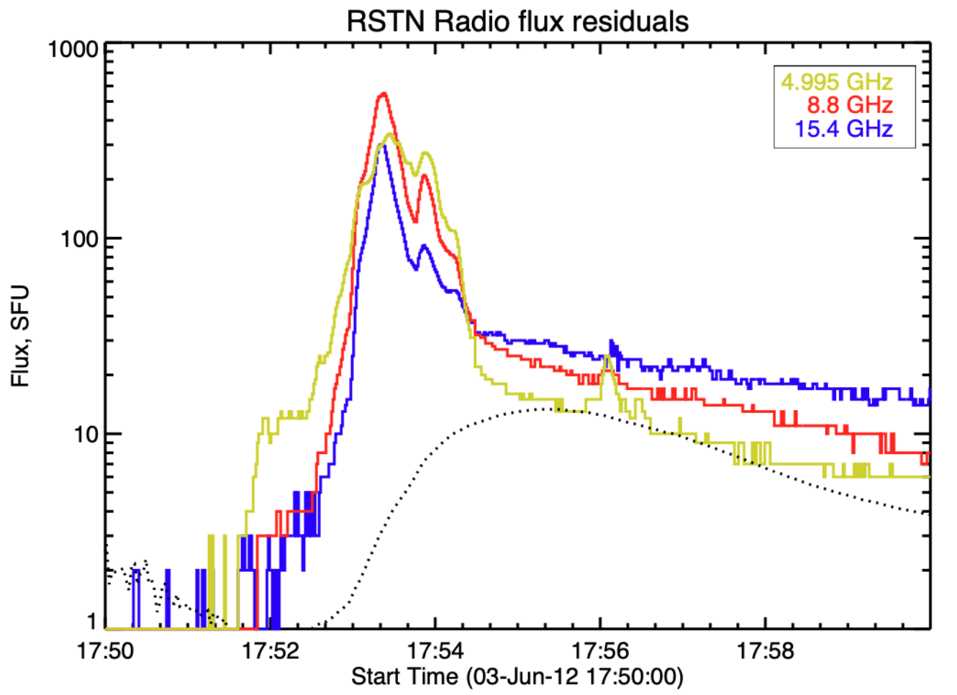
HOPEs at radio wavelengths
HOPE clearly detectable in RSTN data
- Far above free-free level
- High-frequency cutoff

Slide 17
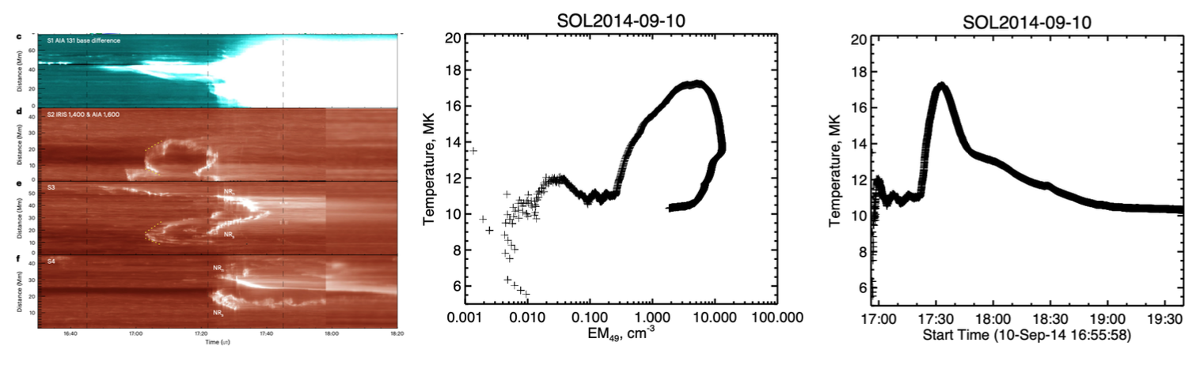
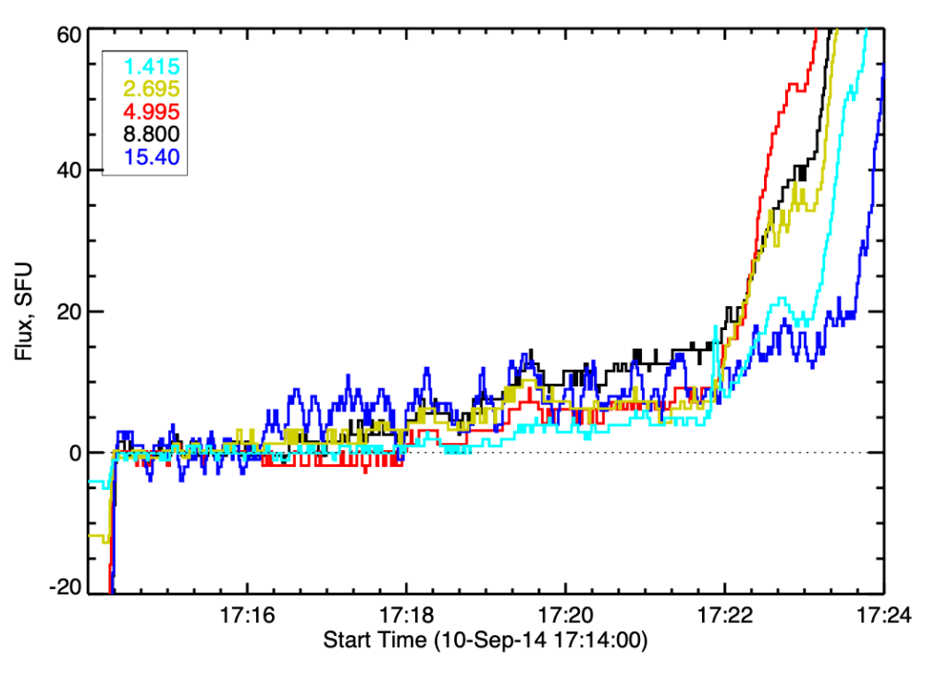
Another example
• SOL2014-09-10 IRIS observations
(Gou et al., 2023)
- note precursor dimming
• RSTN possibly to 15.4 GHz
• But this X1.8 flare is still marginal
via RSTN

Slide 18
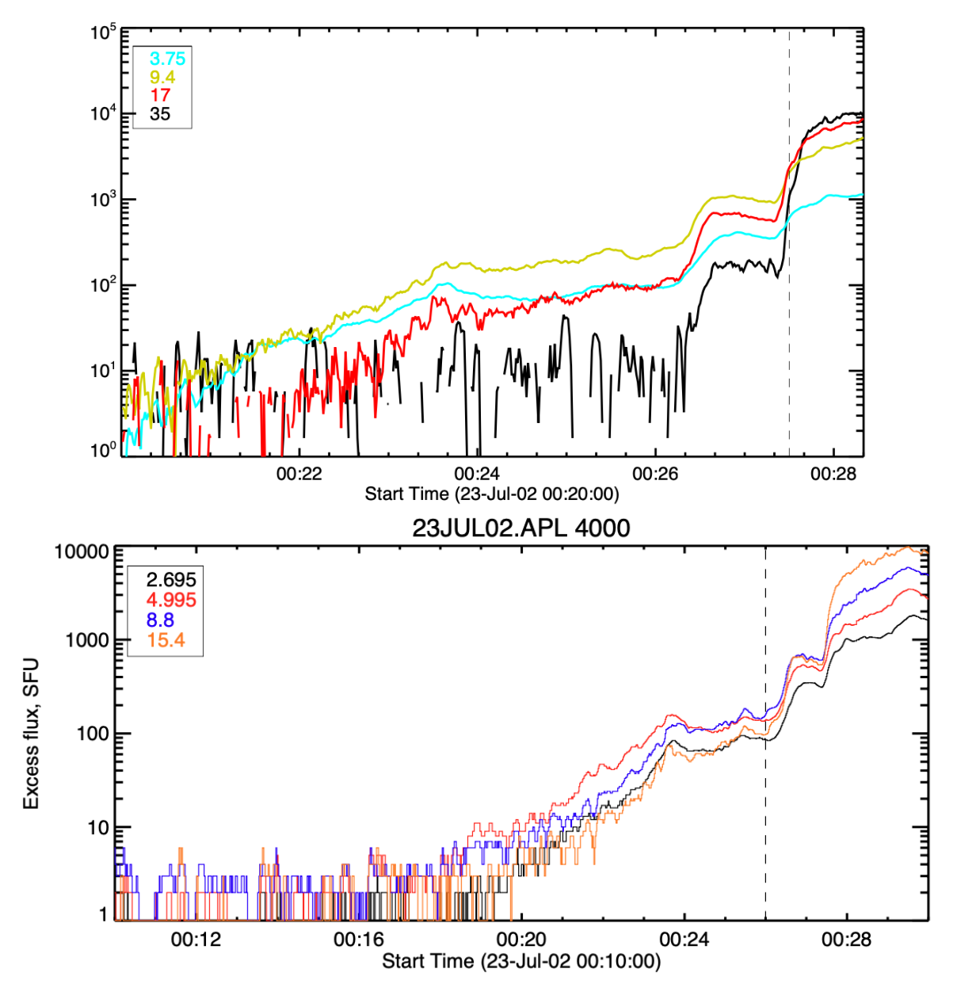
SOL2002-07-23 with NoRP

Slide 19
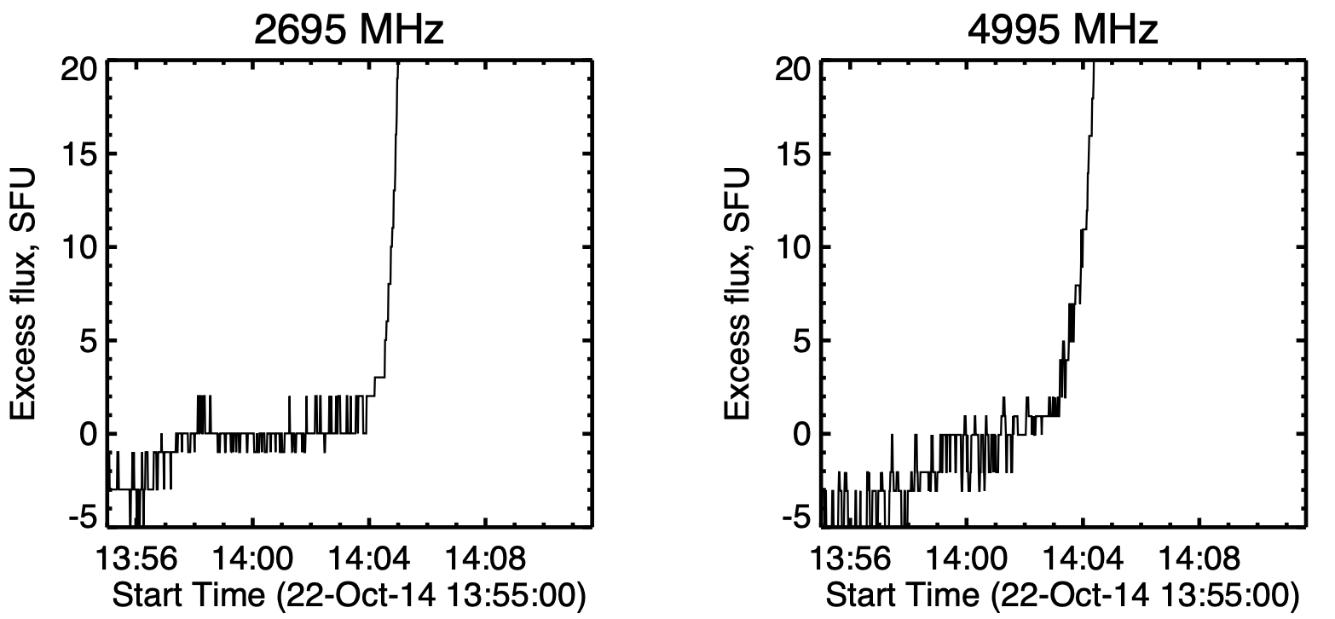
Yet another RSTN example

Slide 20
Survey of NoRP data: all X-class flares with Fermi HXR coverage
1 2 4 9 17 GHz
SOL2011-02-15T01:56 X2.2 01:47:00 01:44:00 - 2 - -3 - SFU
SOL2011-03-09T23:23 X1.5 23:19:00 23:17:00 - - 7 13 2
SOL2011-09-06T22:20 X2.1 22:16:00 22:12:00 1 2 - - -
SOL2011-09-07T22:38 X1.8 22:35:20 22:33:00 - - - 2 -
SOL2012-03-05T04:09 X1.1 chaos in all bands!
SOL2012-10-23T03:17 X1.8 03:15:00 03:10:00 - - - 2 25
SOL2013-05-14T01:11 X3.2 01:00:00 no rHOPE
SOL2013-05-15T01:48 X1.2 01:32:30 01:27:30 25 20 11 16 -
SOL2013-10-28T02:03 X1.0 no rHOPE
SOL2014-02-25T00:49 X4.9 00:41:00 00:36:00 - - 2 - -
SOL2014-10-19T05:03 X1.1 04:18:00 04:10:00 2 4 7 15 15
SOL2015-05-05T22:11 X2.7 22:07:00 no rHOPE
SOL2022-04-17T03:34 X1.1 03:22:30 no rHOPE
SOL2023-01-06T00:57 X1.2 00:55:00 no rHOPE

Slide 21
Survey Conclusions
rHOPE signatures do exist in the NoRP data: in our NoRP X-class sample, 4/13 hits
There is little evidence for coronal activity in the rHOPE phase, based on eCallisto

Slide 22
Radio HOPE mechanisms
• Free-free emission: far too bright
• Coherent radiation: mm waves unlikely
• Thermal gyroresonance: ditto
• Gyrosynchrotron: no HXR
We really have no idea!

Slide 23
The faint frontier
• Solar observations typically occupy the bright
end of any parameter space
• The HOPE development emphasizes the
faintest detectable variations
• In radio astronomy, one solar flux unit (SFU)
equals 10⁴ FU (10⁻²⁶ W/m²Hz)
• How far can we push the GOES XRS?

Slide 24
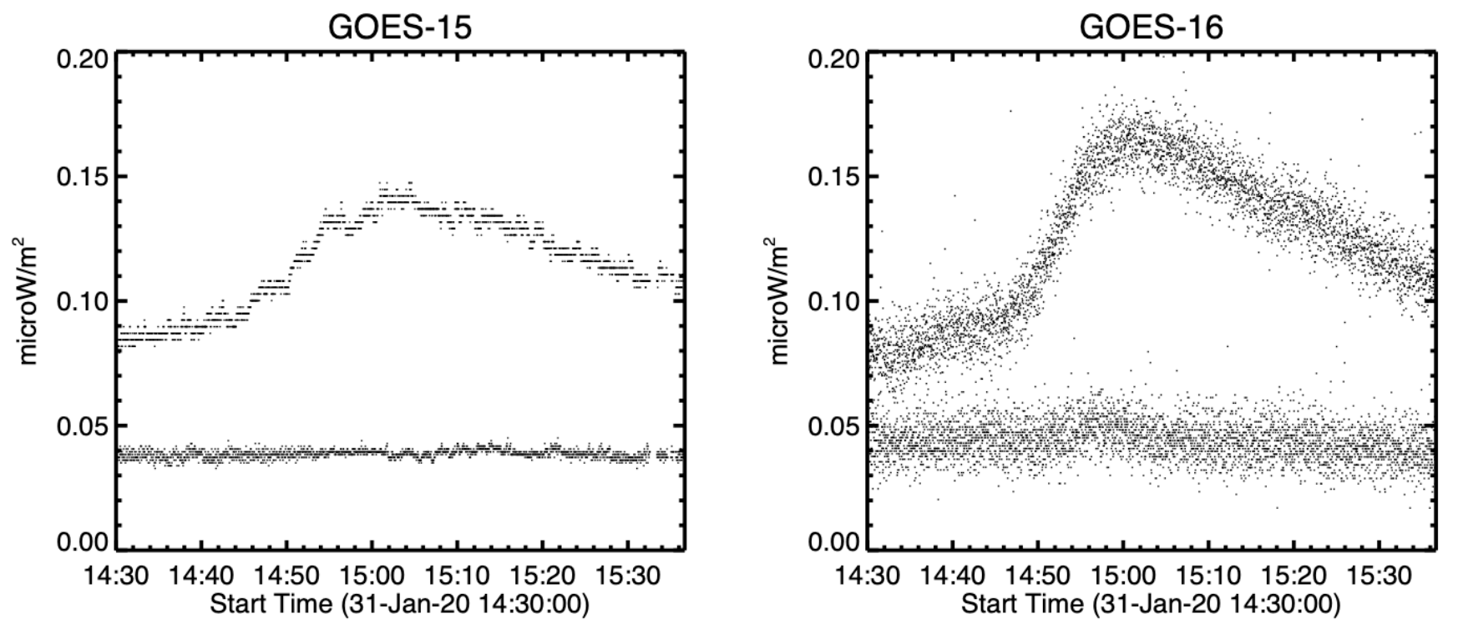
A faint flare
• GOES-R new technology from 2017
• This flare B1.6 but really it’s A9
• The new technology has

Slide 25
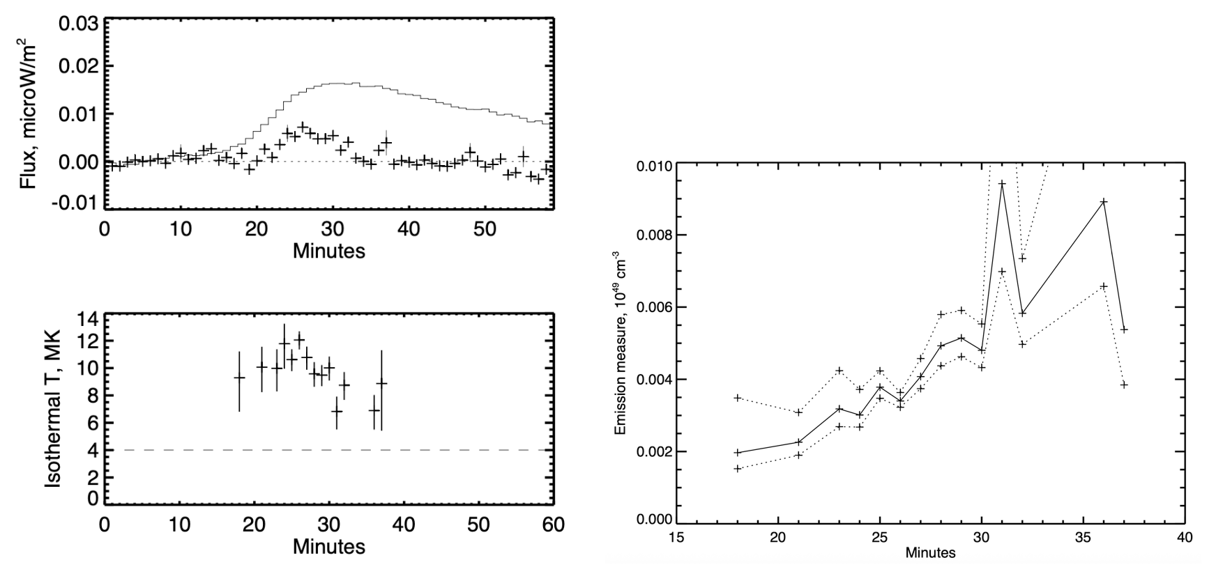
HOPE at GOES A class
• 1-minute averages in GOES-R data
with empirical errors: there is
HOPE in microflares

Slide 26
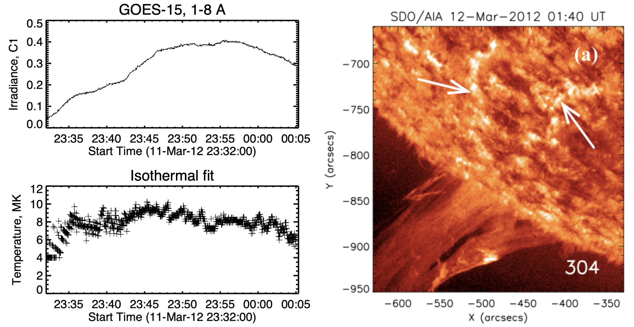
Is there HOPE in filament eruptions?
Su & van Ballegooijen 2012
(polar-crown “stealth” CME)
• Maybe. But one swallow…

Slide 27
Conclusions
HOPE is universal as seen in soft X-rays
It leads to a reliable flare “nowcast”, FAI
We don’t understand the HOPE physics
μwave emission is fairly common in major events
We haven’t identified the radio mechanism
• Generally, there is a broad landscape of unknown
parameter space in solar observation

