Slide 1
Comet SDO-1
H. Hudson

Slide 2
Comet SDO-1
First observation of a comet interacting in the corona – but no radio signatures
A comet interaction in the corona is an unprecedented plasma probe of this region

Slide 3
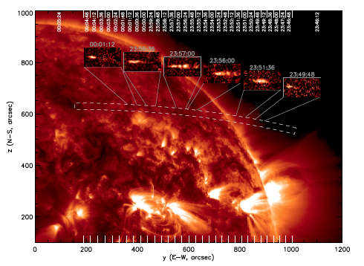
AIA 171 A Imaging

Slide 4
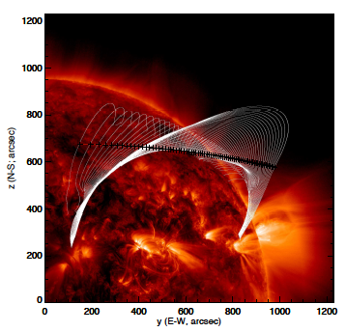
Coronal B field (PFSS)

Slide 5
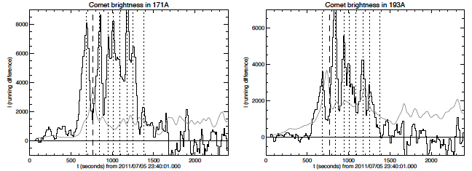
Comet brightness
• The comet was detected in all of the AIA passbands except for 304A
• In the plots above the gray line is 1% of the coronal background
• These passbands nominally show Fe ions, but we are not sure in this case

Slide 6
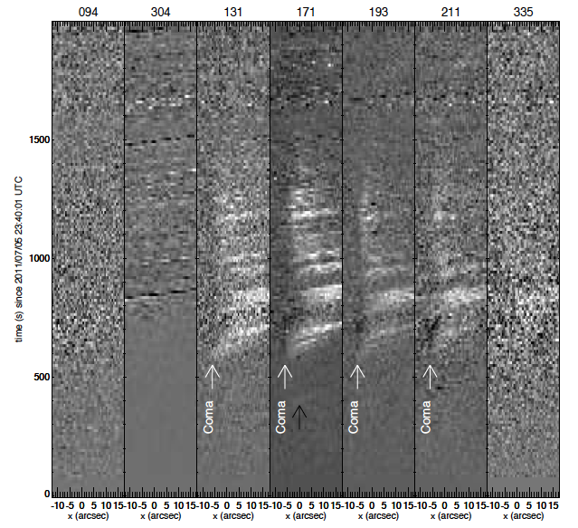

Slide 7
Interesting questions
How do we relate the physics of the comet interaction in the corona to the “artificial comet” experiments (e.g., AMPTE barium releases)? cf. Haerendel et al. 1986
What can we learn from the radio spectrum? For SDO-2, Pascal St.-Hilaire estimates a maximum plasma frequency of ~10 MHz, but… cf. De Pater et al. 1995

Slide 8
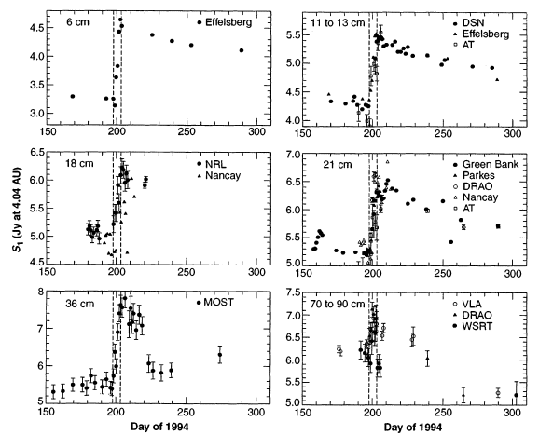
Shoemaker-Levy at Jupiter

Slide 9
Conclusions
Paper on SDO-1 (Schrijver et al.) to appear in Science, January 20, 2012
Another comet is coming December 16 (perihelion 00:07 UT); it may be much brighter

